Slide 1
Analog and digital electronics 21CS33

Slide 2
MODULE-5
Registers and Counters

Slide 3
Books Referred/Source
Charles H Roth and Larry L Kinney, Analog and Digital Electronics, Cengage Learning,2019
Charles H Roth and Larry L Kinney, Fundamental of Logic Design, Cengage Learning, 2017.
Donald P Leach, Albert Paul Malvino & Goutam Saha: Digital Principles and Applications, 7th Edition, Tata McGraw Hill, 2015
Anil K. Maini: Digital Electronics Principles, Devices and Applications, 2007, John Wiley & Sons, Ltd.
Thomas L. Floyd: Digital Fundamentals, 9th Edition., Pearson International Edition.
M. Morris Mano, Michael D. Ciletti : Digital Design With an Introduction to the Verilog HDL, 5th Edition, Pearson Education, Inc.
Ronald J. Tocci, Neal S. Widmer, Gregory L. Moss: Digital systems : principles and applications—10th Edition, Pearson Education International

Slide 4
Objectives
Explain the operation of registers. Show how to transfer data between registers using a tri-state bus.
Explain the operation of shift registers, show how to build them using flip-flops, and analyze their operation. Construct a timing diagram for a shift register.
Explain the operation of binary counters, show how to build them using flip-flops and gates, and analyze their operation.
Given the present state and desired next state of a flip-flop, determine the required flip-flop inputs.
Given the desired counting sequence for a counter.
Construct a timing diagram for a counter by tracing signals through the circuit.
Given a sequential circuit, write the next-state equations for the flip-flops and derive the state graph or state table. Using the state graph, determine the state sequence and output sequence for a given input sequence.
Explain the difference between a Mealy machine and a Moore machine.
Given a state table, construct the corresponding state graph, and conversely.
Analyze a sequential circuit by signal tracing.

Slide 5
Introduction
Each flip-flop can store one bit of information
A register consists of a group of flip-flops with a common clock input.
Registers are commonly used to store and shift binary data.
Counters are another simple type of sequential circuit.
A counter is usually constructed from two or more flip-flops which change states in a prescribed sequence when input pulses are received.

Slide 6
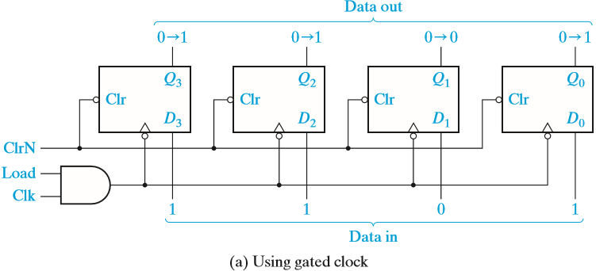
Registers and Register Transfers
4-Bit D Flip-Flop Registers with Data, Load, Clear, and Clock Inputs
When Load = 0, the register is not clocked, and it holds its present value
When Load = 1, the clock signal (Clk) is transmitted to the flip-flop clock inputs and the data applied to the D inputs will be loaded into the flip-flops on the falling edge of the clock.

Slide 7
Registers and Register Transfers
4-Bit D Flip-Flop Registers with Data, Load, Clear, and Clock Inputs
If the Q outputs are 0000 (Q3 = Q2 = Q1 = Q0 = 0) and the data inputs are 1101 (D3 = 1, D2 = 1, D1 = 0 and D0 = 1), after the falling edge of the clock Q will change from 0000 to 1101 as indicated.

Slide 8
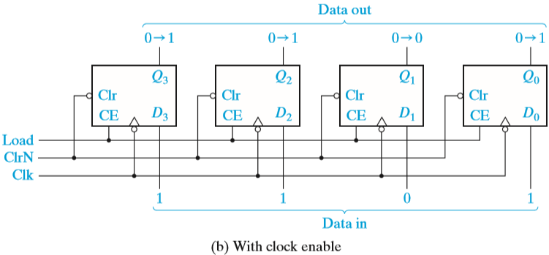
Registers and Register Transfers
If flip-flops with clock enable are available
When Load = 0, the clock is disabled and the register holds its data.
When Load is 1, the clock is enabled, and the data applied to the D inputs will be loaded into the flip-flops, following the falling edge of the clock

Slide 9
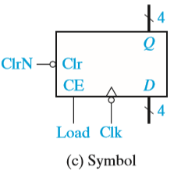
Registers and Register Transfers
A symbol for the 4-bit register using bus notation for the D inputs and Q outputs.

Slide 10
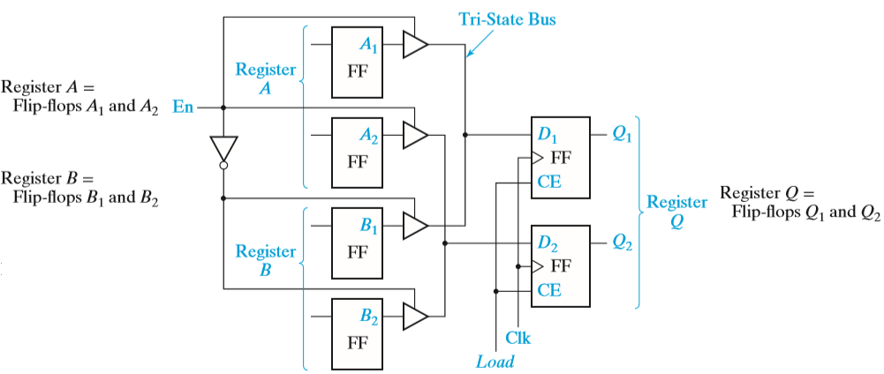
Registers and Register Transfers
Data Transfer Between Registers
Figure shows how data can be transferred from the output of one of two registers into a third register using tri-state buffers.

Slide 11
Registers and Register Transfers
Data Transfer Between Registers
If En = 1 and Load = 1, the output of register A is enabled onto the tri-state bus and the data in register A will be stored in Q after the rising edge of the clock.
If En = 0 and Load = 1, the output of register B will be enabled onto the tri-state bus and stored in Q after the rising edge of the clock.

Slide 12
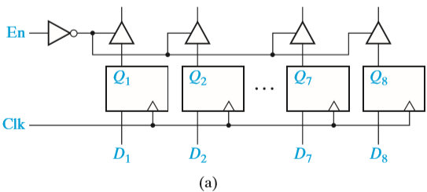
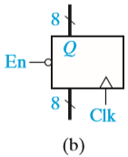
Registers and Register Transfers
Logic Diagram for 8-Bit Register with Tri-State Output
Figure (a) shows an integrated circuit register that contains eight D flip-flops with tri-state buffers at the flip-flop outputs. These buffers are enabled when En = 0.
A symbol for this 8-bit register is shown in Figure (b).

Slide 13
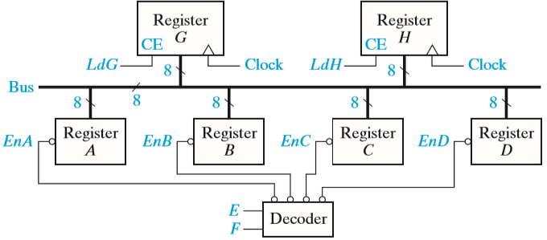
Registers and Register Transfers
Data Transfer Using a Tri-State Bus
Figure shows how data can be transferred from one of four 8-bit registers into one of two other registers.
8 bits of data are transferred in parallel from register A, B, C, or D to register G or H or both.

Slide 14
Registers and Register Transfers
Data Transfer Using a Tri-State Bus
The operation as follows:
If EF = 00, A is stored in G (or H).
If EF = 01, B is stored in G (or H).
If EF = 10, C is stored in G (or H).
If EF = 11, D is stored in G (or H).
If LdG = 1, these signals on the bus are loaded into register G after the rising clock edge or into register H if LdH = 1.

Slide 15
Parallel Adder with Accumulator
In computer circuits, it is frequently desirable to store one number in a register of flip-flops (called an accumulator) and add a second number to it, leaving the result stored in the accumulator.
To build a parallel adder with an accumulator is to add a register to the full adder (FA).

Slide 16
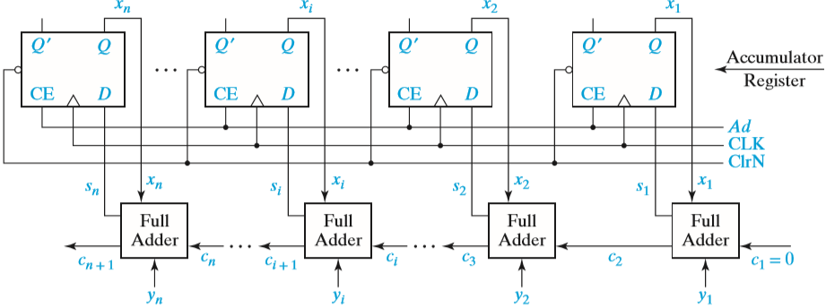
Parallel Adder with Accumulator
n-Bit Parallel Adder with Accumulator
X = xn . . . x2x1 is stored in the accumulator
Y= yn . . . y2 y1 is applied to the full adder inputs,
The sum of X and Y appears at the adder outputs
Add signal (Ad) is used to load the adder outputs into the accumulator flip-flops on the rising clock edge

Slide 17
Parallel Adder with Accumulator
Before addition can take place, the accumulator must be loaded with X.
This can be accomplished in two ways:
Clear the accumulator
Add multiplexers at the accumulator inputs
Clear the accumulator using the asynchronous clear inputs on the flip-flops, and then put the X data on the Y inputs to the adder and add to the accumulator in the normal way.

Slide 18
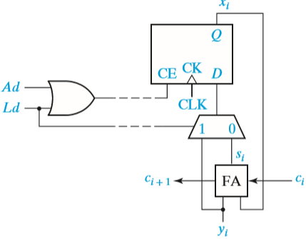
Parallel Adder with Accumulator
Add multiplexers at the accumulator inputs: So that we could select either the Y input data or the adder output to load into the accumulator.

Slide 19
Shift Registers
A shift register is a register in which binary data can be stored, and this data can be shifted to the left or right when a shift signal is applied.
Bits shifted out one end of the register may be lost, or if the shift register is of cyclic type, bits shifted out one end are shifted back in the other end.

Slide 20
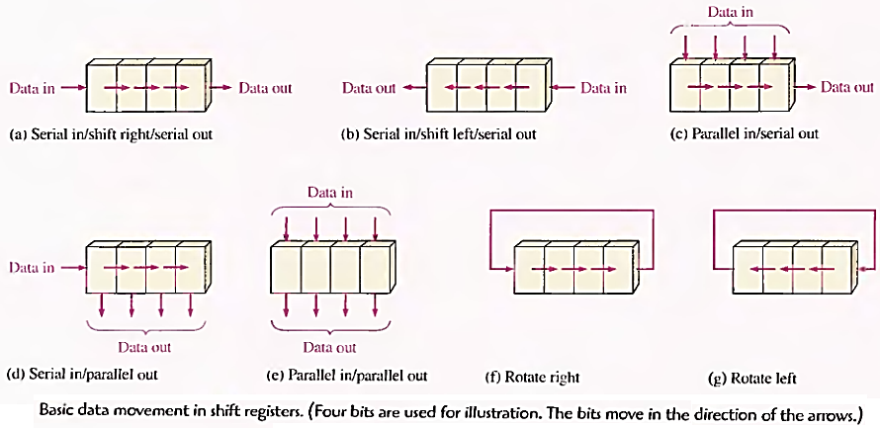
Shift Registers
TYPES OF REGISTERS

Slide 21
Shift Registers
Right-Shift Register
When Shift =1, the clock is enabled and shifting occurs on the rising clock edge.
Shift = 0, no shifting and No changed in flip flop.
The serial input (SI) is loaded into the first flip-flop (Q3) by the rising edge of the clock.
At the same time, the output of the first flip-flop is loaded into the second flip-flop, the output of the second flip-flop is loaded into the third flip-flop, and the output of the third flip-flop is loaded into the last flip-flop

Slide 22
Shift Registers
Right-Shift Register
Shift register initially contains 0101.
The serial input (SI) sequence is 1, 1, 0, 1.
The sequence of shift register states is 0101, 1010, 1101, 0110, 1011.

Slide 23
Shift Registers
Example: Show how a number 0100 is entered serially in a 4-bit shift register using D flip-flop. Also write state table.

Slide 24
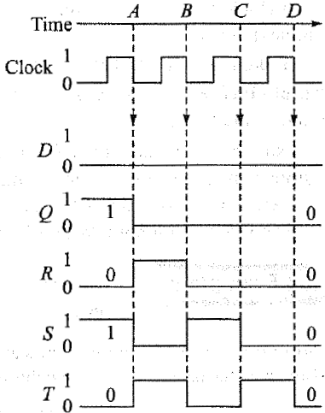
Shift Registers
Example: Suppose that it has the 4-bit number QRST = 1010 stored in it so draw the waveform
Clk | Serial In | Q | R | S | T
0
0
1
0
1
0
A
0
0
1
0
1
B
0
0
0
1
0
C
0
0
0
0
1
D
0
0
0
0

Slide 25
Shift Registers
Cyclic Shift Register
If we connect the serial output to the serial input, as shown by the dashed line, the resulting cyclic shift register performs an end-around shift.
If the initial contents of the register is 0111, after one clock cycle the contents is 1011.
After a second pulse, the state is 1101, then 1110, and the fourth pulse returns the register to the initial 0111 state.

Slide 26
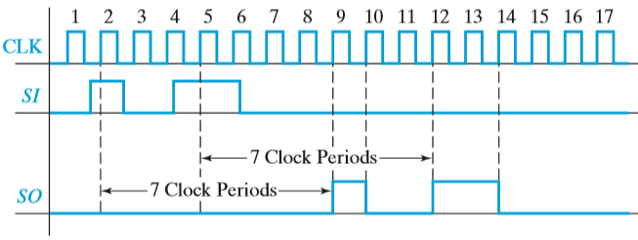
Shift Registers
8-Bit Serial-In, Serial-Out Shift Register

Slide 27
Shift Registers
8-Bit Serial-In, Serial-Out Shift Register
Serial in means that data is shifted into the first flip-flop one bit at a time, and the flip-flops cannot be loaded in parallel.
Serial out means that data can only be read out of the last flip-flop

Slide 28
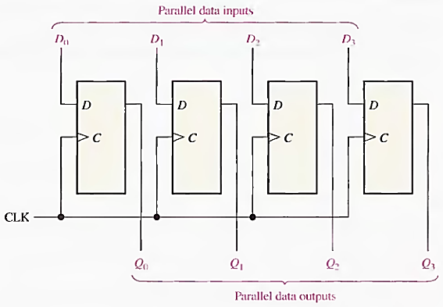
Shift Registers
4-bit parallel-in, parallel-out shift register

Slide 29
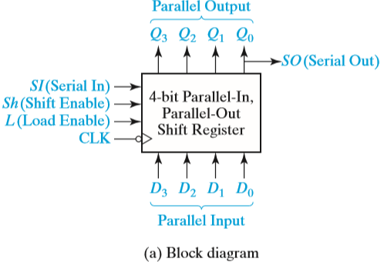
Shift Registers
Shift register implemented using MUXes and D flip-flops (Universal shift register)

Slide 30
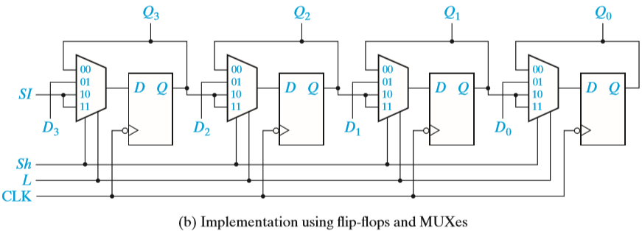
Shift Registers
Shift register implemented using MUXes and D flip-flops

Slide 31
Shift Registers
The next-state equations for the flip-flops are
Q3+ = Sh′ · L′ · Q3 + Sh′ · L · D3 + Sh · SI
Q2+ = Sh′ · L′ · Q2 + Sh′ · L · D2 + Sh · Q3
Q1+ = Sh′ · L′ · Q1 + Sh′ · L · D1 + Sh · Q2
Q0+ = Sh′ · L′ · Q0 + Sh′ · L · D0 + Sh · Q1
Sh | L | Q3+ | Q2+ | Q1+ | Q0+ | Action
0 | 0 | Q3 | Q2 | Q1 | Q0 | No Change
0 | 1 | D3 | D2 | D1 | D0 | Parallel Data loaded from D3,D2,D1,D0
1 | 0 | SI | Q3 | Q2 | Q1 | Serial input from SI
1 | 1 | SI | Q3 | Q2 | Q1

Slide 32
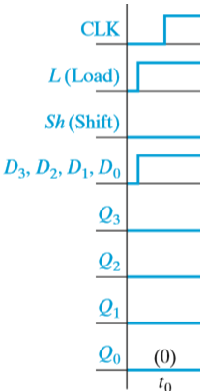
Shift Registers
Timing Diagram for Shift Register
Assuming that the register is initially clear (Q3Q2Q1Q0 = 0000), that the serial input is SI = 0 throughout, and that the data inputs D3D2D1D0 are 1011 during the load time (t0).
Shifting occurs at the end of t1, t2, and t3, and the serial output can be read during these clock times

Slide 33
Shift Registers
Timing Diagram for Shift Register
The first clock pulse loads data into the shift register in parallel.
During the next four clock pulses, this data is available at the serial output. Assuming that the register is initially clear (Q3Q2Q1Q0 = 0000), that the serial input is SI = 0 throughout, and that the data inputs D3D2D1D0 are 1011 during the load time (t0), the resulting waveforms are as shown.
Shifting occurs at the end of t1, t2, and t3, and the serial output can be read during these clock times.
During t4, Sh = L = 0, so no state change occurs.

Slide 34
Shift Registers
A circuit that cycles through a fixed sequence of states is called a Counter.
A shift register with non inverted feedback is called a Ring Counter or Cyclic Shift Register.
A shift register with inverted feedback is called a Johnson Counter or a twisted ring counter.

Slide 35
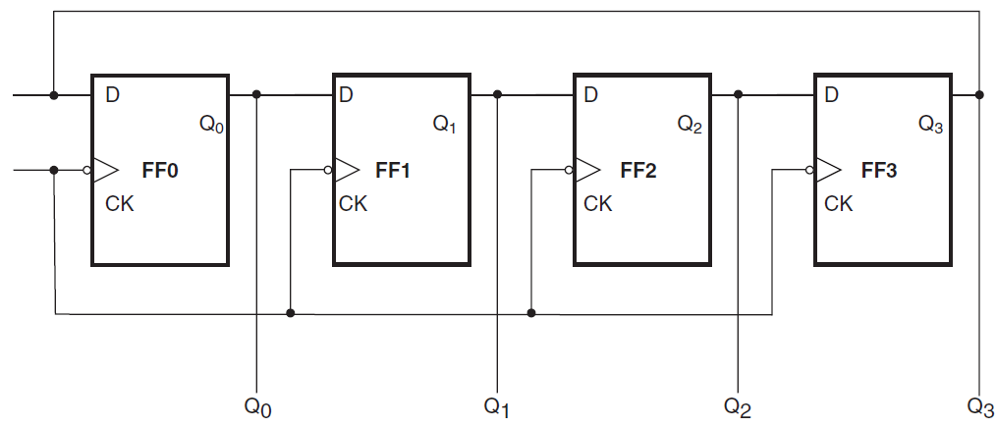
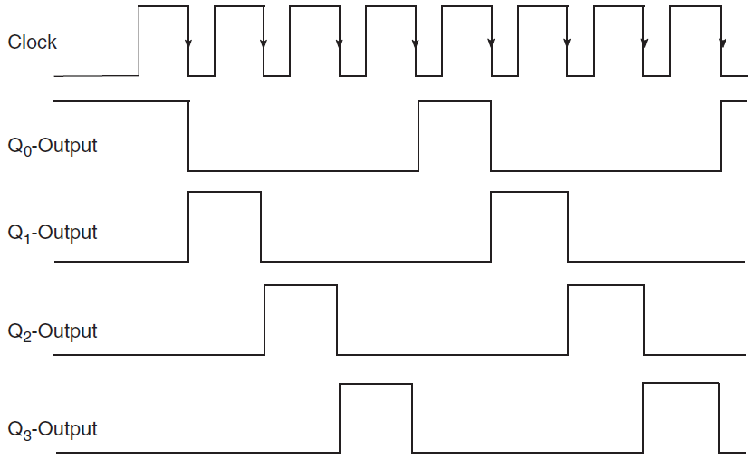
Shift Registers
Clock Pulse | Q0 | Q1 | Q2 | Q3
0 | 1 | 0 | 0 | 0
1 | 0 | 1 | 0 | 0
2 | 0 | 0 | 1 | 0
3 | 0 | 0 | 0 | 1
4 | 1 | 0 | 0 | 0
5 | 0 | 1 | 0 | 0
6 | 0 | 0 | 1 | 0
7 | 0 | 0 | 0 | 1
Ring Counter.

Slide 36
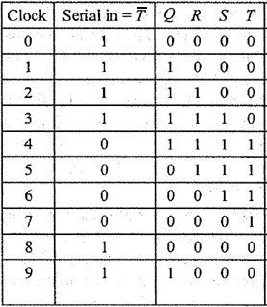
Shift Registers
Johnson Counter

Slide 37
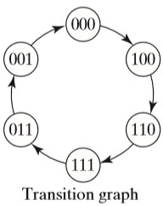
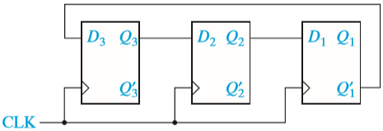
Shift Registers
Johnson counter (Shift Register with Inverted Feedback)
A 3-bit shift register with the Q1 ′ output from the last fl ip-flop fed back into the D input of the first flip-flop.
If the initial state of the register is 000, the initial value of D3 is 1, so after the first clock pulse, the register state is 100.

Slide 38
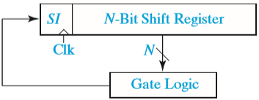
Shift Registers
General Shift Register Counter
Figure shows the general form of a shift register counter where the bit being shifted into the leftmost stage can be a general function of the shift register contents.
If the gate logic only contains exclusive-OR gates, the counter is called a linear (feedback) shift register counter.
For each integer n, there exists a linear n-bit shift register counter that generates a count cycle of length 2n − 1; all states are included except for the all 0’s state.
Linear shift register counters have many applications, including as random number generators and as encoders and decoders for linear error-correcting codes.

Slide 39
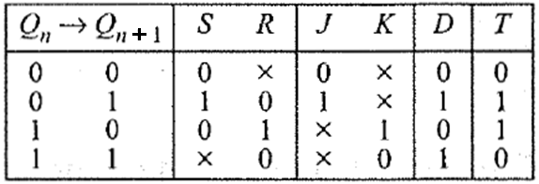
Design of Binary Counters
Flip-Flop Excitation Table:
Excitation table of a flip-flop is looking at its truth table in a reverse way.
Here, flip-flop input is presented as a dependent function of transition Qn→Qn+ 1 and comes later in the table.
This is derived from flip-flop truth table or characteristic equation and directly from its state transition diagram.

Slide 40
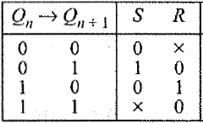
Design of Binary Counters
Excitation table for SR Flip-Flop
One can see if present state is 0 application of SR = 0x does not alter its value where 'x' denotes don't care condition in R input.
State 0 to 1 transition occurs when SR = 10 is present at the input side
While state 1 to 0 transition occurs if SR = 01.
Present state l is maintained if SR = 0, i.e. SR = 00 or SR = 01.

Slide 41
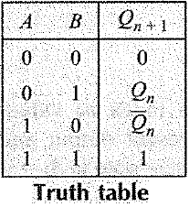
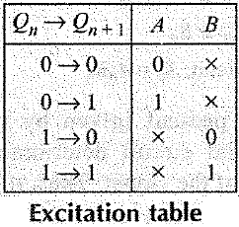
Design of Binary Counters
Example:
A fictitious flip-flop with two inputs A and B functions like this. For AB= 00 and 11 the output becomes 0 and 1 respectively. For AB= 01, flip-flop retains previous output while output complements for AB= 10. Draw the truth table , excitation table and state transition diagrams of this flip-flop.

Slide 42
Design of Binary Counters
DESIGN OF SYNCHRONOUS COUNTERS
At any given time the memory is in a state called the present state and will advance to a next state on a clock pulse a determined by conditions on the excitation lines.
Steps used in the design of the counter follows. In general, these steps can be applied to any sequential circuit:
Specify the counter sequence and draw a state diagram.
Derive a next-state table from the state diagram.
Develop a State (synthesis) Table or transition table showing the flip-flop inputs required for each transition. The transition table is always the same for a given type of flip-flop (Here will take JK flip-flop).
Transfer the J and K states from the transition table to Karnaugh maps. There is a Karnaugh map for each input of each flip-flop.
Group the Karnaugh map cells to generate and derive the logic expression for each flip-flop input.
Implement the expressions with combinational logic and combine with the flip- flops to create the counter.
We follow the step with help of example as Mod-6 (Lab Experiment)

Slide 43
Design of Binary Counters
Design a 3-bit or Mod-8 synchronous binary Up counter.
(a) Use T flip-flops.
(b) Use D flip-flops.

Slide 44
Design of Binary Counters
000
State Diagram
111
001
110
010
101
011
100

Slide 45
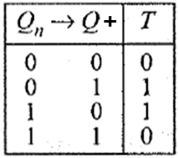
Design of Binary Counters
State (synthesis) Table or transition table

Slide 46
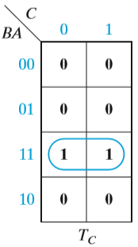
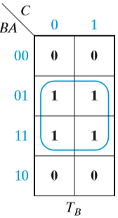
Design of Binary Counters
Karnaugh Maps
T_{C} = BA
T_{B} = A.
T_{A} = 1

Slide 47
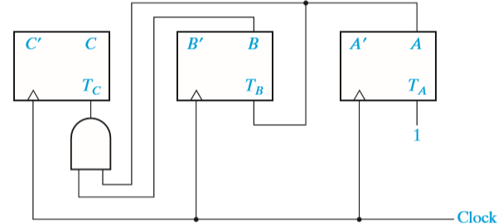
Design of Binary Counters
Counter Implementation (Circuit Diagram)

Slide 48
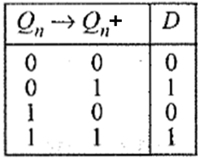
Design of Binary Counters
Now using D- Flip Flip
State (synthesis) Table or transition table
Flip Flop Input
D_{C} | D_{B} | D_{A}
0 | 0 | 1
0 | 1 | 0
0 | 1 | 1
1 | 0 | 0
1 | 0 | 1
1 | 1 | 0
1 | 1 | 1
0 | 0 | 0

Slide 49
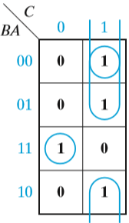
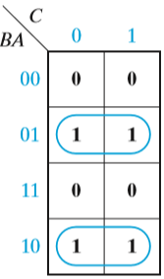
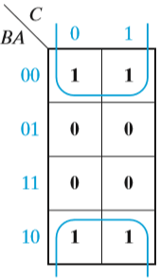
Design of Binary Counters
Karnaugh Maps
DC = C+ = C′BA + CB′ + CA′
= C′BA + C(BA)′
= C ⊕ BA
DB = B+ = BA′ + B′A
= B ⊕ A
DA = A+ = A′

Slide 50
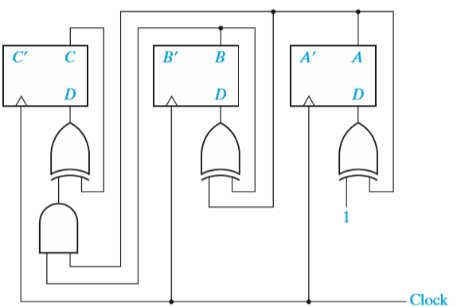
Design of Binary Counters
Counter Implementation (Circuit Diagram)

Slide 51
Design of Binary Counters
The basic principle for constructing a synchronous counter can be stated as follows:
For UP Counter
Each FF should have inputs are High only when the outputs of all lower-order FFs are in the High state.

Slide 52
Design of Binary Counters
Design a 3-bit or Mod-8 synchronous binary Down counter.
(a) Use T flip-flops.
(b) Use D flip-flops.

Slide 53
Design of Binary Counters
000
State Diagram
001
111
010
110
011
101
100

Slide 54
Design of Binary Counters
State (synthesis) Table or transition table
Present State |  |  | Next State |  |  | Flip Flop Input
C | B | A | C+ | B+ | A+ | T_{C} | T_{B} | T_{A}
0 | 0 | 0 | 1 | 1 | 1 | 1 | 1 | 1
0 | 0 | 1 | 0 | 0 | 0 | 0 | 0 | 1
0 | 1 | 0 | 0 | 0 | 1 | 0 | 1 | 1
0 | 1 | 1 | 0 | 1 | 0 | 0 | 0 | 1
1 | 0 | 0 | 0 | 1 | 1 | 1 | 1 | 1
1 | 0 | 1 | 1 | 0 | 0 | 0 | 0 | 1
1 | 1 | 0 | 1 | 0 | 1 | 0 | 1 | 1
1 | 1 | 1 | 1 | 1 | 0 | 0 | 0 | 1

Slide 55
Design of Binary Counters
K-Map
A CB | 0 | 1
00 | 1 | 0
01 | 0 | 0
11 | 0 | 0
10 | 1 | 0
A CB | 0 | 1
00 | 1 | 0
01 | 1 | 0
11 | 1 | 0
10 | 1 | 0
T_{C}=A’B’
T_{B}=A’
T_{A}=1

Slide 56
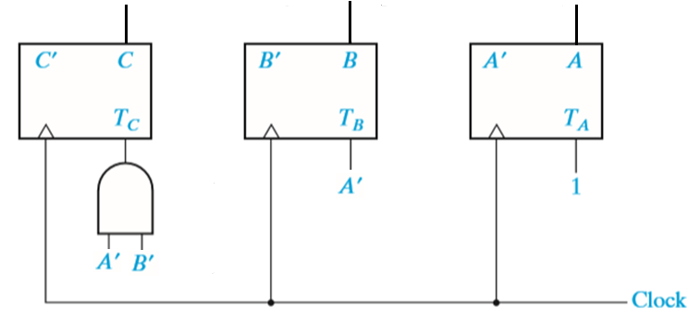
Design of Binary Counters
Circuit Diagram

Slide 57
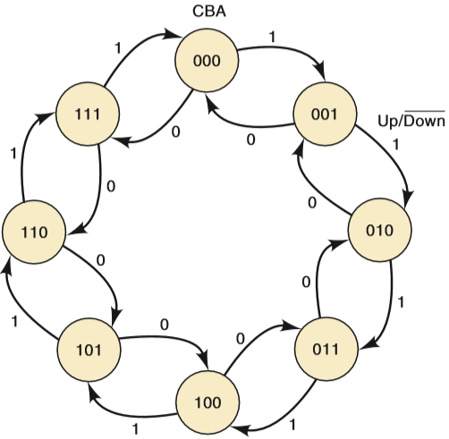
Design of Binary Counters
3-bit Binary Up-Down Counter
State Diagram/ State Transition Diagram

Slide 58
Design of Binary Counters
State (synthesis) Table or transition table
U/D’ | Present State |  |  | Next State |  |  | Flip Flop Input
M | C | A | B | C+ | B+ | A+ | D_{C} | D_{B} | D_{A}
0 | 0 | 0 | 0 | 1 | 1 | 1 | 1 | 1 | 1
0 | 0 | 0 | 1 | 0 | 0 | 0 | 0 | 0 | 0
0 | 0 | 1 | 0 | 0 | 0 | 1 | 0 | 0 | 1
0 | 0 | 1 | 1 | 0 | 1 | 0 | 0 | 1 | 0
0 | 1 | 0 | 0 | 0 | 1 | 1 | 0 | 1 | 1
0 | 1 | 0 | 1 | 1 | 0 | 0 | 1 | 0 | 0
0 | 1 | 1 | 0 | 1 | 0 | 1 | 1 | 0 | 1
0 | 1 | 1 | 1 | 1 | 1 | 0 | 1 | 1 | 0
1 | 0 | 0 | 0 | 0 | 0 | 1 | 0 | 0 | 1
1 | 0 | 0 | 1 | 0 | 1 | 0 | 0 | 1 | 0
1 | 0 | 1 | 0 | 0 | 1 | 1 | 0 | 1 | 1
1 | 0 | 1 | 1 | 1 | 0 | 0 | 1 | 0 | 0
1 | 1 | 0 | 0 | 1 | 0 | 1 | 1 | 0 | 1
1 | 1 | 0 | 1 | 1 | 1 | 0 | 1 | 1 | 0
1 | 1 | 1 | 0 | 1 | 1 | 1 | 1 | 1 | 1
1 | 1 | 1 | 1 | 0 | 0 | 0 | 0 | 0 | 0

Slide 59
Design of Binary Counters
K-Map
BA MC | 00 | 01 | 11 | 10
00 | 1 | 0 | 0 | 0
01 | 0 | 1 | 1 | 1
11 | 1 | 1 | 0 | 1
10 | 0 | 0 | 1 | 0
BA MC | 00 | 01 | 11 | 10
00 | 1 | 0 | 1 | 0
01 | 1 | 0 | 1 | 0
11 | 0 | 1 | 0 | 1
10 | 0 | 1 | 0 | 1
BA MC | 00 | 01 | 11 | 10
00 | 1 | 0 | 0 | 1
01 | 1 | 0 | 0 | 1
11 | 1 | 0 | 0 | 1
10 | 1 | 0 | 0 | 1
D_{C}=C ⨁ (MAB+M’A’B’)
D_{B}= B ⊕ (MA + M’A′)
D_{A}= A’

Slide 60
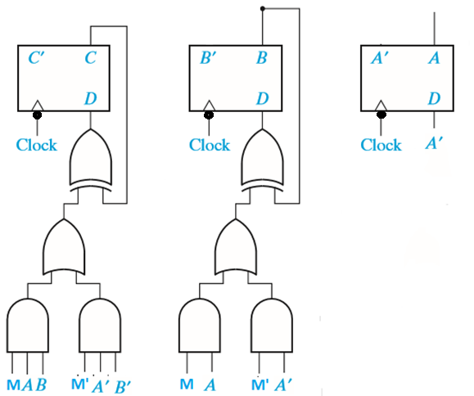
Design of Binary Counters
Circuit Diagram

Slide 61
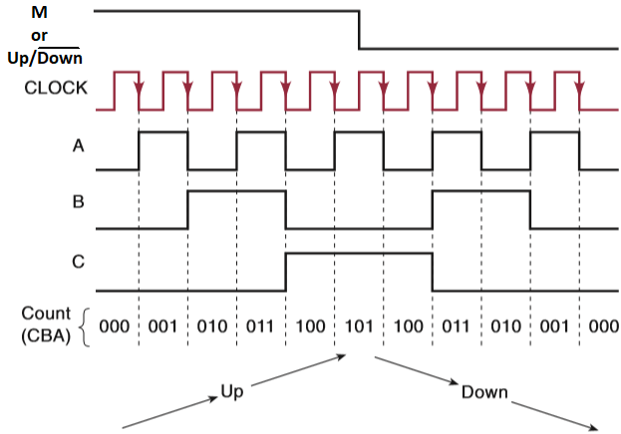
Design of Binary Counters
Timing Diagram

Slide 62
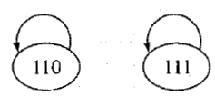
Counters for Other Sequences
An irregular counter is the one which does not follow any regular binary sequence but has N number of distinct states and thus qualifies as a modulo-N counter.

Slide 63
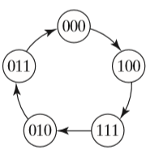
Counters for Other Sequences
Design the synchronous counter for following sequence using T Flip Flop
Transition Graph for Counter

Slide 64
Counters for Other Sequences
Transition Table
Present Output |  |  | Next Output |  |  | Flip Flop Inputs
C | B | A | C+ | B+ | A+ | T_{C} | T_{B} | T_{A}
0 | 0 | 0 | 1 | 0 | 0 | 1 | 0 | 0
0 | 0 | 1 | X | X | X | X | X | X
0 | 1 | 0 | 0 | 1 | 1 | 0 | 0 | 1
0 | 1 | 1 | 0 | 0 | 0 | 0 | 1 | 1
1 | 0 | 0 | 1 | 1 | 1 | 0 | 1 | 1
1 | 0 | 1 | X | X | X | X | X | X
1 | 1 | 0 | X | X | X | X | X | X
1 | 1 | 1 | 0 | 1 | 0 | 1 | 0 | 1

Slide 65
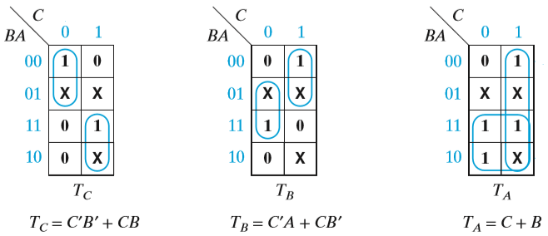
Counters for Other Sequences
K- Map

Slide 66
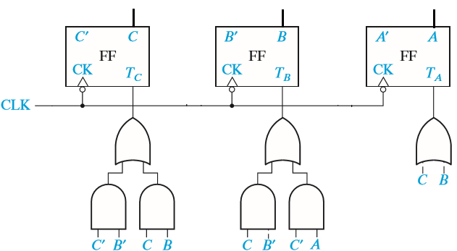
Counters for Other Sequences
Circuit Diagram

Slide 67
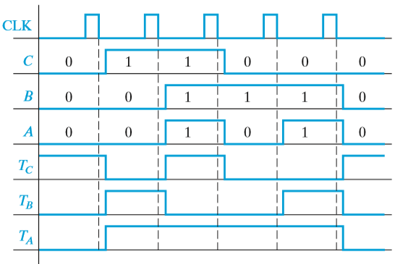
Counters for Other Sequences
Timing Diagram

Slide 68
Counter Design Using S-R and J-K Flip-Flops
Design the synchronous counter for following sequence using SR Flip Flop
Transition Graph for Counter

Slide 69
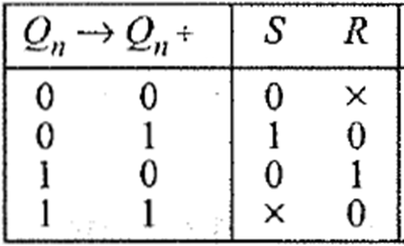
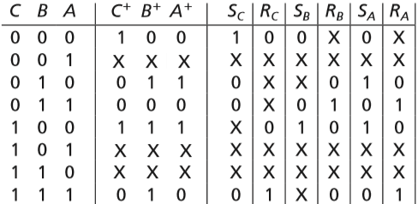
Counter Design Using S-R and J-K Flip-Flops
Transition Table

Slide 70
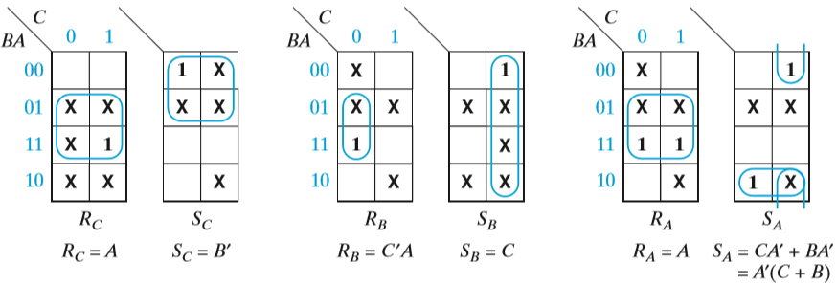
Counter Design Using S-R and J-K Flip-Flops
K-Map

Slide 71
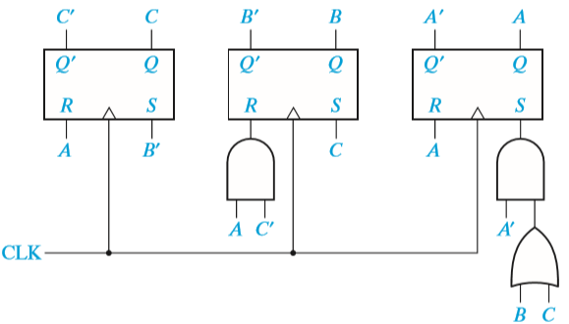
Counter Design Using S-R and J-K Flip-Flops
Circuit Diagram

Slide 72
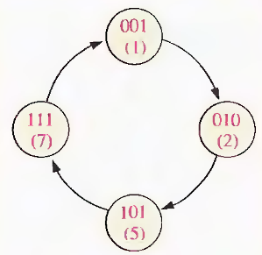
Counter Design Using S-R and J-K Flip-Flops
Design a counter with the irregular binary count sequence shown in the state diagram below. Use J-K flip-flops.

Slide 73
Counter Design Using S-R and J-K Flip-Flops
State Table
Output |  | Input
Qn | Q_{n+1} | J | K
0 | 0 | 0 | X
0 | 1 | 1 | X
1 | 0 | X | 1
1 | 1 | X | 0
Present State |  |  | Next State |  |  | Inputs
Q₂ | Q₁ | Q₀ | Q₂₊₁ | Q₁₊₁ | Q₀₊₁ | J₂ | K₂ | J₁ | K₁ | J₀ | K₀
0 | 0 | 1 | 0 | 1 | 0 | 0 | X | 1 | X | X | 1
0 | 1 | 0 | 1 | 0 | 1 | 1 | X | X | 1 | 1 | X
1 | 0 | 1 | 1 | 1 | 1 | X | 0 | 1 | X | X | 0
1 | 1 | 1 | 0 | 0 | 1 | X | 1 | X | 1 | X | 0

Slide 74
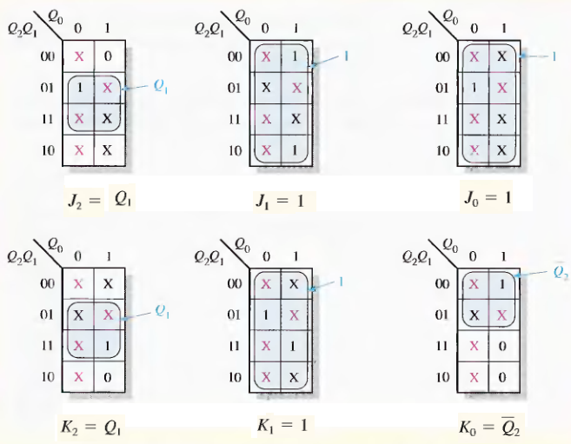
Counter Design Using S-R and J-K Flip-Flops
K-Map Simplification

Slide 75
Counter Design Using S-R and J-K Flip-Flops
Circuit Diagram

Slide 76
Counter Design Using S-R and J-K Flip-Flops
What happens if the circuit for any reason goes to one of the unused state? Does it come back to any of the valid counting state or in the worst case gets locked as shown in below Fig.?
For Mod-6, initializing the designed circuit with 110 or 111 unused state we find that they get back to counting sequence as shown in below Fig.
Lock-out condition : Lock-out of a counter occurs when the counter remains locked into unused states and does not function properly.
However, a designer may not leave unused states to chances and want them to follow certain course if the circuit accidentally enters into one of them .
This can be achieved by Self-Correcting or Self-Starting as the circuit comes out on its own from an invalid state to a valid counting state sequence.

Slide 77
Counter Design Using S-R and J-K Flip-Flops
Design a self-correcting modulo-6 counter, in which all the unused state leads to state CBA = 000.
Step-1

Slide 78
Counter Design Using S-R and J-K Flip-Flops
Step-2 & 3
Present State |  |  | Next State |  |  | Inputs
C_{n} | B_{n} | A_{n} | C_{n+1} | B_{n+1} | A_{n+1} | J_{C} | K_{C} | J_{B} | K_{B} | J_{A} | K_{A}
0 | 0 | 0 | 0 | 0 | 1 | 0 | X | 0 | X | 1 | X
0 | 0 | 1 | 0 | 1 | 0 | 0 | X | 1 | X | X | 1
0 | 1 | 0 | 0 | 1 | 1 | 0 | X | X | 0 | 1 | X
0 | 1 | 1 | 1 | 0 | 0 | 1 | X | X | 1 | X | 1
1 | 0 | 0 | 1 | 0 | 1 | X | 0 | 0 | X | 1 | X
1 | 0 | 1 | 0 | 0 | 0 | X | 1 | 0 | X | X | 1
1 | 1 | 0 | 0 | 0 | 0 | X | 1 | X | 1 | 0 | X
1 | 1 | 1 | 0 | 0 | 0 | X | 1 | X | 1 | X | 1

Slide 79
Counter Design Using S-R and J-K Flip-Flops
Step-4 & 5

Slide 80
Counter Design Using S-R and J-K Flip-Flops
Step-6

Slide 81
Counter Design Using S-R and J-K Flip-Flops
Design a modulo-4 irregular counter with following counting sequence using D flip-flop.

Slide 82
Counter Design Using S-R and J-K Flip-Flops
Show how a modulo-4 counter designed with two flip-flops can generate a repetitive sequence of binary word '1101' with minimum number of memory elements?
The corresponding output is 1→1 → 0 → l. As shown in Figure the sequence '1101' will be generated repetitively by Y. Kamaugh Map representation of Y and will get Y=A+B'.

Slide 83
Counter Design Using SR and JK Flip Flops
Lab Experiment
IC 7476
CLK1
1
16
K1
PRE1
2
J1
Q1
15
Q1
I
C
7
4
7
6
CLR1
3
14
$\overline{Q}$1
J1
4
K1
$\overline{Q}$1
13
GND
VCC
5
12
K2
CLK2
6
J2
Q2
11
Q2
PRE2
7
10
$\overline{Q}$2
CLR2
8
K2
$$\overline{Q}2$$
9
J2

Slide 84
Counter Design Using S-R and J-K Flip-Flops
Step 1: State Diagram
A state diagram shows the progression of states through which the counter advances when it is clocked.
Mod-6

Slide 85
Counter Design Using S-R and J-K Flip-Flops
Step 2: Next-State Table
Derive a next- state table, which lists each state of the counter (present state) along with the corresponding next state.
The next state is the state that the counter goes to from its present state upon application of a clock pulse. The next-state table is derived from the state diagram.
Present State |  |  | Next State
C_{n} | B_{n} | A_{n} | C_{n+1} | B_{n+1} | A_{n+1}
0 | 0 | 0 | 0 | 0 | 1
0 | 0 | 1 | 0 | 1 | 0
0 | 1 | 0 | 0 | 1 | 1
0 | 1 | 1 | 1 | 0 | 0
1 | 0 | 0 | 1 | 0 | 1
1 | 0 | 1 | 0 | 0 | 0

Slide 86
Counter Design Using S-R and J-K Flip-Flops
Step 3: State (synthesis) Table
State table written from Excitation table of the flip-flop.
Excitation table gives inputs need to be present when clock triggers a certain Qn→Qn+ 1 transition of the flip-flop.
State table shows the present state, next state and input state of the each flip-flop.
Combine the Step 2 and 3
Output |  | Input
Qn | Qn+1 | J | K
0 | 0 | 0 | X
0 | 1 | 1 | X
1 | 0 | X | 1
1 | 1 | X | 0
Present State |  |  | Next State |  |  | Inputs
C_{n} | B_{n} | A_{n} | C_{n+1} | B_{n+1} | A_{n+1} | J_{C} | K_{C} | J_{B} | K_{B} | J_{A} | K_{A}
0 | 0 | 0 | 0 | 0 | 1 | 0 | X | 0 | X | 1 | X
0 | 0 | 1 | 0 | 1 | 0 | 0 | X | 1 | X | X | 1
0 | 1 | 0 | 0 | 1 | 1 | 0 | X | X | 0 | 1 | X
0 | 1 | 1 | 1 | 0 | 0 | 1 | X | X | 1 | X | 1
1 | 0 | 0 | 1 | 0 | 1 | X | 0 | 0 | X | 1 | X
1 | 0 | 1 | 0 | 0 | 0 | X | 1 | 0 | X | X | 1

Slide 87
Counter Design Using S-R and J-K Flip-Flops
Step 4&5: Karnaugh Maps
Karnaugh maps can be used to determine the logic required for the J and K inputs of each flip-flop in the counter. There is a Karnaugh map for the J input and a Karnaugh map for the K input of each flip-flop. In this design procedure, each cell in a Karnaugh map represents one of the present states in the counter sequence.

Slide 88
Counter Design Using S-R and J-K Flip-Flops
Step 6: Counter Implementation (Circuit Diagram)
From the Karnaugh maps obtained the expressions for the J and K inputs of each flip-flop.
The final step is to implement the combinational logic from the expressions for the J and K inputs and connect the flip-flops to form the complete Mod-6 counter.

Slide 89
Difference between Asynchronous and Synchronous Counter
Asynchronous Counter
Synchronous Counter
Different flip flops are triggered with different clock, not simultaneously.
Slower than synchronous counter in operation.
Produces decoding error.
Also called Parallel Counter.
Designing as well as implementation is very easy.
Will operate only in fixed count sequence (UP/DOWN).
Examples are: Ripple UP counter, Ripple DOWN counter.
All flip flops are triggered with same clock simultaneously.
Faster than asynchronous counter in operation.
Does not produce any decoding errors.
Also called Serial Counter.
Designing as well implementation are complex due to increasing the number of states.
Will operate in any desired count sequence.
Examples are: Ring counter, Johnson counter.

Slide 90
PROBLEM SOLVING WITH MULTIPLE METHODS
Design a self correcting modulo-3 down counter.
We need 2 flip-flop, say B and A for this purpose which has 4 states. Let the down counter count like 10→01→00→10 and undesired state 11 corrects itself to 10. The excitation table shown below is used for the design purpose.
State table for the self correcting modulo 3 down counter and required inputs using
Design with SR flip-flops
Design with JK flip-flops
Design with D flip-flops
Design with T flip-flops

Slide 91
PROBLEM SOLVING WITH MULTIPLE METHODS

Slide 92
Difference between Combinational and Sequential Circuits
Combinational Circuits
Sequential Circuits

Slide 93
Difference between Combinational and Sequential Circuits
Combinational Circuits
Sequential Circuits
In this, output depends only upon present input.
Speed is fast.
It is designed easy.
There is no feedback between input and output.
This is time independent.
Elementary building blocks: Logic gates
Used for arithmetic as well as boolean operations.
Combinational circuits don’t have capability to store any state.
As combinational circuits don’t have clock, they don’t require triggering.
These circuits do not have any memory element.
It is easy to use and handle.
Examples – Encoder, Decoder, Multiplexer, Demultiplexer
In this output depends upon present as well as past input.
Speed is slow.
It is designed tough as compared to combinational circuits.
There exists a feedback path between input and output.
This is time dependent.
Elementary building blocks: Flip-flops
Mainly used for storing data.
Sequential circuits have capability to store any state or to retain earlier state.
As sequential circuits are clock dependent they need triggering.
These circuits have memory element.
It is not easy to use and handle.
Examples – Flip-flops, Counters

Slide 94
State Tables and Graphs
Design problem normally starts with a word description of input-output relation and ends with a circuit diagram having sequential and combinatorial logic elements.
The word description is first converted to a state transition diagram or Algorithmic State Machine (ASM) chart followed by preparation of state synthesis table.
For flip-flop based implementation,
Excitation tables are used to generate design equations through Karnaugh Map.
The final circuit diagram is developed from these design equations.
There are two different approaches of state machine design called Moore model and Mealy model.

Slide 95
State Tables and Graphs
Model Selection
There are two distinct models by which a synchronous sequential logic circuit can be designed.
In Moore model the output depends only on present state and not on input.
In Mealy model the output is derived from present state as well as input.

Slide 96
State Tables and Graphs
Moore model
Mealy model

Slide 97
State Tables and Graphs
Moore model
Mealy model
Output depends only upon present state/input.
If input changes, output does not change.
More number of states are required.
There is more hardware requirement.
They react slower to inputs (One clock cycle later)
Synchronous output and state generation.
Output is placed on states.
Easy to design.
Output depends on present state as well as present input.
If input changes, output also changes.
Less number of states are required.
There is less hardware requirement.
They react faster to inputs.
Asynchronous output generation.
Output is placed on transitions.
It is difficult to design.

Slide 98
State Tables and Graphs
Design with help of the Problem
Design a sequence detector that receives binary data stream at its input ‘X’ and signals when a combination ‘011' arrives at the input by making its output ‘Y’ high which otherwise remains low. Consider, data is coming from left, i.e. the first bit to be identified is 1, second 1 and third 0 from the input sequence.
First start with Moore Model

Slide 99
State Tables and Graphs Moore Model
The first step in a sequential logic synthesis problem is to convert this word description to State transition diagram or Algorithm State Machine (ASM) Chart.
State Definitions: Moore Model
The output is generated only from the state variables
Let the detector circuit be at state a when initialized.
State ‘a’ can also be considered as one where none of the bit in input sequence is properly detected or the starting point of detection.
Then if 1st bit is detected properly the circuit should be at ‘a’ different state say, ‘b’. Similarly, we need two more states say, ‘c’ and ‘d’ to represent detection of 2nd and 3rd bit in proper order.
When the detector circuit is at state ‘d’, output ‘Y’ is asserted and kept high as long as circuit remains in stated signaling sequence detection. For other states detector output, Y=0.

Slide 100
State Tables and Graphs Moore Model
State transition diagram of sequence detector: Moore model
In Moore model each state and output is defined within a circle in state transition diagram in the format s/Y where s represents a symbol or memory values identified with a state and Y represents the output of the circuit.
An arrow sign marks state transition following an input value 0 or 1 that is written along the path. Note that X represents the binary data input from which sequence '011' is to be detected.

Slide 101
State Tables and Graphs Moore Model
State transition diagram of sequence detector: Moore model
The circuit is initialized with state a.
At state a
If input data X = 1, the first bit of the sequence to be detected is considered detected and the circuit goes to state b.
If X = 0 then it remains at state a to check next bit that arrives.
At state b,
X = 1, then first two bit of the pattern is considered detected and it moves to state c.
If X = 0 (i.e input sequence is '01 ') then detection has to start afresh as we need all three bits of' 011' to match. Thus, the detector goes back to initial state a.
At state c,
X= 0 then input bit stream is '011' and the circuit goes to state d and signals detection of pattern at state d.
If X = l, the detector is in a situation where it has received '111' in order. It stays at c so that if next arriving bit, X = 0 it should signal sequence detection.
At state d
if X =1 the circuit continues sequence detection job, and it goes to state b. That ensures detection of '011' second time in input '011011 .
If X = 0 the circuit goes to initial state a signifying not a single bit has been detected properly subsequent to previous detection.

Slide 102
State Tables and Graphs Moore Model
State Synthesis Table (Transition and State Tables ) or circuit excitation table or simply state table
Note that for m number of memory elements have up to 2^{m} number of different states in a circuit.
State Assignment
Both Moore and Mealy models require minimum two flip-flops (say A and B) to define their states (4 for Moore and 3 for Mealy).
Let the state assignment be as follows.
a: B=0, A=0 b:B=0, A=l c:B=l, A=0 d:B=1, A=l

Slide 103
State Tables and Graphs Moore Model
State Synthesis Table (Transition and State Tables ) or circuit excitation table or simply state table
State Synthesis Table
The next design step is to decide what kind of memory elements are to be used for our design. Flip-flops commonly used for this purpose.
Each flip-flop has a characteristic equation and excitation table.
In synthesis problem we have to find out how flop inputs are to be connected and how final output is generated from flip-flop output.
Normally prefer JK flip-flop it has maximum number of don't care states in its excitation table and that leads to simpler design equation.

Slide 104
State Tables and Graphs Moore Model
State Synthesis Table (Transition and State Tables ) or circuit excitation table or simply state table

Slide 105
State Tables and Graphs Moore Model
Design Equations And Circuit Diagram
K-Map

Slide 106
State Tables and Graphs Moore Model
Design Equations And Circuit Diagram
Circuit Diagram

Slide 107
State Tables and Graphs Mealy Model
State Definitions: Mealy Model
The output can be derived using state as well as input we need three different states for 3-bit sequence detector circuit following Mealy model.
The three states say, a, b, c represents none, 1st bit and 2nd bit detection. When the circuit is at state c if the input is as per the pattern the output is generated in state c itself with proper logic combination of input.

Slide 108
State Tables and Graphs Mealy Model
State Transition Diagram: Mealy Model
The output is written by the side of input along arrow path in the format X/Y, where X and Y represent input and output respectively.

Slide 109
State Tables and Graphs Mealy Model
State Transition Diagram: Mealy Model
At state a.
If it receives input X = 0, and Y= 0 it stays at a else goes to state b that signifies first bit is detected properly. (Y = 0 signifying no detection.)
At state b,
If X = 0, Y= 0 the circuit returns to initial state a, i.e. no bit in given order is detected
If X = 1, goes to state c, signifying two bits in order are detected. In both the cases Y = 0.
At state c
X= 0 then all the three bits of the pattern are received properly and sequence detection can be signaled through Y = l. Also the circuit goes to initial state a and prepares for a new set of detection.
If X = 1 then the sequence received is '111 '.
X= 0 in next clock can make the detection' 110' possible.
So, at state c if X = 1 it is considered as two bits, '11' have been detected properly and the circuit remains at state c.
The output at that time is Y = 0 since sequence is not fully detected.

Slide 110
State Tables and Graphs Mealy Model
State Synthesis Table
State Assignment
a: B = 0, A = l , b: B = 0, A = 0 and proceed with the design

Slide 111
State Tables and Graphs Mealy Model
Design Equations And Circuit Diagram
K-Map

Slide 112
State Tables and Graphs Mealy Model
Design Equations And Circuit Diagram
Circuit Diagram

