Slide 1
Analog and digital electronics 21CS33

Slide 2
Module-4
Introduction to VHDL, Latches and Flip-Flops

Slide 3
Books Referred/Source
Charles H Roth and Larry L Kinney, Analog and Digital Electronics, Cengage Learning,2019
Charles H Roth and Larry L Kinney, Fundamental of Logic Design, Cengage Learning, 2017.
Donald P Leach, Albert Paul Malvino & Goutam Saha: Digital Principles and Applications, 7th Edition, Tata McGraw Hill, 2015
Anil K. Maini: Digital Electronics Principles, Devices and Applications, 2007, John Wiley & Sons, Ltd.
Thomas L. Floyd: Digital Fundamentals, 9th Edition., Pearson International Edition.
M. Morris Mano, Michael D. Ciletti : Digital Design With an Introduction to the Verilog HDL, 5th Edition, Pearson Education, Inc.
Ronald J. Tocci, Neal S. Widmer, Gregory L. Moss: Digital systems : principles and applications—10th Edition, Pearson Education International

Slide 4
Introduction to VHDL

Slide 5
Objective
Represent gates and combinational logic by concurrent VHDL statements.
Given a set of concurrent VHDL statements, draw the corresponding c ombinational logic circuit.
Write a VHDL module for a combinational circuit
by using concurrent VHDL statements to represent logic equations
by interconnecting VHDL components

Slide 6
Introduction
As integrated circuit technology has improved to allow more and more components on a chip, digital systems have continued to grow in complexity.
As digital systems are complex and detailed design of the systems at the gate and flip-flop level has become very tedious and time consuming.
For this reason, the use of Hardware Description Languages (HDL) in the digital design process continues to grow in importance.
A hardware description language allows a digital system to be designed and debugged at a higher level before implementation at the gate and flip-flop level.
The use of computer-aided design tools to do this conversion is becoming more widespread.
The two most popular hardware description languages are VHDL and Verilog.

Slide 7
Introduction
VHDL or VHIC HDL or Very High Speed Integrated Circuit Hardware Description Languages .
VHDL can describe a digital system at several different levels—behavioral, data flow, and structural.
For example, a binary adder could be described
at the behavioral level in terms of its function of adding two binary numbers, without giving any implementation details.
The same adder could be described at the data flow level by giving the logic equations for the adder.
The adder could be described at the structural level by specifying the interconnections of the gates which make up the adder.

Slide 8
Introduction
VHDL is a top-down design methodology in which the system is first specified at a high level and tested using a simulator.
VHDL was designed to be technology independent.
If a design is described in VHDL and implemented in today’s technology, the same VHDL description could be used as a starting point for a design in some future technology.
VHDL is not case sensitive.

Slide 9
VHDL Description of Combinational Circuits
A VHDL signal is used to describe a signal in a physical system.
E.g. The gate circuit of figure has five signals: A, B, C, D, and E.

Slide 10
VHDL Description of Combinational Circuits
Behavioral Level
Dataflow Level
Structural Level
E <= D or (A and B);
C <= A and B after 5 ns;
E <= C or D after 5 ns;
Gate1: AND2 port map (A, B, C);
Gate2: OR2 port map (C, D, E);

Slide 11
VHDL Description of Combinational Circuits
The symbol “<=” is the signal assignment operator which indicates that the value computed on the right-hand side is assigned to the signal on the left side.
signal_name <= expression [after delay];
The square brackets indicate that after delay is optional; they are not part of the statement. If after delay is omitted, then the signal is scheduled to be updated after a delta delay.
The VHDL simulator monitors the right side of each concurrent statement, and any time a signal changes, the expression on the right side is immediately re-evaluated. The new value is assigned to the signal on the left side after an appropriate delay
VHDL signal assignment statements is concurrent statements.

Slide 12
VHDL Description of Combinational Circuits
A Dataflow description of the circuit where it is assumed that each gate has a 5-ns propagation delay.
Unlike a sequential program, the order of the above concurrent statements is unimportant. If we write
E <= C or D;
C <= A and B;
Statement without propagation delays.
If we write
C <= A and B;
E <= C or D;
this implies that the propagation delays are 0 ns.
In this case, the simulator will assume an infinitesimal delay referred to as Δ (delta).
Assume that initially A = 1 and B = C = D = E = 0. If B is changed to 1 at time = 1 ns, then C will change at time 1 +Δ and E will change at time 1 + 2Δ.

Slide 13
VHDL Description of Combinational Circuits
A Structural description of the circuit requires that a two-input AND-gate component and a two-input OR-gate component be declared and defined.
Components may be declared and defined either in a library or within the architecture part of the VHDL code.
Instantiation statements are used to specify how components are connected.
Each copy of a component requires a separate instantiation statement to specify how it is connected to other components and to the port inputs and outputs.
An instantiation statement is a concurrent statement that executes anytime one of the input signals in its port map changes.
port map define input and output signal
The order in which the instantiation statements appear is irrelevant.

Slide 14
VHDL Description of Combinational Circuits
Signal names and other VHDL identifiers may contain letters, numbers, and the underscore character (_).
An identifier must start with a letter, and it cannot end with an underscore.
E.g.
C123 , ab_23 are legal
1ABC and ABC_ are not legal
Anything following a double dash (--) is treated as a comment.
and, or, and after are reserved words (or keywords)
VHDL does not specify an order of precedence for the logic operators but applicable for arithmetic operators.

Slide 15
VHDL Description of Combinational Circuits
A VHDL program has no explicit loops, concurrent statements may execute repeatedly as if they were in a loop.
E.g.
CLK <= not CLK after 10 ns;

Slide 16
VHDL Description of Combinational Circuits
CLK <= not CLK
will cause a run-time error during simulation.
Because there is 0 delay, the value of CLK will change at times 0 +Δ, 0 + 2Δ, 0 + 3Δ, etc.
Because Δ is an infinitesimal time, time will never advance to 1 ns.

Slide 17
VHDL Description of Combinational Circuits
The “after delay” creates an inertial delay model.
Consider a device with an inertial delay of D time units.
If an input change to the device will cause its output to change, then the output changes D time units later.
However, this is not what happens if the device receives two input changes within a period of D time units and both input changes should cause the output to change.
In this case the device output does not change in response to either input change.

Slide 18
VHDL Description of Combinational Circuits
Inertial delay
C <= A and B after 10 ns;
Assume A and B are initially 1, and
A changes to 0 at 15 ns,
to 1 at 30 ns, and
to 0 at 35 ns.
Then C changes to 1 at 10 ns and
to 0 at 25 ns,
but C does not change in response to the A changes at 30 ns and 35 ns because these two changes occurred less than 10 ns apart.
A device with an inertial delay of D time units filters out output changes that would occur in less than or equal to D time units.

Slide 19
VHDL Description of Combinational Circuits
Ideal (transport) delay.
Output changes caused by input changes to a device exhibiting an ideal (transport) delay of D time units are delayed by D time units, and the output changes occur even if they occur within D time units.
signal_name <= transport expression after delay
As an example,
C <= transport A and B after 10 ns;
Assume A and B are initially 1 and A changes to 0 at 15 ns, to 1 at 30 ns, and to 0 at 35 ns.
Then C changes to 1 at 10 ns, to 0 at 25 ns, to 1 at 40 ns, and to 0 at 45 ns.
Note that the last two changes are separated by just 5 ns.

Slide 20
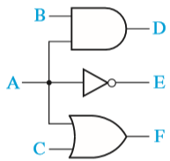
VHDL Description of Combinational Circuits
Three Gates with a Common Input and Different Delays
-- when A changes, these concurrent
-- statements all execute at the same time
D <= A and B after 2 ns;
E <= not A after 1 ns;
F <= A or C after 3 ns;
The three concurrent statements execute simultaneously whenever A changes (signal A as a common input ), just as the three gates start processing the signal change at the same time.
However, if the gates have different delays, the gate outputs can change at different times.

Slide 21
VHDL Description of Combinational Circuits
Signal is of type bit and bit_vector
Bit values in VHDL are enclosed in single quotes to distinguish them from integer values.
In digital design, need to perform the same operation on a group of signals.
A one-dimensional array of bit signals is referred to as a bit-vector.
If a 4-bit vector named B has an index range 0 through 3, then the four elements of the bit_vector are designated B(0), B(1), B(2), and B(3).
The statement B <= “0110” assigns ‘0’ to B(0), ‘1’ to B(1), ‘1’ to B(2), and ‘0’ to B(3).

Slide 22
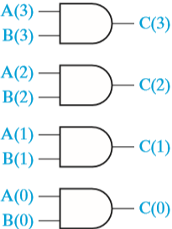
VHDL Description of Combinational Circuits
Array of AND Gates
-- the hard way
-- type bits signal A and B
C(3) <= A(3) and B(3);
C(2) <= A(2) and B(2);
C(1) <= A(1) and B(1);
C(0) <= A(0) and B(0);
-- the easy way
-- type bit-vectors signal A and B
C <= A and B;

Slide 23
VHDL Models for Multiplexers
F = A′I0 + AI1
--The corresponding VHDL statement is
F <= (not A and I0) or (A and I1);
Alternatively
-- conditional signal assignment statement
F <= I0 when A = '0' else I1;
The MUX output is I0 when A = ‘0’, and else it is I1.
In the conditional statement, I0, I1, and F can either be bits or bit-vectors.

Slide 24
VHDL Models for Multiplexers
The general form of a conditional signal assignment statement is
signal_name <= expression1 when condition1
else expression2 when condition2
[ else expressionN];

Slide 25
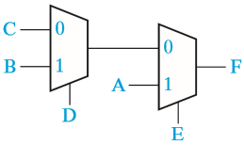
VHDL Models for Multiplexers
Cascaded 2-to-1 MUXes
F <= A when E = '1'
else B when D = '1'
else C;

Slide 26
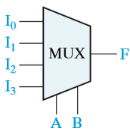
VHDL Models for Multiplexers
4-to-1 Multiplexer
The logic equation for the 4-to-1 MUX is
F = A′B′Ι0 + A′BI1 + AB′I2 + ABI3
--VHDL statement behavioral model
F <= (not A and not B and I0) or (not A and B and I1) or (A and not B and I2) or (A and B and I3);

Slide 27
VHDL Models for Multiplexers
Conditional Assignment Statement
Conditional Assignment Statement
Selected Signal Assignment Statement
F <= I0 when A&B = “00” else I1 when A&B = “01” else I2 when A&B = “10” else I3;
F <= I0 when A = ‘0’ and B = ‘0’ else I1 when A = ‘0’ and B = ‘1’ else I2 when A = ‘1’ and B = ‘0’ else I3;
sel <= A&B;
-- selected signal assignment statement with sel select
F <= I0 when "00",
I1 when "01",
I2 when "10",
I3 when "11";

Slide 28
VHDL Models for Multiplexers
The general form of a selected signal assignment statement is
with expression_s select
signal_s <= expression1 [after delay-time] when choice1, expression2 [after delay-time] when choice2,
. . .
[expression_n [after delay-time] when others];

Slide 29
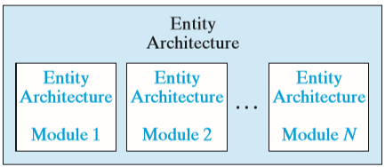
VHDL Modules
VHDL Program Structure
Entity declarations of the form:
entity entity-name is
[port(interface-signal-declaration);]
end [entity] [entity-name];
Architecture declarations of the form
-- Each entity is associated with one or more architecture
architecture architecture-name of entity-name is
[declarations]
begin
architecture body
end [architecture] [architecture-name];

Slide 30
VHDL Modules
In VHDL, must specify an entity and an architecture at the top level, and also specify an entity and architecture for each of the component modules that are part of the system.
Each entity declaration includes a list of interface signals that can be used to connect to other modules or to the outside world.
Declare all of the input and output signals using an entity declaration
The interface-signal-declaration normally has the following form: list-of-interface-signals:
mode type [: = initial-value]
{; list-of-interface-signals: mode type [: = initial-value]};
Input signals are of mode in, out, and inout.
E.g.
port(A, B: in integer : = 2; C, D: out bit);
indicates that A and B are input signals of type integer that are initially set to 2, and C and D are output signals of type bit that are initialized by default to ‘0’.

Slide 31
VHDL Modules
In Architecture the declarations section, we can declare signals and components that are used within the architecture.
The architecture body contains statements that describe the operation of the module.

Slide 32
VHDL Modules
How to defined components?
The component specification is very similar to the entity declaration.
Components used within the architecture are declared at the beginning of the architecture, using a component declaration of the form
component component-name
port (list-of-interface-signals-and-their-types);
end component;
The connections to each component used in a circuit are specified by using a component instantiation statement of the form
label: component-name port map (list-of-actual-signals);
The list of actual signals must correspond one-to-one to the list of interface signals specified in the component declaration.

Slide 33
VHDL Modules
VHDL Module with Two Gates
entity two_gates is
port (A,B,D: in bit; E: out bit);
end two_gates;
architecture gates of two_gates is
signal C: bit;
begin
C <= A and B; -- concurrent
E <= C or D; -- statements
end gates;
The signal C is declared within the architecture because it is an internal signal.
The two concurrent statements that describe the gates are placed between the keywords begin and end.

Slide 34
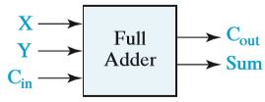
VHDL Modules
Sum = X ⊕ Y ⊕ Cin
Cout = YCin + XCin + XY
--Entity Declaration for a Full Adder Module
entity FullAdder is
port (X,Y,Cin: in bit; -- Inputs
Cout, Sum: out bit); -- Outputs
end FullAdder;
--The operation of the full adder is specified by an architecture
--declaration:
architecture Equations of FullAdder is
begin
-- concurrent assignment statements
Sum <= X xor Y xor Cin after 10 ns;
Cout <= (X and Y) or (X and Cin) or (Y and Cin) after 10 ns;
end Equations;

Slide 35
VHDL Modules
Lab Experiment
Write VHDL code for Half adder, Full Adder, Half Subtractor and Full Subtractor.

Slide 36
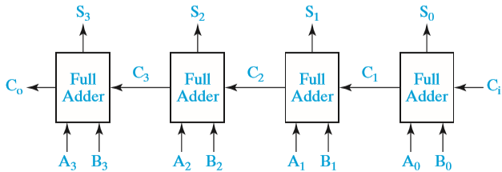
VHDL Modules
4-Bit Binary Adder
entityAdder4 is
port (A,B:in bit_vector(3 downto 0);Ci:in bit; -- Inputs
S:out bit_vector(3 downto 0);Co:out bit); -- Outputs endAdder4;
architecture Structure ofAdder4 is
component FullAdder
port (X,Y,Cin:in bit; -- Inputs Cout,Sum:out bit); -- Outputs
end component;
signal C:bit_vector(3 downto 1);
begin -- instantiate four copies of the FullAdder
FA0:FullAdder port map (A(0),B(0),Ci,C(1),S(0));
FA1:FullAdder port map (A(1),B(1),C(1),C(2),S(1));
FA2:FullAdder port map (A(2),B(2),C(2),C(3),S(2));
FA3:FullAdder port map (A(3),B(3),C(3),Co,S(3));
end Structure;

Slide 37
VHDL Modules
4-Bit Binary Adder
entityAdder4 is
port (A,B:in bit_vector(3 downto 0);Ci:in bit; -- Inputs
S:out bit_vector(3 downto 0);Co:out bit); -- Outputs endAdder4;
architecture Structure ofAdder4 is
component FullAdder
port (X,Y,Cin:in bit; -- Inputs Cout,Sum:out bit); -- Outputs
end compoent;
signal C:bit_vector(3 downto 1);
begin -- instantiate four copies of the FullAdder
FA0:FullAdder port map (A(0),B(0),Ci,C(1),S(0));
FA1:FullAdder port map (A(1),B(1),C(1),C(2),S(1));
FA2:FullAdder port map (A(2),B(2),C(2),C(3),S(2));
FA3:FullAdder port map (A(3),B(3),C(3),Co,S(3));
end Structure;

Slide 38
VHDL Modules
In preparation for simulation, we can place the entity and architecture for the FullAdder and for Adder4 together in one file and compile.
Alternatively, we could compile the FullAdder separately and place the resulting code in a library which is linked in when we compile Adder4.

Slide 39
VHDL Modules

Slide 40
VHDL Modules
Lab Experiment
Write VHDL code for 8 to 1 MUX.

Slide 41
VHDL Modules
Design a 4-to-1 MUX using only three 2-to-1 MUXes. Write an entity- architecture pair to implement a 2-to-1 MUX. Then write an entity-architecture pair to implement a 4-to-1 MUX using three instances of your 2-to-1 MUX. (Hint: The equation for a 4-to-1 MUX can be rewritten as F = A′(I0B′ + I1B) + A(I2B′ + I3B).)
Use the following port definitions:
For the 2-to-1 MUX:
port (i0, i1: in bit; sel: in bit; z: out bit);
For the 4-to-1 MUX:
port (i0, i1, i2, i3: in bit; a, b: in bit; f: out bit);

Slide 42
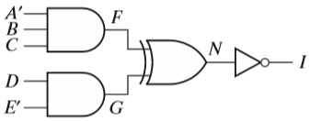
VHDL Modules
Write VHDL statements that represent the following circuit:
(a) Write a statement for each gate.
(b) Write one statement for the whole circuit.

Slide 43
VHDL Modules
Draw the circuit represented by the following VHDL statements:
F <= E and I;
I <= G or H;
G <= A and B;
H <= not C and D;
Implement the following VHDL conditional statement using two 2-to-1 MUXes:
F <= A when D = ‘1’ else B when E = ‘1’ else C;
Write a VHDL module that implements a full adder using an array of bit_vectors to represent the truth table.

Slide 44
VHDL Modules
(a) Draw the circuit represented by the following VHDL statements:
T1 <= not A and not B and I0;
T2 <= not A and B and I1;
T3 <= A and not B and I2;
T4 <= A and B and I3;
F <= T1 or T2 or T3 or T4;
(b) Draw a MUX that implements F. Then write a selected signal assignment statement that describes the MUX.

Slide 45
VHDL Modules
Assume that the following are concurrent VHDL statements:
(a) L <= P nand Q after 10 ns;
(b) M <= L nor N after 5 ns;
(c) R <= not M;
Initially at time t = 0 ns, P = 1, Q = 1, and N = 0. If Q becomes 0 at time t = 4 ns,
(1) At what time will statement (a) execute?
(2) At what time will L be updated?
(3) At what time will statement (c) execute?
(4) At what time will R be updated?

Slide 46
Latches and Flip-Flops

Slide 47
Objective
Explain in words the operation of S-R and gated D latches.
Explain in words the operation of D, D-CE, S-R, J-K, and T flip-flops.
Make a table and derive the characteristic (next-state) equation for such latches and flip-flops. State any necessary restrictions on the input signals.
Draw a timing diagram relating the input and output of such latches and flip-flops.
Show how latches and flip-flops can be constructed using gates. Analyze the operation of a flip-flop that is constructed of gates and latches.

Slide 48
Introduction
Sequential switching circuits have the property that the output depends not only on the present input but also on the past sequence of inputs.
In effect, these circuits must be able to “remember” something about the past history of the inputs in order to produce the present output.
Latches and flip-flops are commonly used memory devices in sequential circuits.
A memory element that has no clock input is often called a latch.
A memory element that has clock input is often called a Flip-Flop.

Slide 49
Introduction
The switching circuits that we have studied so far have not had feedback connections.
By feedback we mean that the output of one of the gates is connected back into the input of another gate in the circuit so as to form a closed loop.
Sequential circuits must contain feedback, but not all circuits with feedback are sequential.
There are a few circuits containing feedback that are combinational.

Slide 50
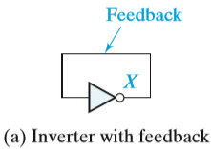
Introduction
Consider the below circuit , an oscillator can be created using any odd number of inverters.
The oscillator waveform has a high and a low time that is the sum of the propagation times of the inverters.
For example, with n inverters and with all having the same delay, the oscillator waveform high time is (n + 1)/2 times the high-to-low inverter propagation delay plus (n − 1)/2 times the low-to-high inverter propagation delay.

Slide 51
Introduction
Consider a feedback loop,
In this case, the circuit has two stable conditions, often referred to as stable states.
The simple loop of two inverters lacks (absence of) any external means of initializing the state to one of the stable states.

Slide 52
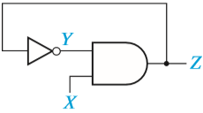
Questions
Assume that the inverter in the given circuit has a propagation delay of 5 ns and the AND gate has a propagation delay of 10 ns. Draw a timing diagram for the circuit showing X, Y, and Z. Assume that X is initially 0, Y is initially 1, after 10 ns X becomes 1 for 80 ns, and then X is 0 again.

Slide 53
SOLUTION

Slide 54
Set-Reset Latch
NOR-Gate latch
The basic flip-flop can be improved by replacing the inverters with either NAND or NOR gates.
The additional inputs on these gates provide a convenient means for application of input signals to switch the flip-flop from one stable state to the other.

Slide 55
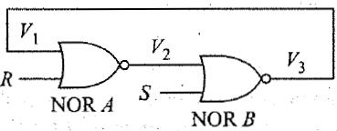
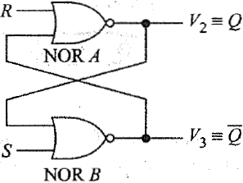
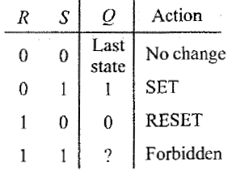
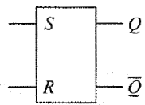
Set-Reset Latch
Two inputs labelled R and S.
Two outputs, defined in more general terms as Q and Q’.

Slide 56
Set-Reset Latch
To aid in understanding the operation of this circuit, recall that an H = 1 at any input of a NOR gate forces its output to an L = 0.
The first input condition in the truth table is R = 0 and S = 0. Since a 0 at the input of a NOR gate has no effect on its output, the flip-flop simply remains in its present state; that is, Q remains unchanged.

Slide 57
Set-Reset Latch
The second input condition R = 0 and S = 1 forces the output of NOR gate B low.
Both inputs to NOR gate A are now low, and the NOR-gate output must be high.
Thus a 1 at the S input is said to SET the flip-flop, and it switches to the stable state where Q = 1.

Slide 58
Set-Reset Latch
The third input condition is R = 1 and S = 0. This condition forces the output of NOR gate A low, and since both inputs to NOR gate B are now low, the output must be high.
Thus a 1 at the R input is said to RESET the flip-flop and it switches to the stable state where Q = 0 (or Q’ = 1).

Slide 59
Set-Reset Latch
The last input condition in the table, R = 1 and S = 1, is forbidden, as it forces the outputs of both NOR gates to the low state.
In other words, both Q = 0 and Q’ = 0 at the same time.
This violates the basic definition of a flip-flop that requires Q to be the complement of Q’, and so it is generally agreed never to impose this input condition.

Slide 60
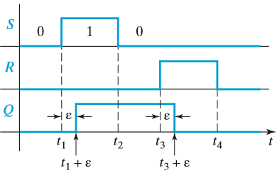
Set-Reset Latch
Timing Diagram for S-R Latch
At t1, S = 0 → 1, Q = 0 → 1 a short time (ε) later.
ε represents the response time or delay time of the latch.
At t2, S = 1 → 0, Q = No change (NC).
At t3, R = 0 → 1, and Q = 1 → 0 a short time (ε) later.
The duration of the S (or R) input pulse must normally be at least as great as ε in order for a change in the state of Q to occur.
If S = 1 for a time less than ε, the gate output will not change and the latch will not change state.`

Slide 61
Set-Reset Latch
Metastable State:
Two-inverter circuit and the set-reset circuit can exist a third stable state called metastable state.
This is the situation where the voltage level at the output of the two inverters or gates is approximately halfway between the voltage levels for a logic 0 and a logic 1.
This state is referred to as a metastable state.
It is metastable because any noise existing in the circuit will cause the circuit to transition to one of the truly stable states.

Slide 62
Set-Reset Latch
Metastable State:
However, certain events can cause the latch to enter the metastable state for a short time.
The simultaneous change in S and R from 1 to 0 in the set-reset latch can cause the latch to enter the metastable state.
Starting with Q = 0 and applying a pulse on S with a length on the borderline between being too short to cause Q to change and just long enough to cause Q to change may cause the circuit to enter the metastable state.
Events causing the circuit to enter the metastable state must be avoided

Slide 63
Set-Reset Latch
The term present state to denote the state of the Q output of the latch or flip-flop at the time any input signal changes, and the term next state to denote the state of the Q output after the latch or flip-flop has reacted to the input change and stabilized.
Let Q(t) represent the present state and Q(t +ε) or Qn or Q+ represent the next state, an equation for Q(t+ε) can be obtained from the circuit can write:

Slide 64
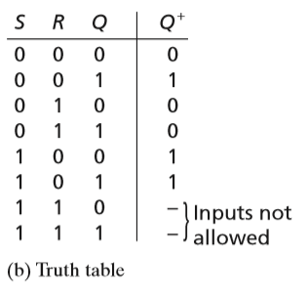
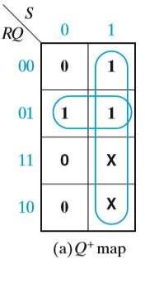
Set-Reset Latch
Derivation of Q+ for an S-R Latch
Next-state equation or characteristic equation is
Q+ = S + R′Q

Slide 65
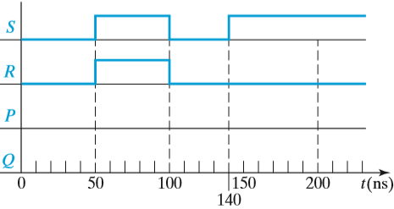
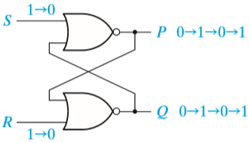
Questions
This problem illustrates the improper operation that can occur if both inputs to an S-R latch are 1 and are then changed back to 0. For Figure shown below, complete the following timing chart, assuming that each gate has a propagation delay of exactly 10 ns. Assume that initially P = 1 and Q = 0. Note that when t = 100 ns, S and R are both changed to 0. Then, 10 ns later, both P and Q will change to 1. Because these 1’s are fed back to the gate inputs, what will happen after another 10 ns?

Slide 66
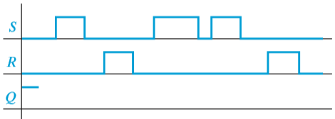
Complete the following timing diagram for an S-R latch. Assume Q begins at 1.

Slide 67
Set-Reset Latch
Switch Debouncing with an S-R Latch
When a mechanical switch is opened or closed, the switch contacts tend to vibrate or bounce open and closed several times before settling down to their final position.
This produces a noisy transition, and this noise can interfere with the proper operation of a logic circuit.

Slide 68
Set-Reset Latch
Switch Debouncing with an S-R Latch
The pull-down resistors connected to contacts a and b assure that when the switch is between a and b the latch inputs S and R will always be at a logic 0, and the latch output will not change state.

Slide 69
Set-Reset Latch
Switch Debouncing with an S-R Latch
The timing diagram shows what happens when the switch is flipped from a to b.
As the switch leaves a, bounces occur at the R input; when the switch reaches b, bounces occur at the S input.
After the switch reaches b, the first time S becomes 1, after a short delay the latch switches to the Q = 1 state and remains there.
Thus Q is free of all bounces even though the switch contacts bounce.

Slide 70
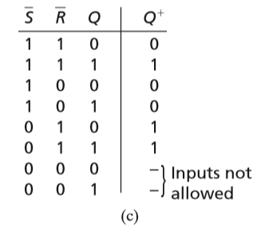
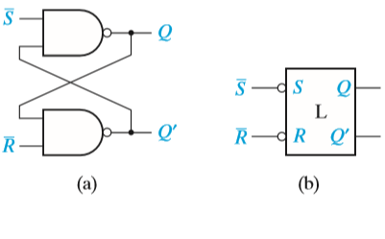
Set-Reset Latch
$\overline{S} \overline{R}$ latch

Slide 71
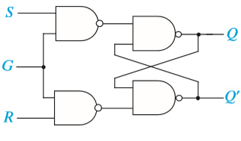
Gated Latches
Gated latches have an additional input called the gate or enable input.
When the gate input is inactive, the state of the latch cannot change.
When the gate input is active, the latch is controlled by the other inputs and operates as indicated in the preceding section.

Slide 72
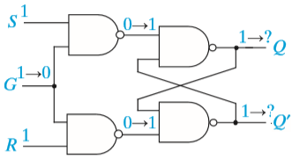
Gated Latches
Race Condition in the Gated S-R Latch
Another reason for disallowing the S = R = 1 input combination is illustrated by considering a change in G from 1 to 0 with S = R = 1.
When G changes, both inputs to the basic S-R latch change from 0 to 1. This causes both gates in the basic S-R latch to attempt to change from 1 to 0; a race condition exists and the propagation delays of the gates determine whether the latch stabilizes with Q = 0 or Q = 1.

Slide 76
Gated Latches
Q+ has a static 1-hazard for the input combinations
G = 1, S = 1, R = 1, Q = 1 and G = 0, S = 1, R = 1, Q = 1.
when G changes from 1 to 0 (or 0 to 1) between these two input combinations, it is possible for Q to change from 1 to 0 so, the hazard may cause a glitch in Q,

Slide 77
Gated Latches
Catching Problem:
This is restriction in gated S-R latches.
The S and R inputs must not be changing or contain glitches while G = 1.
For example, assume Q = 0 when G = 0 → 1 and S = 0 and R = 0.
If S = R = 0 until G returns to 0, then Q remains at 0.
If S contains a 1 glitch, due to a static 1-hazard then Q may be forced to a 1 and will remain there after G becomes 0.
A similar problem occurs if S does not change from 1 to 0 until after G changes to 1.
This is referred to as the 1’s catching problem.
So to avoid S=R=1 next is D-Latch

Slide 78
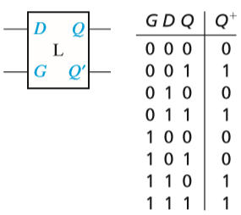
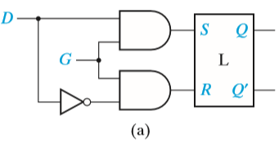
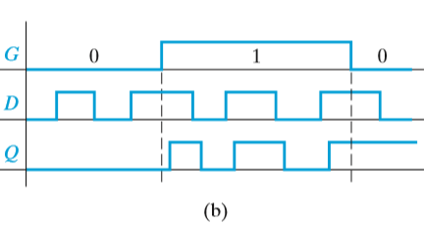
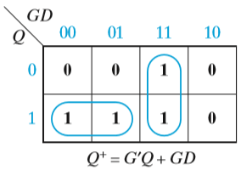
Gated Latches
Gated D Latch (or Transparent latch)
It can be obtained from a gated S-R latch by connecting S to D and R to D′.

Slide 79
Gated Latches
Unreliable Gated D Latch Circuit
Most digital systems use a clock signal to synchronize the change in outputs of the system’s flip-flops to an edge of the clock signal, either the positive (0 to 1) or the negative (1 to 0) edge of the clock.
Flip-flops where the clock signal is connected to the gate inputs of the latches

Slide 80
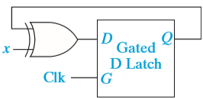
Gated Latches
In the circuit shown,
when the Clk = 1 so Q = Q′ when the input x = 1
and Q = Q when x = 0.
When Clk = 1 and x = 1, D = Q′ causes Q to change and, if Clk remains 1, the change in Q will feed back and cause Q to change again. If Clk remains at 1, Q will oscillate.
Consequently, the circuit will only operate as intended if Clk remains at 1 for a short time; it has to 1 just long enough to allow Q to change but short enough to prevent the change from feeding back and causing a second change.

Slide 81
Gated Latches
With a single latch, it may be possible to control the clock high time so the latch operates as intended, but in a system with several latches, the variation in gate delays would make it impossible to provide the correct clock width to all latches.
To avoid this timing problem, more complicated flip-flops restrict the flip-flop outputs to only change on an edge of the clock, and the outputs cannot change at other times even if the inputs change.
If the inputs to the flip-flop only need to be stable for a short period of time around the clock edge, this refer to the flip-flop as edge-triggered.
The term master-slave flip-flop refers to a particular implementation that uses two gated latches in such a way that the flip-flop outputs only change on a clock edge.

Slide 82
Exercise
Design a gated D latch using only NAND gates and one inverter.

Slide 83
Edge-Triggered D Flip-Flop
If the output of flip-flop can change in response to a 0 to 1 transition on the clock input, we say that the flip-flop is triggered on the rising edge (or positive edge) of the clock. (rising-edge trigger)
If the output can change in response to a 1 to 0 transition on the clock input, we say that the flip-flop is triggered on the falling edge (or negative edge) of the clock. (falling-edge trigger).
The term active edge refers to the clock edge (rising or falling) that triggers the flip-flop state change.

Slide 84
Edge-Triggered D Flip-Flop
D Flip-Flops
Timing for D Flip-Flop (Falling-Edge Trigger)

Slide 85
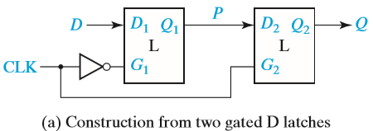
Edge-Triggered D Flip-Flop
D Flip-Flop (Rising Edge Trigger)
A rising-edge-triggered D flip-flop can be constructed from two gated D latches and an inverter

Slide 86
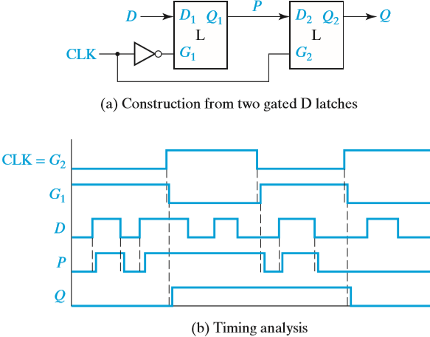
Edge-Triggered D Flip-Flop
D Flip-Flop (Rising Edge Trigger)

Slide 87
Edge-Triggered D Flip-Flop
D Flip-Flop (Rising Edge Trigger)
When CLK = 0, G1 = 1, and the first latch P = D input.
Because G2 = 0, the second latch holds the current value of Q.
When CLK = 0 → 1, G1 =1 → 0, and the current value of D is stored in the first latch, at same time G2 = 1, the value of Q = P.
When CLK changes back to 0, the second latch takes on the value of P and holds it and, then, the first latch starts following the D input again.
If the first latch starts following the D input before the second latch takes on the value of P, the flip-flop will not function properly.

Slide 88
Edge-Triggered D Flip-Flop
D Flip-Flop (Rising Edge Trigger)
Therefore, the circuit designers must pay careful attention to timing issues when designing edge-triggered flip-flops.
With this circuit, output state changes occur only following the rising edge of the clock.
The value of D at the time of the rising edge of the clock determines the value of Q, and any extra changes in D that occur between rising clock edges have no effect on Q.

Slide 89
Edge-Triggered D Flip-Flop
Because a flip-flop changes state only on the active edge of the clock, the propagation delay of a flip-flop is the time between the active edge of the clock and the resulting change in the output.
There are also timing issues associated with the D input.
To function properly:
The D input to an edge-triggered flip-flop must be held at a constant value for a period of time before and after the active edge of the clock.
If D changes at the same time as the active edge, the behavior is unpredictable.
The amount of time that D must be stable before the active edge is called the setup time (tsu),
The amount of time that D must hold the same value after the active edge is the hold time (th).

Slide 90
Edge-Triggered D Flip-Flop
Setup and Hold Times for an Edge-Triggered D Flip-Flop
The times at which D is allowed to change during the clock cycle are shaded in the timing diagram.
The propagation delay (tp) from the time the clock changes until the Q output changes is also indicated.

Slide 91
Edge-Triggered D Flip-Flop
The setup time allows a change in D to propagate through the first latch before the rising edge of Clock. The hold time is required so that D gets stored in the first latch before D changes.

Slide 92
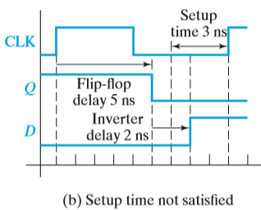
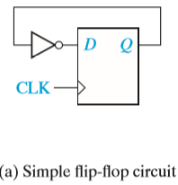
Edge-Triggered D Flip-Flop
Determination of Minimum Clock Period
Suppose the inverter has a propagation delay of 2 ns,
The flip-flop has a propagation delay of 5 ns and a setup time of 3 ns.

Slide 93
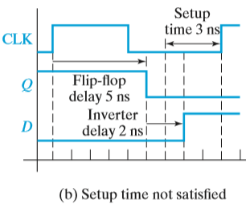
Edge-Triggered D Flip-Flop
Determination of Minimum Clock Period
That the clock period is 9 ns, i.e., the time between successive active edges (rising edges for this figure).
Then, 5 ns after a clock edge, the flip-flop output will change, and 2 ns after that, the output of the inverter will change.
Therefore, the input to the flip-flop will change 7 ns after the rising edge, which is 2 ns before the next rising edge.
But the setup time of the flip-flop requires that the input be stable 3 ns before the rising edge; therefore, the flip-flop may not take on the correct value.

Slide 94
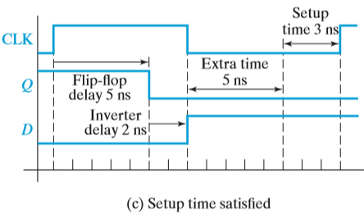
Edge-Triggered D Flip-Flop
Determination of Minimum Clock Period
Now the clock period is 15 ns
Again, the input to the flip-flop will change 7 ns after the rising edge.
However, because the clock is slower, this is 8 ns before the next rising edge.
Therefore, the flip-flop will work properly.
Note in Figure (c) that there is 5 ns of extra time between the time the D input is correct and the time when it must be correct for the setup time to be satisfied.

Slide 95
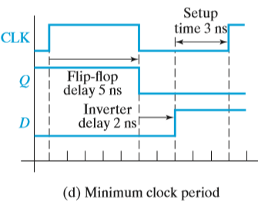
Edge-Triggered D Flip-Flop
Determination of Minimum Clock Period
We can use a shorter clock period, and have less extra time, or no extra time.
Figure (d) shows that 10 ns is the minimum clock period which will work for this circuit.

Slide 96
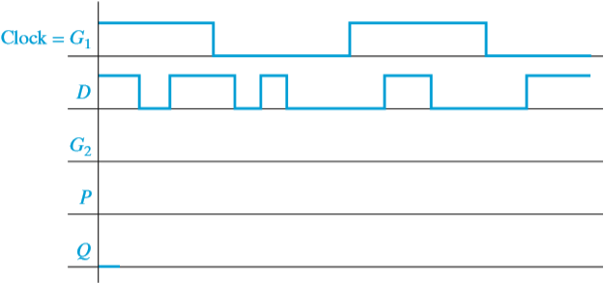
Questions
What change must be made in following circuit to implement a falling-edge-triggered D flip-flop? Complete the following timing diagram for the modified flip-flop.

Slide 97
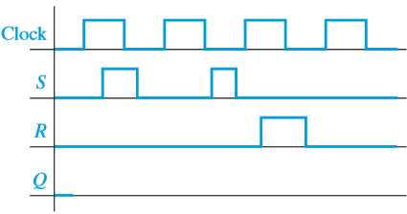
Questions
Fill in the timing diagram for a falling-edge-triggered S-R flip-flop. Assume Q begins at 0.

Slide 98
S-R Flip-Flop
An S-R flip-flop is similar to an S-R latch in that S = 1 sets the Q output to 1, and R = 1 resets the Q output to 0.
Q+ is the value of Q after the propagation delay thru the latch.
Q+ is the value that Q assumes after the active clock edge.
The essential difference is that the flip-flop has a clock input, and the Q output can change only after an active clock edge.

Slide 99
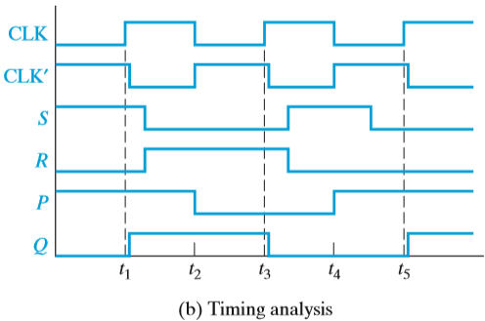
S-R Flip-Flop
S-R Flip-Flop Implementation and Timing

Slide 100
S-R Flip-Flop
S-R Flip-Flop Implementation and Timing
This flip-flop changes state after the rising edge of the clock.
The circuit is often referred to as a master-slave flip-flop.
When CLK = 0, the S and R inputs set the outputs of the master latch to the appropriate value while the slave latch holds the previous value of Q.
When CLK = 0 → 1, the value of P is held in the master latch and this value is transferred to the slave latch.
The master latch holds the value of P while CLK = 1, and, hence, Q does not change.
When the clock changes from 1 to 0, the Q value is latched in the slave, and the master can process new inputs.
In timing diagram Initially, S = 1 and Q changes to 1 at t1. Then R = 1 and Q changes to 0 at t3.

Slide 101
S-R Flip-Flop
S-R Flip-Flop Implementation and Timing

Slide 102
S-R Flip-Flop
S-R Flip-Flop Implementation and Timing
For a rising-edge-triggered flip-flop the value of the inputs is sensed at the rising edge of the clock, and the inputs can change while the clock is low. For the master-slave flip-flop, if the inputs change while the clock is low, the flip-flop output may be incorrect.
For example, in timing diagram
At t4, S = 1 and R = 0, so P = 1.
At t5, S = 0 , but P does not change, Q = 1 after the rising edge of CLK.
However, at t5, S = R = 0, so the state of Q should not change.
We can solve this problem if we only allow the S and R inputs to change while the clock is high.

Slide 103
J-K Flip-Flop
Master-Slave J-K Flip-Flop (Q Changes on Rising Edge)
Two S-R latches connected in a master-slave arrangement except S and R have been replaced with J and K, and the Q and Q′ outputs are feeding back into the input gates.
Because S = J·Q′·CLK′ and R = K·Q·CLK′, only one of S and R inputs to the first latch can be 1 at any given time.

Slide 104
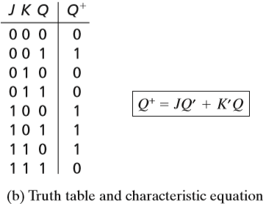
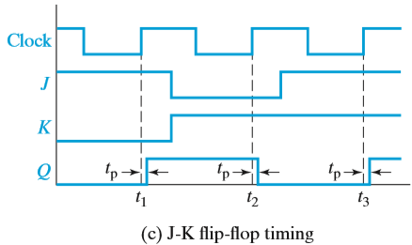
J-K Flip-Flop

Slide 105
J-K Flip-Flop
Lab Experiment:
Realize a J-K Master-Slave Flip-Flop using NAND gates and verify its truth table.
J
Q
CLK
K
Input |  | Output
J | K | Q_{n+1}
0 | 0 | Q_{n}
0 | 1 | 0
1 | 0 | 1
1 | 1 | $\overline{Qn}$

Slide 106
J-K Flip-Flop
Lab Experiment: Write HDL code for a J-K Master-Slave Flip-Flop.
entity JK_FF_VHDL is
port( J,K: in std_logic;
Clock: in std_logic;
Output: out std_logic);
end JK_FF_VHDL;
architecture Behavioral of JK_FF_VHDL is
signal temp: std_logic;
begin
process (Clock)
begin
if rising_edge(Clock) then
if (J='0' and K='0') then
temp <= temp;
elsif (J='0' and K='1') then
temp <= '0';
elsif (J='1' and K='0') then
temp <= '1';
elsif (J='1' and K='1') then
temp <= not (temp);
end if;
end if;
end process;
Output <= temp;
end Behavioral;

Slide 107
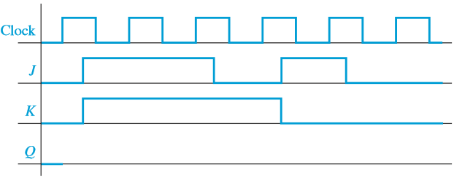
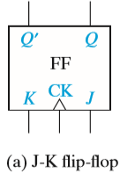
Complete the following timing diagram for the flip-flop shown below.

Slide 108
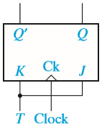
T Flip-Flop
T (Toggle) flip-flop
Implementation of T Flip-Flops
Conversion of J-K to T
Connect the J and K inputs of a J-K flip-flop together
Q+ = JQ′ + K′Q = TQ′ + T′Q

Slide 109
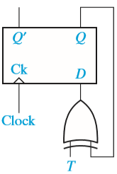
T Flip-Flop
Implementation of T Flip-Flops
Conversion of D to T
Q+ = Q ⊕ T = TQ′ + T′Q

Slide 110
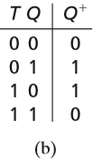
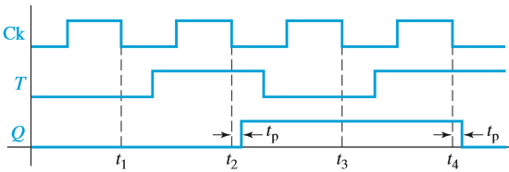
T Flip-Flop

Slide 111
Flip-Flops with Additional Inputs
Flip-flops often have additional inputs which can be used to set the flip-flops to an initial state independent of the clock.
Clear (Clr) and Preset (Pre) Input
Clr and Pre are often referred to as asynchronous clear and preset inputs because their operation does not depend on the clock.
Clr will reset the flip-flop to Q = 0,
Pre will set the flip-flop to Q = 1.

Slide 112
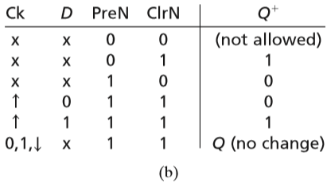
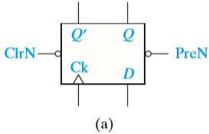
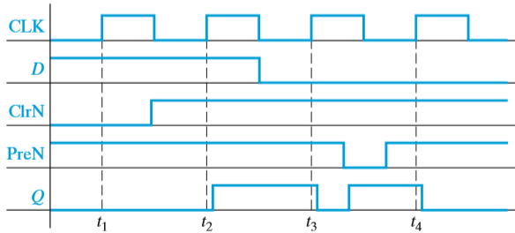
Flip-Flops with Additional Inputs
ClrN or PreN to indicate active-low clear and preset inputs

Slide 113
Flip-Flops with Additional Inputs
The clear and preset inputs can also be synchronous, i.e., the clear and set operations occur on the active edge of the clock.
Often a synchronous clear or preset will override the other synchronous inputs, e.g., a D flip-flop with a synchronous clear input will clear on the active edge of the clock when the clear input is active independent of the value on D.

Slide 114
Flip-Flops with Additional Inputs
D Flip-Flop with Clock Enable (D-CE)
In synchronous digital systems, the flip-flops are usually driven by a common clock so that all state changes occur at the same time in response to the same clock edge.
When designing such systems, we frequently encounter situations where we want some flip-flops to hold existing data even though the data input to the flip-flops may be changing.
One way to do this is to gate the clock

Slide 115
Flip-Flops with Additional Inputs
D Flip-Flop with Clock Enable (D-CE)
Gating the Clock:
This method has two potential problems.
First, gate delays may cause the clock to arrive at some flip-flops at different times than at other flip-flops, resulting in a loss of synchronization.
Second, if En changes at the wrong time, the flip-flop may trigger due to the change in En instead of due to the change in the clock, again resulting in loss of synchronization.

Slide 116
Flip-Flops with Additional Inputs
D Flip-Flop with Clock Enable (D-CE)
Rather than gating the clock, a better way is to use a flip-flop with a clock enable (CE).
A D flip-flop with a clock enable, which we will call a D-CE flip-flop.
Q+ = Q·CE′ + D·CE

Slide 117
Complete the following timing diagram for a J-K flip-flop with a falling-edge trigger and asynchronous ClrN and PreN inputs.

Slide 118
Asynchronous Sequential Circuits
The signals on the feedback loops in a sequential circuit define the state of the circuit. In asynchronous sequential circuits the state of the circuit can change whenever any input changes.
Eg: Latch, a master-slave and edge-triggered flipflop
In order for asynchronous circuits to operate in a well defined manner, they must satisfy several restrictions

Slide 119
Asynchronous Sequential Circuits
P+ = x′P + xQ
Q+ = x′P′ + xQ
Note that both equations contain static 1-hazards.
P+ contains a static 1-hazard for xPQ = 111 ↔ 011.
Figure shows next-state table with the stable states circled.

Slide 120
Asynchronous Sequential Circuits
Stable state xPQ = 111 and changing x to 0.
The table indicates that the next state is PQ = 10 (i.e., P does not change and Q changes to 0).
When x changes to 0, the output of Gate 2 changes to 0 causing the outputs of both gates 4 and 5 to change to 0.

Slide 121
Asynchronous Sequential Circuits
When the x inverter output changes to 1, P = 0 prevents the output of Gate 1 from changing to 1 so P remains 0; however, the output of Gate 3 changes to 1 and Q becomes 1.

Slide 122
Asynchronous Sequential Circuits
The circuit stabilizes in state PQ = 01. This incorrect state transition is due to the static 1-hazard in P+, which causes a 0 glitch in P if the x inverter delay is large and, because of the feedback, P never changes back to 1.
This problem can be eliminated by designing the circuits to be free of hazards.
Even if the circuit is free of hazards, delays in the “wrong” places in the circuit can cause incorrect state transitions.

Slide 123
VARIOUS REPRESENTATIONS OF FLIP-FlOPS
Characteristic Equations of Flip-flops
The characteristic equations of flip-flops are useful in analyzing circuits made of them. Here, next output Qn+1 is expressed as a function of present output Qn and input to flip-flops.

Slide 124
Introduction to Counter
A counter driven by a clock can be used to count the number of clock cycles.
Since the clock pulses occur at known intervals, the counter can be used as an instrument for measuring time and therefore period or frequency.
There are basically two different types of counters-synchronous and asynchronous.
Serial, or asynchronous counter is defined as each flip-flop is triggered by the previous flip-flop, and thus the counter has a cumulative settling time.
An increase in speed of operation can be achieved by use of a parallel or synchronous counter. Here, every flip-flop is triggered by the clock (in synchronism), and thus settling time is simply equal to the delay time of a single flip-flop.
Serial and parallel counters are used in combination to compromise between speed of operation and hardware count.

Slide 125
ASYNCHRONOUS COUNTERS-1
The term asynchronous refers to events that do not have a fixed time relationship with each other and, generally, do not occur at the same time.
An asynchronous counter is one in which the flip-flops (FF) within the counter do not change states at exactly the same time because they do not have a common clock pulse.
The clock input of an asynchronous counter is always connected only to the LSB flip-flop.
A 2-Bit Asynchronous Binary Counter
Figure shows a 2-bit counter connected for asynchronous operation. Notice that the clock (CLK) is applied to the clock input (C) of only the first flop-flop, FF0, which is always the least significant bit (LSB). The second flip-flop, FF1, is triggered by the $\overline{Q0}$ out-put of FF0. FF0 changes state at the positive-going edge of each clock pulse, but FF1 changes only when triggered by a negative-going transition of the Q0 output of FF0.

Slide 126
ASYNCHRONOUS COUNTERS-2
Ripple Counters (Up Counter)
Figure shows (Next slide) three negative edge- triggered, JK flip-flops connected in cascade.
The system clock, a square wave, drives flip-flop A. The output of A drives B, and the output of B drives flip-flop C. All the J and K inputs are tied to +V_{CC}· This means that each flip-flop will change state (toggle) with a negative transition at its clock input.
When the output of a flip-flop is used as the clock input for the next flip-flop, we call the counter a ripple counter, or asynchronous counter.
The A flip-flop must change state before it can trigger the B flip-flop, and the B flip-flop has to change state before it can trigger the C flip-flop.
If each flip-flop in this three-flip-flop counter has a propagation delay time of 10 ns, the overall propagation delay time for the counter is 30 ns.

Slide 127
ASYNCHRONOUS COUNTERS-3

Slide 128
ASYNCHRONOUS COUNTERS-4
The waveform at the output of flip-flop A is one-half the clock frequency.
The waveform at the output of flip-flop B is one-half the frequency of A and one-fourth the clock frequency.
The frequency of the waveform at C is one-half that at B, but it is only one-eighth the clock frequency.
What is the clock frequency, if the period of the waveform at C is 24 μs?
Since there are eight clock cycles in one cycle of C, the period of the clock must be 24/8 = 3 μs. The clock frequency must then be l/(3 x 10⁻⁶) = 333 kHz.

Slide 129
ASYNCHRONOUS COUNTERS-5
A binary ripple counter counts in a straight binary sequence, a counter having n flip-flops will have 2^{n} output conditions.
For instance, the three-flip-flop counter just discussed has 2³ = 8 output conditions (000 through 111). Five flip-flops would have 2⁵ = 32 output conditions (00000 through 11111 ), and so on.
The largest binary number that can be represented by n cascaded flip-flops has a decimal equivalent of 2^{n-1}.
For example, the three-flip-flop counter reaches a maximum decimal number of 2³- 1.
The maximum decimal number for five flip-flops is 2⁵ - l = 31, while six flip-flops have a maximum count of 63.
A three-flip-flop counter is often referred to as a modulus-8 (or mod-8) counter since it has eight states. Similarly, a four-flip-flop counter is a mod-16 counter, and a six-flip-flop counter is a mod-64 counter.
The modulus of a counter is the total number of states through which the counter can progress.

Slide 130
ASYNCHRONOUS COUNTERS-6
How many flip-flops are required to construct a mod-128 counter? A mod-32? What is the largest decimal number that can be stored in a mod-64 counter?
A mod-128 counter must have seven flip-flols, since 2⁷ = 128.
Five flip-flops are needed to construct a mod-32 counter.
The largest decima1 number that can be stored in a six-flop flip counter (mod-64) is 111111 = 63.
Note carefully the difference between the modulus ( total number of states) and the maximum decimal number.

Slide 131
ASYNCHRONOUS COUNTERS-8
Example

Slide 132
ASYNCHRONOUS COUNTERS-9
Ripple Counters (Down Counter)
In 3-bit ripple up counter the system clock is still used at the clock input to flip-flop A, but the complement of A, A’, is used to drive flip-flop B, likewise; B’ is used to drive flip-flop C.

Slide 133
ASYNCHRONOUS COUNTERS-10
Ripple Counters (4-bit Down Counter)

Slide 134
DECADE COUNTERS-1
A Mod-5 Counter

Slide 135
DECADE COUNTERS-2
A Mod-5 Counter
A modulo – 5 counter, the counter should reset when it reaches state 101.
The inputs to the NAND gate should be connected to the outputs Q1 and Q3.
When the output of both these stages attains 1, then the output of the NAND gate is 0 and this resets the counter.

Slide 136
DECADE COUNTERS-3
A Mod-12 Counter

Slide 137
DECADE COUNTERS-4
In Lab We Use this Table
Lab Experiment: The 7490

Slide 138
DECADE COUNTERS-5
Lab Experiment: The 7490
MOD-10 Counter
Clock | Output
 | QD | QC | QB | QA
0 | 0 | 0 | 0 | 0
1 | 0 | 0 | 0 | 1
2 | 0 | 0 | 1 | 0
3 | 0 | 0 | 1 | 1
4 | 0 | 1 | 0 | 0
5 | 0 | 1 | 0 | 1
6 | 0 | 1 | 1 | 0
7 | 0 | 1 | 1 | 1
8 | 1 | 0 | 0 | 0
9 | 1 | 0 | 0 | 1
CLK
+5V
14,INPUT A
05,VCC
01,INPUT B
12
QA
06, Rq1
IC 7490
DECADE COUNTER
09
QB
07, RO1
08
QC
10,GND
11
QD

Slide 139
DECADE COUNTERS-6
Lab Experiment: The 7490
MOD-8 Counter
Clock | Output
 | QD | QC | QB | QA
0 | 0 | 0 | 0 | 0
1 | 0 | 0 | 0 | 1
2 | 0 | 0 | 1 | 0
3 | 0 | 0 | 1 | 1
4 | 0 | 1 | 0 | 0
5 | 0 | 1 | 0 | 1
6 | 0 | 1 | 1 | 0
7 | 0 | 1 | 1 | 1
CLK
+5V
14,INPUT A
05,VCC
01,INPUT B
12
QA
06,Rq1
IC 7490
DECADE COUNTER
09
QB
07,Rq2
08
QC
10,GND
02,R1
11
QD
03,R2

