Slide 1
MODULE-II INPUT/OUTPUT ORGANIZATION
By,
Mrs. Ashwini Janagal
Department of AIML
JNN College of Engineering

Slide 2
ACCESSING I/O DEVICES

Slide 3
ACCESSING I/O DEVICES
Processor
Memory
Single Bus Architecture
Bus
I/O de
vice 1
I/O de
vice
n
BUS
ADDRESS LINES
DATA LINES
CONTROL LINES

Slide 4
ACCESSING I/O DEVICES
BUS
ADDRESS LINES
DATA LINES
CONTROL LINES
If Processor Wants to Send/Receive any Data from some I/O device...........................
FINALLY data transaction will happen on DATA LINE
PROCESSOR will keep ADDRESS of the device on ADDRESS LINE
DEVICE will identify its ADDRESS and respond on CONTROL LINE
PROCESSOR
ADDRESS LINES
DATA LINES
CONTROL LINES

Slide 5
ACCESSING I/O DEVICES
How do you address I/O devices?
BUS
I/O ADDRESSING
ADDRESS LINES
DATA LINES
CONTROL LINES
I/O and MEMORY with SAME ADDRESS SPACE
SEPARATE
I/O ADDRESS SPACE
Called as “MEMORY MAPPED I/O”.
SAME INSTRUCTIONS to access MEMORY and I/O.
Simple.
If DATAIN is KEYBOARD REGISTER, LOCA is MEMORY LOCATION.
MOVE DATAIN, R0;
MOVE LOACA, R1

Slide 6
ACCESSING I/O DEVICES
How do you address I/O devices?
BUS
I/O ADDRESSING
ADDRESS LINES
DATA LINES
CONTROL LINES
I/O and MEMORY with SAME ADDRESS SPACE
SEPARATE
I/O ADDRESS SPACE
SPECIAL INSTRUCTIONS to transfer data to and from I/O devices.
Ex: Some INTEL Versions have separate 16 bit ADDRESS for I/O DEVICES.
I/O address lines need not be physically separate from memory address lines.

Slide 7
ACCESSING I/O DEVICES
Address lines
Bus
Data lines
Decoding the address sent by Processor to enable device to identify itself.
Control lines
Address
Control
Data and
I/O
decoder
circuits
status registers
int
erface
Input device
Data register holds the Data Being Transferred -- to or from the processor.
Status register holds information necessary for the operation of the I/O device.

Slide 8
ACCESSING I/O DEVICES
Address lines
Bus
Data lines
Control lines
Address
Control
Data and
I/O
decoder
circuits
status registers
int
erface
Input device
Always remember -- I/O devices are very slow compared to memory and processor.
Synchronization is required.
Ex: SIN flag in Keyboard STATUS REGISTER.
SIN=1, Data (Character) is READY at KEYBOARD REGISTER
SIN=0, after DATA is READ FROM PROCESSOR.

Slide 9
ACCESSING I/O DEVICES

Slide 10
ACCESSING I/O DEVICES
STATUS IN and OUT for KEYBOARD AND DISPLAY.
DIRQ-> DISPLAY Interrupt Request
DEN --> DISPLAY ENABLE
KEN --> KEYBOARD ENABLE
KIRQ-> KEYBOARD Interrupt Request

Slide 11
INTERRUPTS

Slide 12
INTERRUPTS-INTERRUPT HARDWARE
Three Ways to Access I/O Devices
Program Controlled I/O
Interrupts
Direct Memory Access (DMA)

Slide 13
INTERRUPTS-INTERRUPT HARDWARE
Three Ways to Access I/O Devices
Program Controlled I/O
Interrupts
Direct Memory Access (DMA)

Slide 14
INTERRUPTS-INTERRUPT HARDWARE
What is an Interrupt?
Answer: A COMMUNICATION SIGNAL to let know that Input/Output device is ready.
INTERRUPT REQUEST LINE
A BUS CONTROL LINE to send INTERRUPT.
INTERRUPT SERVICE ROUTINE
A subroutine called in response to INTERRUPT.

Slide 15
INTERRUPTS-INTERRUPT HARDWARE
EXAMPLE
Consider a program consisting of two functions. ‘COMPUTE” and “PRINT”.
“COMPUTE” : Will generate an output of 100 lines.
“PRINT”: Will print the lines. One line at a time.
“PRINT” will send one line and wait for Printer to finish the task. Then Next Line will be sent.

Slide 16
INTERRUPTS-INTERRUPT HARDWARE
So....What Happens at This Location?

Slide 17
INTERRUPTS-INTERRUPT HARDWARE
Execution Control has to jump to Interrupt Service Routine
Before Branching Store the current values of
Program Counter (PC)
Processor Registers.
Control Flags

Slide 18
INTERRUPTS-INTERRUPT HARDWARE
Saving and Restoring may be done Automatically
Its Time Consuming

Slide 19
INTERRUPTS-INTERRUPT HARDWARE
Interrupt Latency
Time taken from Interrupt Reception to Start of Interrupt Service routine.
How do you reduce Latency?
1. Processor Automatically store only minimum information.
2. Rest if necessary user in program has to add extra instructions.

Slide 20
INTERRUPTS-INTERRUPT HARDWARE
INTERRUPT-HARDWARE
There are Multiple I/O Devices Connected. Can they send Interrupts together? How this will be handled?
No Interrupt :
I/P=V_{dd}
INTR=0
Interrupt From Any Device:
I/P=0
INTR=1

Slide 21
INTERRUPTS-INTERRUPT HARDWARE
INTERRUPT-HARDWARE
There are Multiple I/O Devices Connected. Can they send Interrupts together? How this will be handled?
WHAT ARE THE ISSUES NOT SOLVED HERE??????

Slide 22
INTERRUPTS-INTERRUPT HARDWARE
Enabling and Disabling Interrupts
1. What if Processor Doesn’t want to be Interrupted?
2. Interrupts can come at any time and change the course of execution. So they need some controlling.
3. Interrupt from keyboard is acceptable only when there is an editor program running.

Slide 23
INTERRUPTS-INTERRUPT HARDWARE
After receiving Interrupt Signal how does processor let that device know that “Wait, I have received your signal” ?
Interrupt Acknowledgement Signal - Sent by Processor.
Start of Data Transfer will let that device know. Why I have to send an acknowledgement?

Slide 24
INTERRUPTS-INTERRUPT HARDWARE
What if Processor Doesn’t want to be Interrupted?
When Interrupt Service Routine is Executing ---- Other interrupt should not come....
First Line of Service Routine- Disable Request Line
Last Line of Service Routine - Enable Request Line

Slide 25
INTERRUPTS-INTERRUPT HARDWARE
Enabling and Disabling Interrupts
1. Case 1: Interrupt from Single Device
Step 1: Keep Interrupt signal high until Processor Accepts it. i.e., until execution of Service Routine
Step 2: Signal is high.... should not be considered as another interrupt as it lead to infinite loop.
METHOD-1
Step 2.1: Ignore Until Execution of First Line of Service Routine
Step 2.2: Disable Interrupt Request Line
Step 2.2: Execute remaining service routine
Step 2.2: At the end Enable request line

Slide 26
INTERRUPTS-INTERRUPT HARDWARE
Enabling and Disabling Interrupts
1. Case 1: Interrupt from Single Device
Step 1: Keep Interrupt signal high until Processor Accepts it. i.e., until execution of Service Routine
Step 2: Signal is high.... should not be considered as another interrupt as it lead to infinite loop.
METHOD-2
Step 2.1:Processor Automatically DISABLE the request line

Slide 27
INTERRUPTS-INTERRUPT HARDWARE
Enabling and Disabling Interrupts
1. Case 1: Interrupt from Single Device
HOW TO ENBALE/DISABLE DEVICES?
1. PROCESSOR STATUS REGISTER(PS) : To indicate status of register
2.
a. INTERRUPT-ENABLE-BIT in PS register=1, means Interrupt enabled
b. INTERRUPT-ENABLE-BIT in PS register=0, means Interrupt Disabled.

Slide 28
INTERRUPTS-INTERRUPT HARDWARE
Enabling and Disabling Interrupts
1. Case 1: Interrupt from Single Device
Edge Triggered Interrupt Request Line: Leading edge of signal Activates Interrupts.
Only once INTERRUPTS are registered.

Slide 29
INTERRUPTS-INTERRUPT HARDWARE
Enabling and Disabling Interrupts
1. Case 1: Interrupt from Single Device
SUMMARY
1. Device raises an Interrupt.
2. Processor Interrupts current running program.
3. INTERRUPT DISABLE by changing PS bits.
4. Interrupt Acknowledgement.
5. Interrupt Service Routine is Run
6. INTERRUPT ENABLE

Slide 30
INTERRUPTS-INTERRUPT HARDWARE
Enabling and Disabling Interrupts
1. Case 2: HANDLING MULTIPLE DEVICES
Imagine the devices connected to processor with single shared bus

Slide 31
INTERRUPTS-INTERRUPT HARDWARE
Enabling and Disabling Interrupts
1. Case 2: HANDLING MULTIPLE DEVICES
Imagine the devices connected to processor with single shared bus
INTERRUPT HAS COME FROM WHICH DEVICE???????????

Slide 32
INTERRUPTS-INTERRUPT HARDWARE
Enabling and Disabling Interrupts
1. Case 2: HANDLING MULTIPLE DEVICES
Imagine the devices connected to processor with single shared bus
WHICH SERVICE ROUTINE TO EXECUTE??????

Slide 33
INTERRUPTS-INTERRUPT HARDWARE
Enabling and Disabling Interrupts
1. Case 2: HANDLING MULTIPLE DEVICES
Imagine the devices connected to processor with single shared bus
ALREADY ONE DEVICE INTERRUPT SERVICE ROUTINE IS EXECUTING......SHOULD OTHER DEVICE BE ALLOWD TO SEND INTERRUPT NOW????????

Slide 34
INTERRUPTS-INTERRUPT HARDWARE
Enabling and Disabling Interrupts
1. Case 2: HANDLING MULTIPLE DEVICES
Imagine the devices connected to processor with single shared bus
WHAT IF TWO THREE DEVICES SEND INTERRUPT AT SAME TIME?

Slide 35
INTERRUPTS-INTERRUPT HARDWARE
Enabling and Disabling Interrupts
1. Case 2: HANDLING MULTIPLE DEVICES
SIMPLE WAY TO FIND WHICH DEVICE IS HAS SENT INTERRUPT - POLLING
1. CHECK the STATUS register of each device.
2. If IRQ bit is 1, then that device has sent Interrupt.
3. POLL All the devices connected, and in order if IRQ bit=1, then run that devices SERVICE ROUTINE.

Slide 36
INTERRUPTS-INTERRUPT HARDWARE
Enabling and Disabling Interrupts
1. Case 2: HANDLING MULTIPLE DEVICES
VECTORED INTERRUPT
1. Even though POLLING is simple, it wastes lot of time in POLLING.
2. VECTORED INTERRUPT- INTERRUPTING DEVICE will IDENTIFY ITSELF by sending some CODE.
3. PROCESSOR will directly start EXECUTING respective SERVICE ROUTINE

Slide 37
INTERRUPTS-INTERRUPT HARDWARE
Enabling and Disabling Interrupts
1. Case 2: HANDLING MULTIPLE DEVICES
WHAT IS THE CODE SENT???????
VECTORED INTERRUPT
1. Even though POLLING is simple, it wastes lot of time in POLLING.
2. VECTORED INTERRUPT- INTERRUPTING DEVICE will IDENTIFY ITSELF by sending some CODE.
3. PROCESSOR will directly start EXECUTING respective SERVICE ROUTINE

Slide 38
INTERRUPTS-INTERRUPT HARDWARE
Enabling and Disabling Interrupts
1. Case 2: HANDLING MULTIPLE DEVICES
WHAT IS THE CODE SENT???????
VECTORED INTERRUPT
1. Even though POLLING is simple, it wastes lot of time in POLLING.
2. VECTORED INTERRUPT- INTERRUPTING DEVICE will IDENTIFY ITSELF by sending some CODE.
3. PROCESSOR will directly start EXECUTING respective SERVICE ROUTINE
MAY BE STARTING ADDRESS OF SERVICE ROUTINE
Its size may vary from 4 to 8 bits.

Slide 39
INTERRUPTS-INTERRUPT HARDWARE
Enabling and Disabling Interrupts
1. Case 2: HANDLING MULTIPLE DEVICES
VECTORED INTERRUPT
1. The location pointed by Interrupting device is where STARTING ADDRESS of SERVICE ROUTINE is stored.
2. INTERRUPT VECTOR: Vector of STARTING ADDRESS OF SERVICE ROUTINES.

Slide 40
INTERRUPTS-INTERRUPT HARDWARE
Enabling and Disabling Interrupts
1. Case 2: HANDLING MULTIPLE DEVICES
VECTORED INTERRUPT
How is VECTOR code sent ???????

Slide 41
INTERRUPTS-INTERRUPT HARDWARE
Enabling and Disabling Interrupts
1. Case 2: HANDLING MULTIPLE DEVICES
How is VECTOR code sent ???????
VECTORED INTERRUPT
1. DATA BUS is used.
2. DEVICE will RISE INTERRUPT REQUEST
3. DEVICE will WAIT until INTERRUPT ACKNOWLEDGEMENT.
4. DEVICE will SEND the CODE over DATA BUS.

Slide 42
INTERRUPTS-INTERRUPT HARDWARE
Enabling and Disabling Interrupts
1. Case 2: HANDLING MULTIPLE DEVICES
PRESSURE OF SOME UNIT IN A FACTORY IS IN DANGER LEVEL
THERE IS SOME ROBBER OPENING THE DOOR OF BANK.... SESOR IS SENDING THE SIGNAL.....
INTERRUPT NESTINBG
1. What if there is an INTERRUPT REQUEST which can’t be IGNORED.

Slide 43
INTERRUPTS-INTERRUPT HARDWARE
Enabling and Disabling Interrupts
1. Case 2: HANDLING MULTIPLE DEVICES
INTERRUPT NESTING
1. What if there is an INTERRUPT REQUEST which can’t be IGNORED.
2. That means, some I/O devices are not so important so they should not interfere.
3. But some I/O devices are very important and as and when they want their INTERRUPT SIGNAL should be handled.

Slide 44
INTERRUPTS-INTERRUPT HARDWARE
Enabling and Disabling Interrupts
1. Case 2: HANDLING MULTIPLE DEVICES
How to DESIGN THIS????
INTERRUPT NESTINBG
1. What if there is an INTERRUPT REQUEST which can’t be IGNORED.
2. That means, some I/O devices are not so important so they should not interfere.
3. But some I/O devices are very important and as and when they want their INTERRUPT SIGNAL should be handled.

Slide 45
INTERRUPTS-INTERRUPT HARDWARE
Enabling and Disabling Interrupts
1. Case 2: HANDLING MULTIPLE DEVICES
INTERRUPT NESTINBG
1. Give a PRIORITY to each device.
PRIORITY OF PROCESSOR IS PRIORITY OF THE PROCESS IT IS EXECUTING

Slide 46
INTERRUPTS-INTERRUPT HARDWARE
Enabling and Disabling Interrupts
1. Case 2: HANDLING MULTIPLE DEVICES
INTERRUPT NESTINBG
1. Give a PRIORITY to each device.
PROCESSOR PRIORITY is a code in PROCESSOR STATUS (PS) REGISTER.

Slide 47
INTERRUPTS-INTERRUPT HARDWARE
Enabling and Disabling Interrupts
1. Case 2: HANDLING MULTIPLE DEVICES
INTERRUPT NESTINBG
1. Give a PRIORITY to each device.
We can change PRIORITY using PRIVILEGED INSTRUCTIONS.

Slide 48
INTERRUPTS-INTERRUPT HARDWARE
Enabling and Disabling Interrupts
1. Case 2: HANDLING MULTIPLE DEVICES
INTERRUPT NESTINBG
1. Give a PRIORITY to each device.
Do you know about PRIVILEGED EXCEPTION
We can change PRIORITY using PRIVILEGED INSTRUCTIONS.

Slide 49
INTERRUPTS-INTERRUPT HARDWARE
Enabling and Disabling Interrupts
1. Case 2: HANDLING MULTIPLE DEVICES
When an INTERRUPT SERVICE ROUTINE is executing, if another INTERRUPT comes then,
i. INTERRUPT REQUEST is from a device with LOWER PRIORIRTY compared to the present one then IGNORE IT.
ii. INTERRUPT REQUEST is from a device with HIGHER PRIORIRTY compared to the present one then stop this one and EXECUTE the SERVICE ROUTINE of NEW REQUEST.

Slide 50
INTERRUPTS-INTERRUPT HARDWARE
Enabling and Disabling Interrupts
1. Case 2: HANDLING MULTIPLE DEVICES

Slide 51
INTERRUPTS-INTERRUPT HARDWARE
Enabling and Disabling Interrupts
1. Case 2: HANDLING MULTIPLE DEVICES
Handling Simultaneous Requests
INTERRUPT REQUEST
INTERRUPT ACKNOWLEDGEMENT

Slide 52
INTERRUPTS-INTERRUPT HARDWARE
Enabling and Disabling Interrupts
1. Case 2: HANDLING MULTIPLE DEVICES
Handling Simultaneous Requests
INTERRUPT REQUEST
INTERRUPT ACKNOWLEDGEMENT

Slide 53
INTERRUPTS-INTERRUPT HARDWARE
Enabling and Disabling Interrupts
1. Case 2: HANDLING MULTIPLE DEVICES
Handling Simultaneous Requests
INTERRUPT REQUEST
INTERRUPT ACKNOWLEDGEMENT

Slide 54
INTERRUPTS-INTERRUPT HARDWARE
Controlling Device Requests
1. Which Device will raise Interrupt?
Only the devices which are used by current programs. (What happens when you press keyboard keys when no editor program is running????)
2. How will you tell other devices that they are not allowed to send Interrupts?
DEN (Display Enable) and KEN (Keyboard Enable) will do it.

Slide 55
INTERRUPTS-INTERRUPT HARDWARE
Controlling Device Requests
1. Which Device will raise Interrupt?
Only the devices which are used by current programs. (What happens when you press keyboard keys when no editor program is running????)
2. How will you tell other devices that they are not allowed to send Interrupts?
DEN (Display Enable) and KEN (Keyboard Enable) will do it.
If DEN=1 then the display can set DIRQ=1 to rise an interrupt.

Slide 56
INTERRUPTS-INTERRUPT HARDWARE
Controlling Device Requests
Example: Write the steps to perform the following operations.
Consider a Processor where SERVICE ROUTINE is stored in location INTVEC.
IE (Interrupt Enable) in Processor status register is Bit 9.
PROBLEM:
Read a line in From KEYBOARD and store the characters (1 Byte each) from memory location LINE.

Slide 57
INTERRUPTS-INTERRUPT HARDWARE
Controlling Device Requests
Step 1: Load Starting Address of SERVICE ROUTINE in INTVEC.
Step 2: Load starting address of LINE in PNTR.
Step 3: Enable Keyboard Interrupt service (KEN=1).
Step 4: Enable Interrupts in processor by setting IE=1

Slide 58
INTERRUPTS-INTERRUPT HARDWARE
Controlling Device Requests
Step 5: When key is pressed Interrupt Request is issued. Service routine will read the data from register and make KIRQ=0;
Step 6: Read character will be placed in location pointed by PNTR and Increment PNTR.
Step 7: On reaching EOL (END OF LINE) Disable Keyboard Interrupt (KEN=0) and inform the program.
Step 8: Return;

Slide 59
INTERRUPTS-INTERRUPT HARDWARE
EXCEPTIONS
What is an Exception?
Any Event that causes Interruption to the execution of any program.

Slide 60
INTERRUPTS-INTERRUPT HARDWARE
EXCEPTIONS
Which are the different kinds of Exception?
1. “Interrupt from I/O device” is also an exception.
2. Recovery from error: Some instruction level error/Operation level error, processor will rise exception.
3. Debugging: A program, which helps the programmer to find errors. With the help of Exception it provides “TRACE” and “BREAKPOINT”

Slide 61
INTERRUPTS-INTERRUPT HARDWARE
EXCEPTIONS
Which are the different kinds of Exception?
1. “Interrupt from I/O device” is also an exception.
2. Recovery from error: Some instruction level error/Operation level error, processor will rise exception.
3. Debugging: A program, which helps the programmer to find errors. With the help of Exception it provides “TRACE” and “BREAKPOINT”
In TRACE mode Exception happens after the execution of every instruction.
After every execution, it will allow us to check variable values, register contents etc.

Slide 62
INTERRUPTS-INTERRUPT HARDWARE
EXCEPTIONS
Which are the different kinds of Exception?
1. “Interrupt from I/O device” is also an exception.
2. Recovery from error: Some instruction level error/Operation level error, processor will rise exception.
3. Debugging: A program, which helps the programmer to find errors. With the help of Exception it provides “TRACE” and “BREAKPOINT”
Instead of every Instruction, Breakpoints will be set for specific instructions and exception will happens only when execution reaches that point.

Slide 63
INTERRUPTS-INTERRUPT HARDWARE
Suppose you set “BREAKPOINT” for instruction ‘i’, then DEBUGGER will replace ‘i+1’ with SOFTWARE INTERRUPT.
This SOFTWARE INTERRUPT” will help in checking the intermediate values. When user is done original i+1 instruction will be reloaded.
EXCEPTIONS
Which are the different kinds of Exception?
1. “Interrupt from I/O device” is also an exception.
2. Recovery from error: Some instruction level error/Operation level error, processor will rise exception.
3. Debugging: A program, which helps the programmer to find errors. With the help of Exception it provides “TRACE” and “BREAKPOINT”

Slide 64
INTERRUPTS-INTERRUPT HARDWARE
EXCEPTIONS
Which are the different kinds of Exception?
1. “Interrupt from I/O device” is also an exception.
2. Recovery from error: Some instruction level error/Operation level error, processor will rise exception.
3. Debugging: A program, which helps the programmer to find errors. With the help of Exception it provides “TRACE” and “BREAKPOINT”.
4. Privileged Instructions: “ Instructions” which can be executed only when processor is running in supervisor mode.
If anyone try to execute “PRIVILEGED INSTURCTION” the “PRIVILEGED EXCEPTION” will be raised.

Slide 65
INTERRUPTS-INTERRUPT HARDWARE
EXCEPTIONS
What happens when Exception is raised?
Same as Interrupts, Current process is suspended and Exception Handling subroutine will be called.

Slide 66
INTERRUPTS-INTERRUPT HARDWARE
USE OF INTERRUPTS IN OPERATING SYSTEM
OS is responsible for coordinating all the activities of the computer.
OS uses INTERRUPTS to perform following operations.
Assign Priorities
Switch between different user programs.
Security and Protection

Slide 67
INTERRUPTS-INTERRUPT HARDWARE
USE OF INTERRUPTS IN OPERATING SYSTEM
Application Programs (Software that we create) depends on OS for many things, for example I/O device communication.
When APPLICATION has to perform I/O, it requests OS.
OS will perform I/O by using Interrupts.

Slide 68
INTERRUPTS-INTERRUPT HARDWARE
USE OF INTERRUPTS IN OPERATING SYSTEM
OS provides various services.
How does your program find out about the services?
Each service has a “SOFTWARE INTERRUPT INSTRUCTION” calling which will execute an “SERVICE ROUTINE” whose addresses are maintained by Processor in vector format.
OR we may use “ONE INSTRUCTION WITH DIFFRENET OPERANDS”
Application Programs (Software that we create) depends on OS for many things, for example I/O device communication.
When APPLICATION has to perform I/O, it request OS.
OS will perform I/O by using Interrupts.

Slide 69
INTERRUPTS-INTERRUPT HARDWARE
USE OF INTERRUPTS IN OPERATING SYSTEM
Switching from “USER MODE” to “SUPERVISOR MODE” for “INTERRUPT” by setting a bit in “PROCESSOR STATUS REGISTER”
So when Interrupt Request comes, processor switches to supervisor mode to give OS complete access to resources.
After returning from “SERVICE ROUTINE” original STATUS WORD of processor is restored.

Slide 70
INTERRUPTS-INTERRUPT HARDWARE
USE OF INTERRUPTS IN OPERATING SYSTEM
Use of Exception in MULTITASKING
SEVERAL user programs are run at a time.
TIME SLICING is used for this : Each program is run for a small amount of time (Say $λ$) one by one.
An Interrupt will be generated every $λ$ time to switch from one process to another.

Slide 71
INTERRUPTS-INTERRUPT HARDWARE
USE OF INTERRUPTS IN OPERATING SYSTEM
Some Essential Functions in OS for Multitasking are listed here

Slide 72
INTERRUPTS-INTERRUPT HARDWARE
USE OF INTERRUPTS IN OPERATING SYSTEM
Some Essential Functions in OS for Multitasking are listed here

Slide 73
INTERRUPTS-INTERRUPT HARDWARE
USE OF INTERRUPTS IN OPERATING SYSTEM
Some Essential Functions in OS for Multitasking are listed here

Slide 74
DIRECT MEMORY ACCESS

Slide 75
DIRECT MEMORY ACCESS
move DATAIN, R0
Either Processor will check STATUS flag of every device.
In Both the Cases Overhead is More
Or, Processor will wait for INTERRUPT from Kay board
What if Instead of 1 word, we need to transfer large number of data?

Slide 76
DIRECT MEMORY ACCESS
A separate control unit to transfer without Processor Intervening for every word.
This approach is called “Direct Memory Access” (DMA).

Slide 77
DIRECT MEMORY ACCESS
A separate control unit to transfer without Processor Intervening for every word.
This approach is called “Direct Memory Access” (DMA).

Slide 78
DIRECT MEMORY ACCESS
1. Part of I/O Interface.
2. Responsible for I/O transfers.
3. For each word transfered it provides.
Memory Address
Bus signal that controls data transfer.
Keep track of memory location (Incrementing the address) and count of number of words transfered.
A separate control unit to transfer without Processor Intervening for every word.
This approach is called “Direct Memory Access” (DMA).

Slide 79
DIRECT MEMORY ACCESS
1. Its operation is under the control of PROGRAM BEING EXECUTED by the processor.
2. Processor will initiate by sending
Starting address
Number of words in block
Direction of Transfer
A separate control unit to transfer without Processor Intervening for every word.
This approach is called “Direct Memory Access” (DMA).

Slide 80
DIRECT MEMORY ACCESS
While Transfer is taking place.
1. Program requested for transfer will be suspended until transfer is completed (OS puts the program in BLOCKED STATE)
2. Processer may execute other programs.
A separate control unit to transfer without Processor Intervening for every word.
This approach is called “Direct Memory Access” (DMA).

Slide 81
DIRECT MEMORY ACCESS
A separate control unit to transfer without Processor Intervening for every word.
This approach is called “Direct Memory Access” (DMA).

Slide 82
DIRECT MEMORY ACCESS
BUS ARBITRATION
Bus Master : Device which initializes transfer.
Bus Arbitration: Transfering Bus Mastership from One Device to Another.
Bus Arbitration Types
Centralized
Distributed

Slide 83
DIRECT MEMORY ACCESS
CENTRALIZED BUS ARBITRATION
Bus Controller will be a PROCESSOR or a SEPARATE UNIT attached to bus.
The controller will decide about the arbitration process

Slide 84
DIRECT MEMORY ACCESS
CENTRALIZED BUS ARBITRATION
Bus Controller will be a PROCESSOR or a SEPARATE UNIT attached to bus.

Slide 85
DIRECT MEMORY ACCESS
DISTRIBUTED BUS ARBITRATION
Every device participates in arbitration.

Slide 86
DIRECT MEMORY ACCESS
DISTRIBUTED BUS ARBITRATION
Every device participates in arbitration.
1
1
0

Slide 87
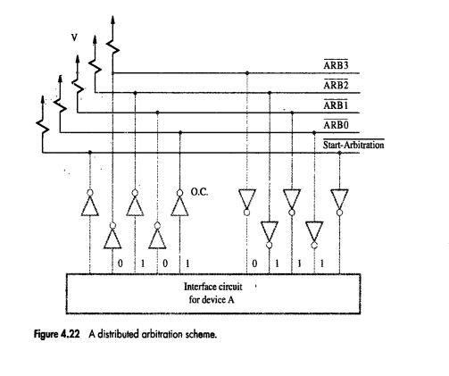
DIRECT MEMORY ACCESS
1 or 0 is 1
But as it is
The device which has sent ‘1’ will win
$$\overline{ARB3}$$
DISTRIBUTED BUS ARBITRATION
Every device participates in arbitration.
1
0
1
0
0
1

Slide 88
BUSES

Slide 89
BUSES
TYPES of BUSES
SYNCHRONOUS
ASYNCHRONOUS

Slide 90
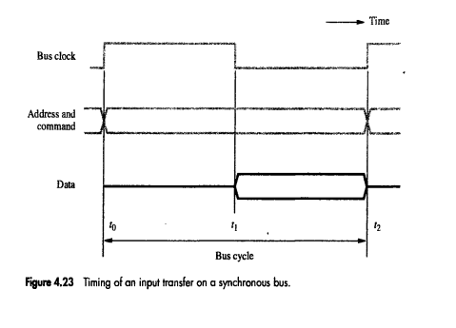
BUSES
TYPES of BUSES
SYNCHRONOUS
ASYNCHRONOUS
INPUT TRANSFER IN SYNCHRONOUS BUS

Slide 91
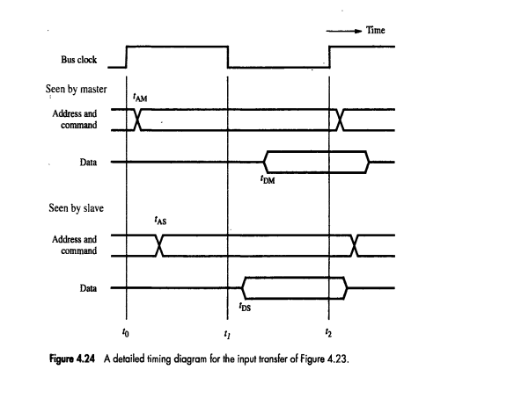
BUSES
TYPES of BUSES
SYNCHRONOUS
ASYNCHRONOUS
INPUT TRANSFER IN SYNCHRONOUS BUS

Slide 92
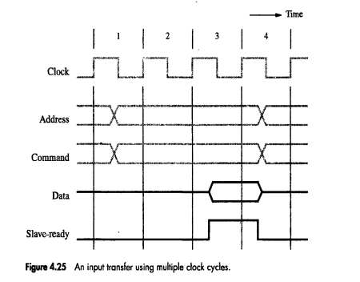
BUSES
TYPES of BUSES
SYNCHRONOUS
ASYNCHRONOUS
INPUT TRANSFER IN SYNCHRONOUS BUS with MULTIPLE CYCLES

Slide 93
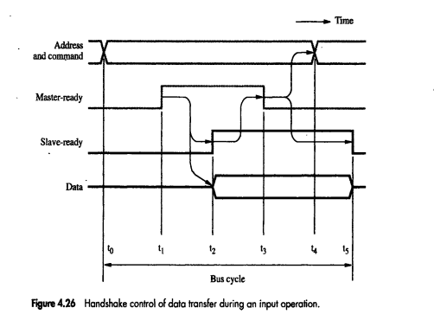
BUSES
TYPES of BUSES
SYNCHRONOUS
ASYNCHRONOUS
INPUT TRANSFER IN ASYNCHRONOUS BUS

Slide 94
INTERFACE CIRCUITS

Slide 95
INTERFACE CIRCUITS
I/O INTERFACE: Is the circuitry required to connect I/O device to Computer.
COMPUTER
I
N
T
E
R
F
A
C
E
TO CONNECT I/O DEVICE
BUS
P
O
R
T
TO READ/WRITE DATA FROM INTERFACE

Slide 96
INTERFACE CIRCUITS
I/O INTERFACE: Is the circuitry required to connect I/O device to Computer.
COMPUTER
I
N
T
E
R
F
A
C
E
TO CONNECT I/O DEVICE
BUS
P
O
R
T
TO READ/WRITE DATA FROM INTERFACE

Slide 97
INTERFACE CIRCUITS
Functions of I/O Interface:
STORAGE BUFFER: For at least one word of data.
STATUS FLAG : For processor to decide whether the BUFFER is FULL.
ADDRESS DECODING: To verify whether address sent by PROCESSOR is its own or not.
TIMING SIGNAL generation
FORMAT CONVERSION: From Bus to I/O device.

Slide 98
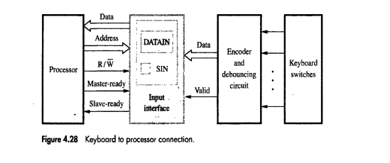
INTERFACE CIRCUITS
Parallel Port
8 bits are sent in parallel.
KEYBOARD-to-PROCESSOR CONNECTION

Slide 99
INTERFACE CIRCUITS
Parallel Port
Generates ASCII CODE for the Key Pressed
8 bits are sent in parallel.
KEYBOARD-to-PROCESSOR CONNECTION

Slide 100
INTERFACE CIRCUITS
Parallel Port
8 bits are sent in parallel.
Key Pressed should be considered only once.
KEYBOARD-to-PROCESSOR CONNECTION

Slide 101
INTERFACE CIRCUITS
Parallel Port
8 bits are sent in parallel.
1 when key is pressed and data is ready.
KEYBOARD-to-PROCESSOR CONNECTION

Slide 102
INTERFACE CIRCUITS
Parallel Port
8 bits are sent in parallel.
DATAIN: ASCII value stored.
SIN: 1 when data is stored in DATAIN.
KEYBOARD-to-PROCESSOR CONNECTION

Slide 103
INTERFACE CIRCUITS
Parallel Port
8 bits are sent in parallel.
Master Ready and Slave Ready for Asynchrous Communication
KEYBOARD-to-PROCESSOR CONNECTION

Slide 104
INTERFACE CIRCUITS
Parallel Port
8 bits are sent in parallel.
1: Read operation
0: Write Operation
KEYBOARD-to-PROCESSOR CONNECTION

Slide 105
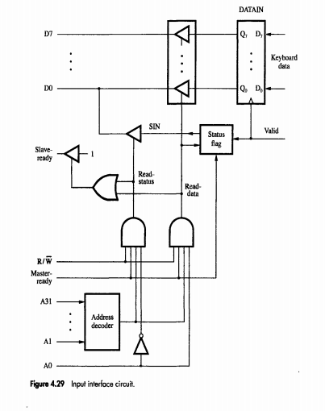
INTERFACE CIRCUITS
Parallel Port
8 bits are sent in parallel.
8 bit Data Line
INPUT INTERFACE CIRCUIT

Slide 106
INTERFACE CIRCUITS
Parallel Port
8 bits are sent in parallel.
32 bit Address Line
INPUT INTERFACE CIRCUIT

Slide 107
INTERFACE CIRCUITS
Parallel Port
SIN connected to DATA LINE D0
8 bits are sent in parallel.
Status Flag
Slave Ready
Read/Write
Master Ready
INPUT INTERFACE CIRCUIT

Slide 108
INTERFACE CIRCUITS
Parallel Port
Two Types of Operations
1. Read the Status (SIN)
2.Read the Data in DATAIN
INPUT INTERFACE CIRCUIT

Slide 109
INTERFACE CIRCUITS
Parallel Port
Two Types of Operations
1. Read the Status (SIN) (A0=0)
2.Read the Data in DATAIN (A0=1)
1
1
0
1
1
1
Master Ready=1
1
1
Processor has kept address of Keyboard on address bus.
0
A0=0
INPUT INTERFACE CIRCUIT

Slide 110
INTERFACE CIRCUITS
Parallel Port
Processor will read SIN from Data Line D0
Two Types of Operations
1. Read the Status (SIN) (A0=0)
2.Read the Data in DATAIN (A0=1)
1
1
0
R/$\overline{W}$=1
1
TRI-STATE BUFFER WILL BE ACTIVATED
1
Master Ready=1
0
1
1
Processor has kept address of Keyboard on address bus.
A0=0
INPUT INTERFACE CIRCUIT

Slide 111
INTERFACE CIRCUITS
Parallel Port
Two Types of Operations
1. Read the Status (SIN) (A0=0)
2.Read the Data in DATAIN (A0=1)
1
0
1
1
1
1
Master Ready=1
1
0
Processor has kept address of Keyboard on address bus.
1
A0=1
INPUT INTERFACE CIRCUIT

Slide 112
INTERFACE CIRCUITS
Parallel Port
Two Types of Operations
1. Read the Status (SIN) (A0=0)
2.Read the Data in DATAIN (A0=1)
Processor will read DATAIN from Data Lines D0 to D7
1
0
1
R/$\overline{W}$=1
TRI-STATE BUFFER WILL BE ACTIVATED
1
1
Master Ready=1
1
0
Processor has kept address of Keyboard on address bus.
1
A0=1
INPUT INTERFACE CIRCUIT

Slide 113
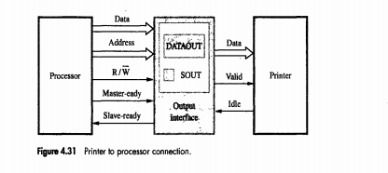
INTERFACE CIRCUITS
Parallel Port
PRINTER TO PROCESSOR CONNECTION

Slide 114
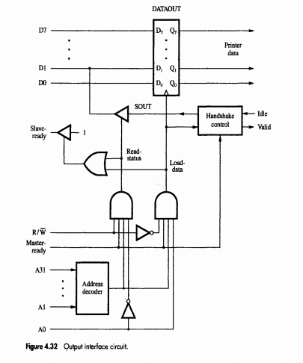
INTERFACE CIRCUITS
Parallel Port
Two Types of Operations
1. Read the Status (SIN) (A0=0)
2.WRITE the Data to DATAOUT (A0=1 and R/$\overline{W}=0$)
1
1
1
0
1
Master Ready=1
1
1
1
Processor has kept address of Printer on address bus.
0
A0=0
OUTPUT INTERFACE CIRCUIT

Slide 115
INTERFACE CIRCUITS
Parallel Port
Two Types of Operations
1. Read the Status (SIN) (A0=0)
2.WRITE the Data to DATAOUT (A0=1 and R/$\overline{W}=0$)
Processor will read SOUT from Data Lines D0
1
1
0
TRI-STATE BUFFER WILL BE ACTIVATED
R/$\overline{W}$=1
1
Master Ready=1
1
1
1
Processor has kept address of Printer on address bus.
0
A0=0
OUTPUT INTERFACE CIRCUIT

Slide 116
INTERFACE CIRCUITS
Parallel Port
Two Types of Operations
1. Read the Status (SIN) (A0=0)
2.WRITE the Data to DATAOUT (A0=1 and R/$\overline{W}=0$)
1
0
0
1
1
Master Ready=1
1
1
0
Processor has kept address of Printer on address bus.
1
A0=1
OUTPUT INTERFACE CIRCUIT

Slide 117
INTERFACE CIRCUITS
Parallel Port
Two Types of Operations
1. Read the Status (SIN) (A0=0)
2.WRITE the Data to DATAOUT (A0=1 and R/$\overline{W}=0$)
Data in lines D0-D7 are sent to PRINTER
1
0
1
TRI-STATE BUFFER WILL BE ACTIVATED
R/$\overline{W}$=0
1
Master Ready=1
1
1
0
Processor has kept address of Printer on address bus.
1
A0=1
OUTPUT INTERFACE CIRCUIT

Slide 118
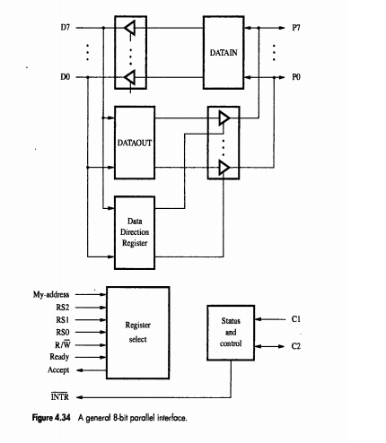
INTERFACE CIRCUITS
General 8 bit Parallel Port

Slide 119
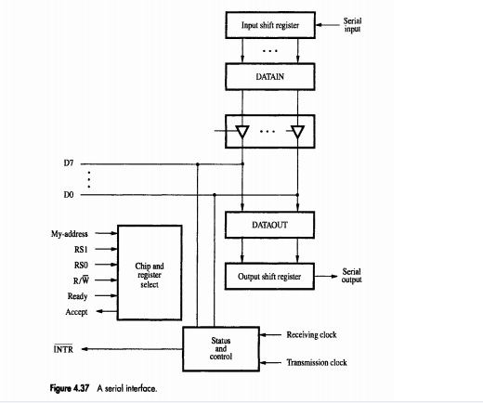
INTERFACE CIRCUITS
Serial Port

