Slide 1
MODULE-III MEMORY SYSTEMS
ASHWINI J P
By,
Mrs. Ashwini Janagal
Department of AIML
JNN College of Engineering

Slide 2
BASIC CONCEPTS

Slide 3
BASIC CONCEPTS
Programs and the data that they operate on are stored in memory.
EXECUTION SPEED - Depends on SPEED with which Instructions and Data move between MEMORY and PRECESSOR
IDEAL Memory
High Speed
Large
Inexpensive

Slide 4
BASIC CONCEPTS
In Real World
High Speed ---- Very Costly -- So we can offord only SMALL size
Low Speed ---- Very Cheap -- We can Offord LARGE size.

Slide 5
BASIC CONCEPTS
How much memory can be used in a computer?
Depends on Adressing Scheme.
Ex 1: 16 bit Address Line --> 2¹⁶ = 64K(kilo) memory (K=2¹⁰)
Ex 2: 32 bit Address Line --> 2³² = 4G(Giga) memory (G=2³⁰)
Ex 3: 40 bit Address Line --> 2⁴⁰ = 1T(Tera) memory (T=2⁴⁰)

Slide 6
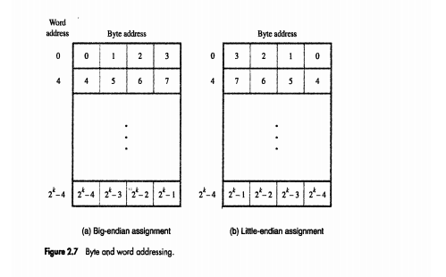
BASIC CONCEPTS
Most Modern Computers are BYTE ADDRESSABLE.
‘k’ address bit. Address for each Byte.
Big Endian: Used in 68000
Little Endian: INTEL

Slide 7
SEMICONDUCTOR RAM MEMORIES

Slide 8
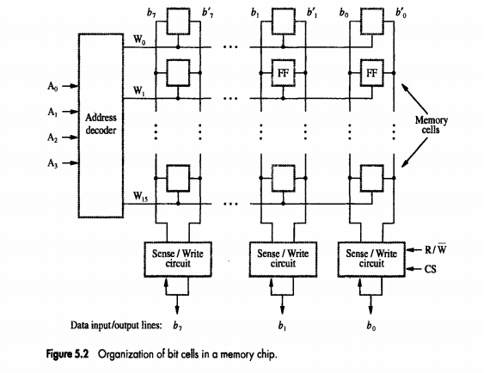
SEMICONDUCTOR RAM MEMORIES
Wide range of Speed - 100ns to 10ns.
VLSI technology led to cost reduction.
INTERNAL ORGANIZATION
Memory Cell - Capable to store 1 bit.
Arranged as array (Two Dimensional)

Slide 9
SEMICONDUCTOR RAM MEMORIES
WORD LINE
BIT LINE
(SENSE for READ)

Slide 10
SEMICONDUCTOR RAM MEMORIES
16 words and 8 bits per word
16×8 memory.
Total 128 bits.
4 address lines+ 8 data lines+ R/W +CS(Chip Select)= 14 external lines.

Slide 11
SEMICONDUCTOR RAM MEMORIES
What are the different ways in which 1K (1024) memory cells can be arranged?
128×8
ADDRESS
DECODER
w0
w1
ADDRESS LINES
w128
7 Address Lines+ 8 Data LInes+ Read Write+Chip Select = 17 Lines

Slide 12
SEMICONDUCTOR RAM MEMORIES
What are the different ways in which 1K (1024) memory cells can be arranged?
1K×1 Organization
10 Address Lines+ 1 Data LInes+ Read Write+Chip Select = 13 Lines

Slide 13
SEMICONDUCTOR RAM MEMORIES
How can you arrange 4M memory?
512K×8 Organization
How many External Lines are required for this implementation?

Slide 14
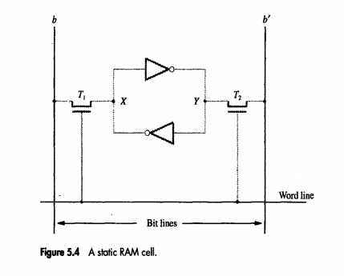
SEMICONDUCTOR RAM MEMORIES
What is STATIC MEMORY?
Memories capable of storing the the contents as long as power is available.
LATCH
TRANSISTOR
TRANSISTOR
b - Bit Value
b` - Bit Complement
When Word line is GROUND
then b=0 then b`=1
And it is retained as long as power supply is there

Slide 15
SEMICONDUCTOR RAM MEMORIES
What is STATIC MEMORY?
Memories capable of storing the the contents as long as power is available.
READ OPERATION
Close switched T1 and T2.
Sense/write line will sense values of b and b`

Slide 16
SEMICONDUCTOR RAM MEMORIES
What is STATIC MEMORY?
Memories capable of storing the the contents as long as power is available.
WRITE OPERATION
Sense/write line will put appropriate value at b and b` (1 or 0)
Then Activate the word line.

Slide 17
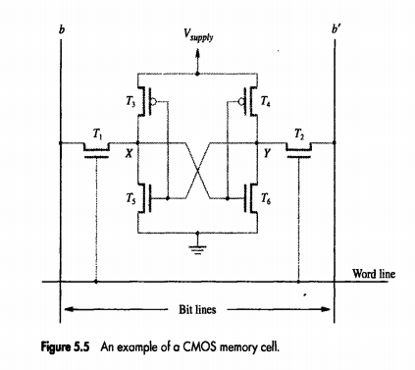
SEMICONDUCTOR RAM MEMORIES
What is STATIC MEMORY?
Memories capable of storing the the contents as long as power is available.
Transistor Pairs (T3, T5), (T4,T6) form the inverters of the latch.
For ‘1’: T3 and T6 are on.
(b=1 and b`=0)
For ‘0’: T5 and T4 are on
(b=0, b`=1)

Slide 18
SEMICONDUCTOR RAM MEMORIES
5V in older version
3V in newer version
What is STATIC MEMORY?
Memories capable of storing the the contents as long as power is available.
Transistor Pairs (T3, T5), (T4,T6) form the inverters of the latch.
For ‘1’: T3 and T6 are on.
(b=1 and b`=0)
For ‘0’: T5 and T4 are on
(b=0, b`=1)

Slide 19
SEMICONDUCTOR RAM MEMORIES
ASYNCHRONOUS DRAMS
SRAMS need lot of transistors.
Therefore we use Dynamic RAMS
What is DYNAMIC RAM?
Memory cells which can’t store the value indefinitely.
Periodic Refreshment Required
Cheaper compared to SRAMS

Slide 20
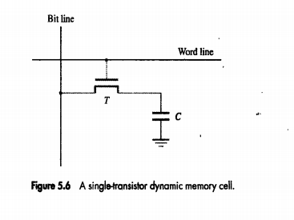
SEMICONDUCTOR RAM MEMORIES
ASYNCHRONOUS DRAMS
SRAMS need lot of transistors.
Therefore we use Dynamic RAMS
CHARGE IS RETAINED FOR JUST 10 MILLI SECONS
Information is stored in the form of charge on capacitor
What is DYNAMIC RAM?
Memory cells which can’t store the value indefinitely.
Periodic Refreshment Required
Cheaper compared to SRAMS

Slide 21
SEMICONDUCTOR RAM MEMORIES
ASYNCHRONOUS DRAMS
READ OPERATION
Switch on TRANSISTOR and apply proper VOLTAGE to CAPACITOR.
Once TRANSISTOR is switched off CAPACITOR will start to discharge.
So periodically it shouold be refreshed after it id discharged to a threshold.
SENSE AMPLIFIER will sence the charge and if it goes beyond a threshold appropriate actions will be taken.

Slide 22
SEMICONDUCTOR RAM MEMORIES
ASYNCHRONOUS DRAMS
READ OPERATION
Switch on TRANSISTOR and apply proper VOLTAGE to CAPACITOR.
Once TRANSISTOR is switched off CAPACITOR will start to discharge.
So periodically it shouold be refreshed after it id discharged to a threshold.
SENSE AMPLIFIER will sence the charge and if it goes beyond a threshold appropriate actions will be taken.

Slide 23
SEMICONDUCTOR RAM MEMORIES
ROW ADDRESS STROBE
ROW address is put first here
SELECTED ROW will be READ and REFRESHED
2¹²=4096
2⁹=512
ROW ADDRESS STROBE
COLUMN address is put here

Slide 24
SEMICONDUCTOR RAM MEMORIES
Refrshing has to happen PERIODICALLY
A REFRESH CIRCUIT will take care of it.
RAS and CAS are active low and they are used for asynchronous communication.
SELECTED ROW will be READ and REFRESHED

Slide 25
SEMICONDUCTOR RAM MEMORIES
DRAMS are widely used because of their
High Density
Low Cost
Different Organizations
Ex: 64 Mbit can be organized as 16M×4, 8M×8 or 4M ×16.

Slide 26
SEMICONDUCTOR RAM MEMORIES
FAST PAGE MODE
To read a BYTE
First you select the row (4096 bits)
Next you select one BYTE (8 bits) from it.
If Processor wants to read NEXT BYTE from SAME ROW
Then once again SAME ROW is SELECTED(4096 bits)
And the process continues...
WHY SELECT SAME ROW TWO TIMES??????

Slide 27
SEMICONDUCTOR RAM MEMORIES
FAST PAGE MODE
LOGIC: Send BYTES in SEQUENCE.
SEND Row Address ONLY ONCE
Read BYTES sequentially with successive CAS signal
WHY SELECT SAME ROW TWO TIMES??????

Slide 28
SEMICONDUCTOR RAM MEMORIES
SYNCHRONOUS DRAMS (SDRAMS)
DRAMS which works in synchronization with CLOCK SIGNALS.

Slide 29
SEMICONDUCTOR RAM MEMORIES
SYNCHRONOUS DRAMS (SDRAMS)
Various Modes of Operation
Single Word Transfer
Burst Transfer
No need to send CAS for every column transfer.
Column Counter and Clock Signals are used internally for burst transfer
Refreshes Every 64ms

Slide 30
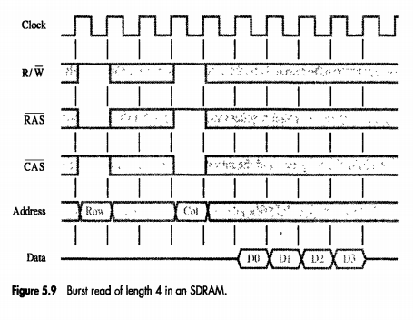
SEMICONDUCTOR RAM MEMORIES
ROW ADDRESS is placed when RAS is LOW
(2 to 3 clock cycles are required)
COLUMN ADDRESS is placed when CAS is LOW
After 1 cycle of keeping column address data bits are placed on data bus

Slide 31
SEMICONDUCTOR RAM MEMORIES
In Commercial SDRAMs Clock Speed is Above 100Mhz
SDRAM will automatically increment and read next 3 sets of data bits
ROW ADDRESS is placed when RAS is LOW
(2 to 3 clock cycles are required)
COLUMN ADDRESS is placed when CAS is LOW
After 1 cycle of keeping column address data bits are placed on data bus

Slide 32
SEMICONDUCTOR RAM MEMORIES
Latency and Bandwidth
Transfer between Memory and Processor can take place in different sizes.
Single Word
Small Block of Words
Large Block of Words
Pages of Data

Slide 33
SEMICONDUCTOR RAM MEMORIES
Memory Latency
Amount of time it takes to transfer a WORD of data to or from memory.
For reading one WORD this is the complete performance indication.

Slide 34
SEMICONDUCTOR RAM MEMORIES
Memory Bandwidth
For Burst Transfer, performance depends on
Rate at Which Successive Words are transfered
Size of Block.
As block size varies, we measure it in “NUMBER OF BITS/BYTES PER SECOND” known as BANDWIDTH.
BANDWIDTH depends on
Memory Speed, Processor Speed and Transfer Link Speed.(Rate of Transfer, Acess and Width of Bus)

Slide 35
SEMICONDUCTOR RAM MEMORIES
DOUBLE DATA RATE SDRAM
Instead of TRANSFERING on START OF POSITIVE EDGES
TRANSFER on start of POSITIVE as well NEGATIVE EDGES - BANDWIDTH will be DOUBLED
They are called DOUBLE DATA RATE SDRAMS
IMPLEMENTATION
Cell Array is Arranged in two banks which can be accessed separately.
CONSECUTIVE WORDS stored in SEPARATE BANKS - INTERLEAVING organization.
Two consecutive words can be accessed in one clock cyle (in both edges).

Slide 36
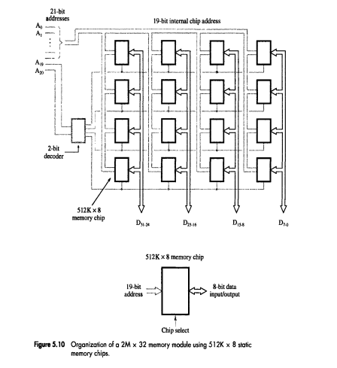
SEMICONDUCTOR RAM MEMORIES
STRUCTURE OF LARGE MEMORIES
STATIC MEMORY CHIPS
2M Words(32 bit each) from 512K×8 Static RAM memory Chips.
19 bits to address 512K
2 bits to address 4 rows - Chip Select (CS)
1 row = 512K ×32
512 Words
4 rows = (512×1024 ×4) Words
2097152=2M words

Slide 37
SEMICONDUCTOR RAM MEMORIES
STRUCTURE OF LARGE MEMORIES
DYNAMIC MEMORY CHIPS
Organization is same as Static Memory Chips.
Large Memories are avaialable - So difficult to place on MOTHERBOARD.
Single Inline Memory Module (SIMMs)
Dual Inline Memory Module (DIMMs).
Several Memory Chips placed on SEPARATE BOARD that is pugged through single socket to MOTHERBOARD
4M×32, 16M×32 and 32M×32 DIMMs are all can connected through 100-pin socket
8M×64, 16M×64 and 32M×64 DIMMs are all can connected through 168-pin socket

Slide 38
SEMICONDUCTOR RAM MEMORIES
MEMORY SYSTEMS CONSIDERATIONS
Factors affecting the choice of Memory Chip
Cost
Speed
Power Dissipation
Size of chip
Static RAMS used only when application requires speed - as it is costly - Used in CACHE MEMORIES
Dynamic RAM - Most widely Used

Slide 39
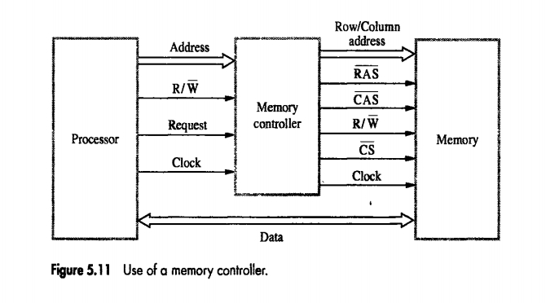
SEMICONDUCTOR RAM MEMORIES
MEMORY SYSTEMS CONSIDERATIONS
MEMORY CONTROLLER
Dynamic RAM memory chips -- MULTIPLEXED ADDRESS INPUTS
Adress is devided as
ROW Adress - Controlled by RAS
COLUMN Address - Controlled by CAS
PROCESSOR sends complete Adress
Multiplexing of Address Bits is done by MEMORY CONTROLLER

Slide 40
SEMICONDUCTOR RAM MEMORIES
MEMORY SYSTEMS CONSIDERATIONS
REFRESH OVERHEAD
Dynamic Memories have to be refreshed.
Older DRAMS - Refresh period was 16ms
Newer DRAMS - Refresh Period is 64ms.
If a SDRAM is arranged in 8K rows. (8*1024= 8192 )
It takes 4 Cycles to read 1 Row
8192 * 4 = 32768 cycles to refresh whole memory
If CLOCK RATE=133Mhz
Time to Refresh All rows = 32768/133*10⁶ = 246*10⁻⁶ = 0.246ms in every 64ms

Slide 41
SEMICONDUCTOR RAM MEMORIES
MEMORY SYSTEMS CONSIDERATIONS
RAMBUS BUS
Bus Speed NOT ONLY depends on chip organization but, also on CONNECTING BUS
A normal synchronous bus at speed 133Mhz can do one TRANSFER at 7.5ns, or 2 transfer if both the edges are used.
If we increase the WIDTHof the bus, then it will take lots of SPACE on MOTHERBOARD
ALTERNATIVE - Use NARROW BUS with HIGH SPEED
Proprietery design by Rambus Inc. called RAMBUS BUS.

Slide 42
SEMICONDUCTOR RAM MEMORIES
MEMORY SYSTEMS CONSIDERATIONS
RAMBUS BUS
Usual Bus : Voltage Level : Bit ‘0’ by 0 and Bit ‘1’ by ‘V_{sup}’
In RAMBUS BUS: Voltage below V_{ref} is ‘0’ and above V_{ref} is ‘1’.
Reference Voltage is 2V. Swing will be just 0.3v above or below.
Small Voltage Swing: Tansition Time will be less.
Rambus has provided the complete standards for these channels.
Current speed is 400Mhz with SINGLE EDGE and 800Mhz with DOUBLE EDGE

Slide 43
SEMICONDUCTOR RAM MEMORIES
MEMORY SYSTEMS CONSIDERATIONS
RAMBUS BUS
Original Specification : 9 Data lines and some control lines
9 Data LInes : 8 for Transfering 1 Byte + 1 for Parity
TWO CHANNEL RAMBUS: Called Direct RDRAM -> 18 Data Lines
MASTER-SLAVE communication:
PROCESSOR -> MASTER
RDRAM -> SLAVE
COMMUNICATION: Happens Through PACKETS

Slide 44
SEMICONDUCTOR RAM MEMORIES
MEMORY SYSTEMS CONSIDERATIONS
RAMBUS BUS
COMMUNICATION: Happens Through PACKETS
Three Types of Packets
REQUEST
ACKNOWLEDGE
DATA
Sent By MASTER
Indicates TYPE OF OPERATION
Information Sent
Desired MEMORY ADDRESS
NUMBER OF BYTES : Specified in 8 bit count
After receiving REQUEST address SLAVE will send
POSITIVE ACKNOWLEDGE - If it is READY
BUSY signal - If not Possible
Each Packet transferMay take MULTIPLE CLOCK CYCLE

Slide 45
SEMICONDUCTOR RAM MEMORIES
MEMORY SYSTEMS CONSIDERATIONS
RAMBUS BUS
Similar to SIMMs and DIMMs they have RIMMs which can hold upto 16 RDRAMS.

Slide 46
READ-ONLY MEMORIES

Slide 47
READ ONLY MEMORIES
RAM memories are volatile.
What if I want my memory to retain the information even when power is off?
For example:
Hard Disk stores data even when power is not there.
Even your OS is stored in Hard Disk.
When you switch on machine, OS has to be transfered from Hard Disk to RAM. Who will do that?(This is known as BOOTING)

Slide 48
READ ONLY MEMORIES
When you switch on machine, OS has to be transfered from Hard Disk to RAM. Who will do that?
BOOTING is a big program which is once again stored in Hard disk. Who will transfer it to RAM?
BOOT DISK: A small amount of NON-VOLATILE memory, where starting parts of BOOT Program is saved.

Slide 49
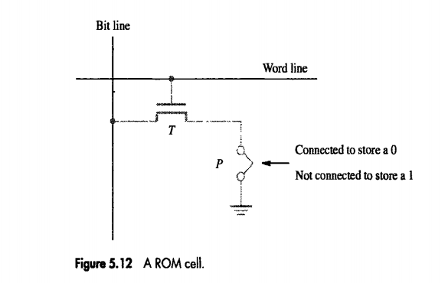
READ ONLY MEMORIES
There are many types of NON-VOLATILE memory.
One, which just allows READ operation is READ-ONLY MEMORY (ROM).

Slide 50
READ ONLY MEMORIES
DATA is WRITTEN when it is manufactured.
TYPES
PROM (Programmable ROM)
EPROM(Erasable Programmable ROM))
EEPROM (Electrically Erasable Programmable ROM)
FLASH Memory

Slide 51
READ ONLY MEMORIES
PROM (Programmable ROM)
A fuse is kept at point p.
Initially all the cells have ‘0’
Wherever you want to store ‘1’, burn the fuse of such cells.
PROS and CONS
Economically cheaper compared to ROM.

Slide 52
READ ONLY MEMORIES
EPROM (Erasable Programmable ROM)
Fuse is replaced by transistor.
By inducting a small charge it works as permanent open switch (bit ‘0’)
Pros: Contents can be erased and programmed.
ERASE OPERATION: Charge in transistor can be dissipated by exposure to ULTRAVIOLET Light.
Cons: Only one cell at a time.

Slide 53
READ ONLY MEMORIES
EEPROM (Electrically Erasable Programmable ROM)
Programming and Erasing with different Voltage Levels.

Slide 54
READ ONLY MEMORIES
FLASH MEMORY
Technology derived from EEPROM.
Flash Cell - Single Transistor with trapped charge.
EEPROM- READ and WRITE ONE CELL
FLASH - READ and Write one BLOCK.
If you have to write a sinlgle cell - NOT POSSIBLE in Flash memory. You have to write WHOLE BLOCK.
PROS: Higher Density and Less Cost.
Very Attractive for portable devices. Camera, MP3 players etc.

Slide 55
READ ONLY MEMORIES
FLASH CARD
Flash Chip on a Small Card.
Variety of Sizes : 8, 32 or 64 MBytes.
64MBytes can store : 1 Hour of music.
FLASH DRIVES
Can replace Hard Disk Drives. But current size is less than 1 Giga Byte.
Disadvantage: Compared to Hard Disk they are costlier.
They may deteriorate after some point: May be after millions of write operation.

Slide 56
SPEED SIZE AND COST

Slide 57
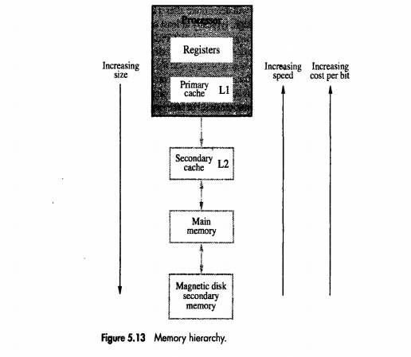
SPEED, SIZE and COST
Ideally SRAMs are best if you consider SPEED. But they are very COSTLY.
Alternative is DRAM. But they are SLOW.
Even Though DRAMs are CHEAP, They are NOT CHEAP enough to BUY 100s of GAGABYTES.
Alternative is SECONDARY STORAGE.
They are VERY SLOW, but they can be bought in LARGE QUANTITY as they are very CHEAP.
Entire MEMORY SYSTEM is arranged as a HIERACHY.
Connected With the Help of SIMMS, DIMMS or RIMMS

Slide 58
CACHE MEMORIES
Mapping Functions

Slide 59
CACHE MEMORIES - Mapping Functions
Main Memory is very SLOW compared to current processor technology.
CACHE MEMORY: Make MAIN MEMORY appear faster for PROCESSOR
CACHE MEMORY works on the concept of LOCALITY OF REFERENCE.

Slide 60
CACHE MEMORIES - Mapping Functions
LOCALITY OF REFERENCE
Few Instructions are executed REPEATEDLY.
Instructions in LOOPS
Instructions ina SUBROUTINE which is called repeatedly.
Other instructions may be executed only once or may not even be executed.

Slide 61
CACHE MEMORIES - Mapping Functions
LOCALITY OF REFERENCE
How do you find out which instruction will be repeated?
Two Aspects:
TEMPORAL
SPATIAL
CHANCES are that : Recently Executed Instruction may be repeated
CHANCES are that : Instructions near to the Recently Executed Instruction may be executed next.

Slide 62
CACHE MEMORIES - Mapping Functions
If ACTIVE SEGMENTS of the program are kept in CACHE memory, them SPEED of EXECUTION can be enhanced.
TEMPORAL:
When Some Instruction/Data is executed for the first time, it will be transfered from RAM to CACHE
But, It will NOT BE deleted after the execution, as chances are there that same instruction will be executed repeatedly (May be it’s part of a loop)

Slide 63
CACHE MEMORIES - Mapping Functions
SPATIAL:
When Some Instruction/Data is to be copied, instead of copying just one information, several adjacent informations will be copied together as they may be required in future.

Slide 64
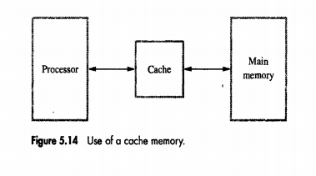
CACHE MEMORIES - Mapping Functions
When PROCESSOR wants to READ a memory, it sends the address and that block will be transferred from Main Memory to Cache word by word.

Slide 65
CACHE MEMORIES - Mapping Functions
Next time when PROCESSOR wants something from that block, it will access it directly from CACHE.

Slide 66
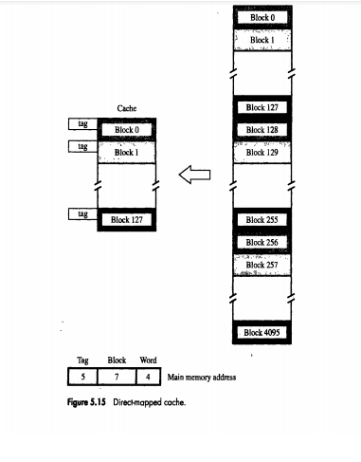
CACHE MEMORIES - Mapping Functions
Next time when PROCESSOR wants something from that block, it will access it directly from CACHE.

Slide 67
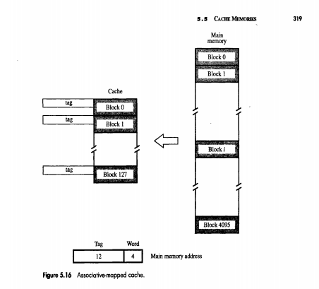
CACHE MEMORIES - Mapping Functions
Next time when PROCESSOR wants something from that block, it will access it directly from CACHE.

Slide 68
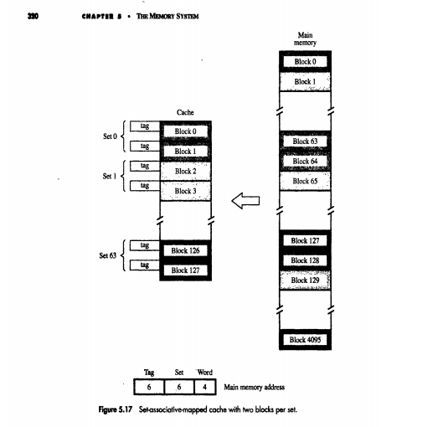
CACHE MEMORIES - Mapping Functions
Next time when PROCESSOR wants something from that block, it will access it directly from CACHE.

Slide 69
VIRTUAL MEMORIES

Slide 70
VIRTUAL MEMORIES
In modern computers PHYSICAL MEORY will not be as large as spanned by the processor.
Ex:
If processor sends 32 bit address, then MAIN MEMORY size should be 4GB.
But in reality your RAM size may be just 1GB.

Slide 71
VIRTUAL MEMORIES
Parts of the programs are kept in RAM and remaining when required will be transfered from SECONDARY MEMORY to RAm by OS.
Which block to move, which one to remove from RAMetc. will be decided and done by OS.

Slide 72
VIRTUAL MEMORIES
VIRTUAL MEMORY TECHNIQUE
Techniques that automatically move Program and Data Blocks into Physical Main Memory When they are required for execution.
There are two types of addresses
1. Virtual or Logical Address
2. Physical Address
Binary Address Sent by PROCESSOR
Translated Address by MMU (Memory Management Unit)

Slide 73
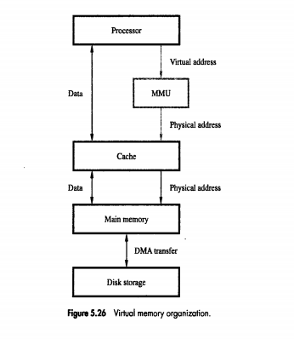
VIRTUAL MEMORIES
VIRTUAL MEMORY TECHNIQUE
Techniques that automatically move Program and Data Blocks into Physical Main Memory When they are required for execution.
There are two types of addresses
1. Virtual or Logical Address
2. Physical Address

Slide 74
VIRTUAL MEMORIES
ADDRESS TRANSLATION
Programs and Data are stored in UNIT of MEMORY called PAGE.
PAGEs are of FIXED LENGTH.
Normally they range from 2K to 16KBytes.
Basic unit moved from SECONDARY MEMORY to RAMis PAGE.
PAGES can;t be very small: Time taken to LOCATE a page in Hard Disk is MORE.

Slide 75
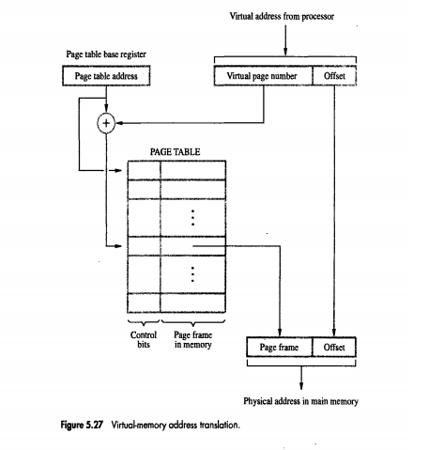
VIRTUAL MEMORIES
ADDRESS TRANSLATION
Programs and Data are stored in UNIT of MEMORY called PAGE.
PAGEs are of FIXED LENGTH.
Normally they range from 2K to 16KBytes.
Basic unit moved from SECONDARY MEMORY to RAMis PAGE.
PAGES can;t be very small: Time taken to LOCATE a page in Hard Disk is MORE.

