Slide 1
MODULE-V PIPELINE AND VECTOR PROCESSING
By,
Mrs. Ashwini Janagal
Department of AIML
JNN College of Engineering

Slide 2
PARALLEL PROCESSING

Slide 3
Parallel Processing
Parallel processing is a term used to denote a large class of techniques that are used to provide simultaneous data-processing tasks for the purpose of increasing the computational speed of a computer system
The purpose of parallel processing is to speed up the computer processing capability and increase its throughput, that i.s, the amount of processing that can be accomplished during a given interval of time.

Slide 4
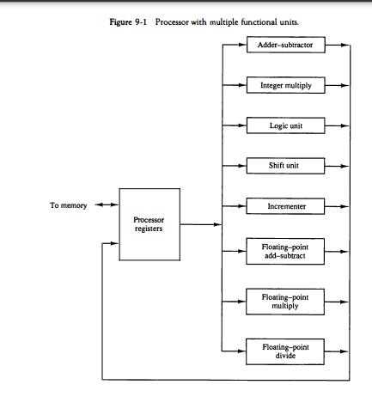
Parallel Processing
SEPARATE EACH EXECUTION UNIT SUCH THAT THEY CAN OPERATE IN PARALLEL

Slide 5
Parallel Processing
Classification according to M. J. Flynn
Single Instruction Single Data
Single Instruction Multiple Data
Multiple Instruction Single Data
Multiple Instruction Multiple DAta

Slide 6
Pipelining
Divide Sequential Process into Sub-process.
Each subprocess belong to a segment
And segments can be executed in parallel
But there will be dependency between segments.
Output from one segment will be the Input to other segment.

Slide 7
Pipelining
Example

Slide 8
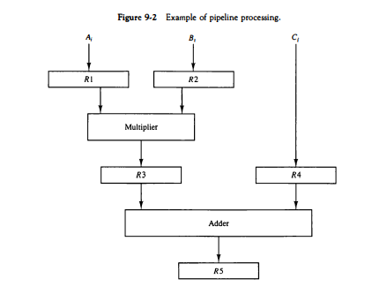
Pipelining
Example

Slide 9
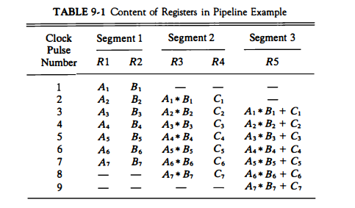
Pipelining
Example

Slide 10
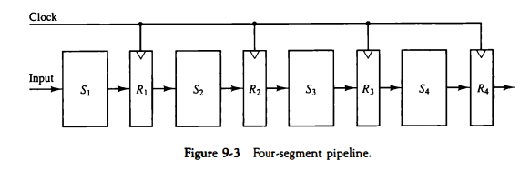
Pipelining
The technique is efficient for those applications that need to repeat the same task many times with different sets of data.

Slide 11
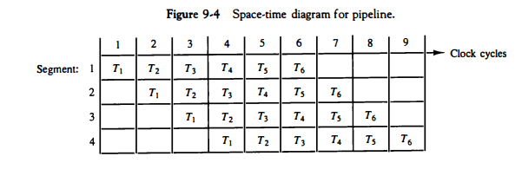
Pipelining
TASK: TOTAL OPERATION Performed going THROUGH ALL SEGMENTS of PIPELINE
Tasks=6
Segments=4

Slide 12
Pipelining
TASK: TOTAL OPERATION Performed going THROUGH ALL SEGMENTS of PIPELINE
Tasks=6
Segments=4
If we have
n- Tasks
k- Segments
t_{p} clock cyle in each segment

Slide 13
Pipelining
TASK: TOTAL OPERATION Performed going THROUGH ALL SEGMENTS of PIPELINE
If we have
n- Tasks
k- Segments
t_{p} clock cyle in each segment
Tasks=6
Segments=4
If we have
n- Tasks
k- Segments
t_{p} clock cyle in each segment

Slide 14
Arithmetic Pipelining
Pipeline concept in ALU.
Mostly used for Floating point operations.
Floating point addition/subtraction can be divided into 4 parts.
Compare the exponents.
Align the Mantissa.
Add/Subtract Mantissa
Normalize the result
Example
1) 8.70 × 10⁻¹ + 9.95 × 10¹
2) 8.70 × 10⁻¹ = 0.087 × 10¹
3) 0.087 × 10¹ + 9.95 × 10¹
4) 10.037 × 10¹
5)10.037 × 10¹ = 1.0037 × 10²

Slide 15
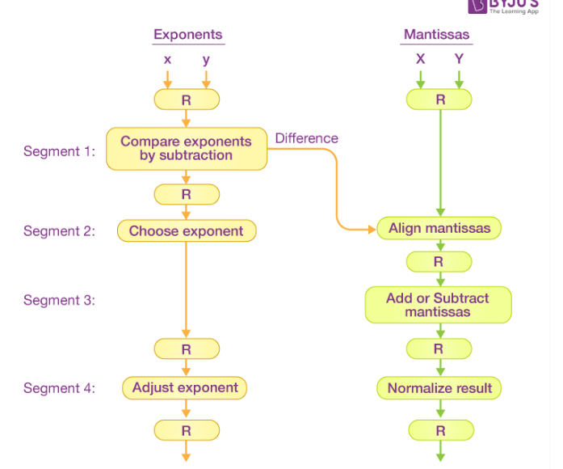
Arithmetic Pipelining

Slide 16
Instruction Pipelining
An instruction pipeline reads consecutive instructions from memory while previous instructions are being executed in other segments.
Instruction Execution Steps
Fetch the instruction from memory.
Decode the instruction.
Calculate the effective address.
Fetch the operands from memory.
Execute the instruction.
Store the result in the proper place

Slide 17
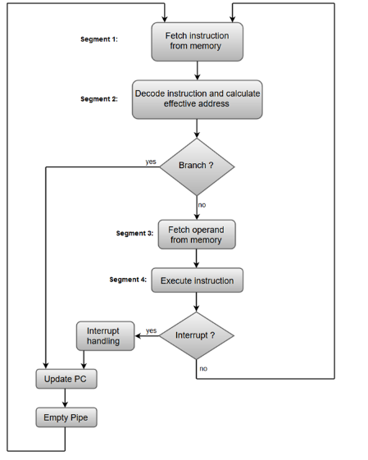
Instruction Pipelining
Example:
4 Segment Instruction Pipeline

Slide 18
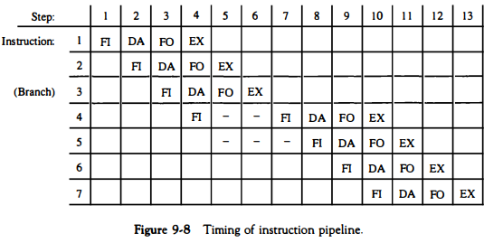
Instruction Pipelining
FI: Fetch Instruction
DA: Decode and Calculates Effective Address
FO: Fetch OPerands
EX: Execute

Slide 19
Instruction Pipelining
Difficulties to Implement iNstruction Pipelining
Resource Conflict: Access to memory by different segments at same time
Data Dependence : Instruction depends on output of previous instruction
Branch Difficulties: Branch Instruction that will change the value of PC.

Slide 20
Instruction Pipelining
Difficulties to Implement iNstruction Pipelining
Resource Conflict: Access to memory by different segments at same time
Data Dependence : Instruction depends on output of previous instruction
Branch Difficulties: Branch Instruction that will change the value of PC.
An instruction is stuck in FO because operand is still not yet generated by previous instruction
add R1, R2.
sub R2,R3

Slide 21
Instruction Pipelining
Difficulties to Implement iNstruction Pipelining
Resource Conflict: Access to memory by different segments at same time
Data Dependence : Instruction depends on output of previous instruction
Branch Difficulties: Branch Instruction that will change the value of PC.
How to Handle Data Dependency?
Hardware Interlock: interlock is a circuit that detects instructions whose source operands are destinations of instructions farther up in the pipeline. Such instructions will be delayed in pipeline.

Slide 22
Instruction Pipelining
Difficulties to Implement iNstruction Pipelining
Resource Conflict: Access to memory by different segments at same time
Data Dependence : Instruction depends on output of previous instruction
Branch Difficulties: Branch Instruction that will change the value of PC.
How to Handle Data Dependency?
Operand Forwarding: special hardware to detect a conflict and then avoid it by routing the data through special paths between pipeline segments.
Ex: If O/P of some instruction in I/P to next then O/P from ALU is passed as I/P to ALU.

Slide 23
Instruction Pipelining
Difficulties to Implement iNstruction Pipelining
Resource Conflict: Access to memory by different segments at same time
Data Dependence : Instruction depends on output of previous instruction
Branch Difficulties: Branch Instruction that will change the value of PC.
How to Handle Data Dependency?
Delayed Load: The compiler is designed to detect a data conflict and reorder the instructions as necessary to delay the loading of the conflicting data by inserting
no-operation instructions

Slide 24
Instruction Pipelining
Difficulties to Implement iNstruction Pipelining
Resource Conflict: Access to memory by different segments at same time
Data Dependence : Instruction depends on output of previous instruction
Branch Difficulties: Branch Instruction that will change the value of PC.
How to Handle Branch Difficulties?
Prefetch Target Inst.: Prefetch both possible instructions.

Slide 25
Instruction Pipelining
Difficulties to Implement iNstruction Pipelining
Resource Conflict: Access to memory by different segments at same time
Data Dependence : Instruction depends on output of previous instruction
Branch Difficulties: Branch Instruction that will change the value of PC.
How to Handle Branch Difficulties?
Branch Target Buffer(BTB): It is an associative memory included in the fetch segment of pipeline. It stores the target instructions and next few instructions. When branch happens instruction is readily available in BTB.

Slide 26
Instruction Pipelining
Difficulties to Implement iNstruction Pipelining
Resource Conflict: Access to memory by different segments at same time
Data Dependence : Instruction depends on output of previous instruction
Branch Difficulties: Branch Instruction that will change the value of PC.
How to Handle Branch Difficulties?
Loop Buffer: This is a small very high speed register file maintained by the instruction fetch segment of the pipeline. Loops are stored here with all possible branches.

Slide 27
Instruction Pipelining
Difficulties to Implement iNstruction Pipelining
Resource Conflict: Access to memory by different segments at same time
Data Dependence : Instruction depends on output of previous instruction
Branch Difficulties: Branch Instruction that will change the value of PC.
How to Handle Branch Difficulties?
Branch Prediction: some additional logic to guess the outcome of a conditional branch instruction before it is executed.The pipeline then begins prefetching the instruction stream from the predicted path.

Slide 28
Instruction Pipelining
Difficulties to Implement iNstruction Pipelining
Resource Conflict: Access to memory by different segments at same time
Data Dependence : Instruction depends on output of previous instruction
Branch Difficulties: Branch Instruction that will change the value of PC.
How to Handle Branch Difficulties?
Delayed Branch: In this procedure, the compiler detects the branch instructions and rearranges the machine language code sequence by inserting useful instructions that keep the pipeline operating without interruptions.

