Slide 1
DATA STRUCTURES AND APPLICATIONS
- Integrated Professional Core Course

Slide 2
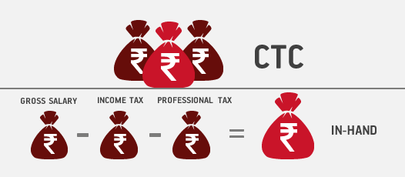
WHY?

Slide 3
WHY??
Bad programmers worry about the code. Good programmers worry about data structures and their relationships.
Software Product Based Companies require quality Software Developers .
According to the report by Glassdoor, the average base pay of Software Developers in India is found to be around 12 Lakhs per annum.
The average base of software developers ranges from Rs. 4,00,000 to Rs 20,00,000 per year.
As per various standard reports, less than 10% of engineers are actually employable in software-related jobs. That is where Data Structures and Algorithms come in.
They are so important in Product Based Companies’ interviews as they are the hallmark of any good Software Developer.

Slide 4
Data item refers to single unit of values
Group items
Elementary items
Data items that can be divided
Data items that cannot be divided

Slide 5
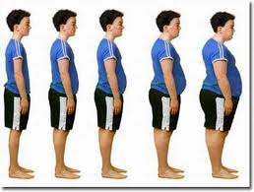
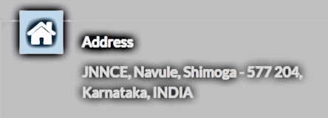
Examples
Aadhar Card Number- Elementary (Long)
Person Age– Elementary (Int)
Person Name – Group (Char Array)
Person Address– Group (Char Array)
Person Weight– Elementary (Float)

Slide 6
PERSON
Entity
Attributes
ID | Name | Age | Weight | Address
001 | Eena | 23 | 66.2 | Hasmukh Nagar, Shimoga, Karnataka, 577202
002 | Meena | 25 | 55.1 | Ajeeb Nagar, Shimoga, Karnataka, 577203
003 | Dika | 19 | 100 | Daamu Nagar, Shimoga, Karnataka, 577204
Entity Set

Slide 8
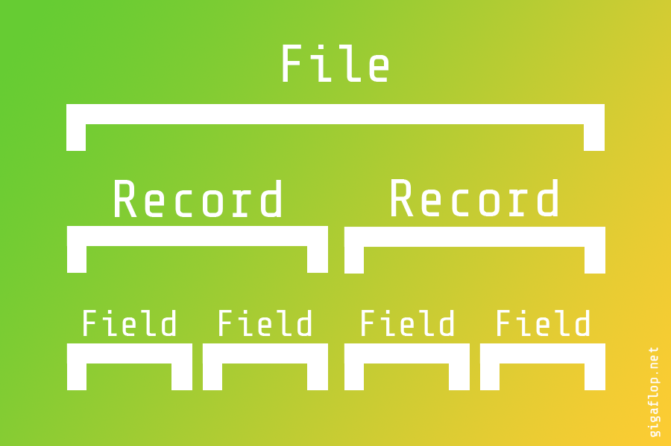
Introduction
Primary goals
Areas of growth
Timeline
Summary
Unique fields are called key fields

Slide 9
Fixed or variable length records

Slide 10
Hospital patient file:
Name, Admission Date, Social Security Number, Room Number, Bed Number, Doctor
Primary keys?
Identify each data item as elementary or group and also their types

Slide 11
2. Which of following data items may lead to variable-length records when included as items in the record:
(a) Age (b) Sex (c) Name of the spouse (d) Names of children (e) Education (f) Previous employers

Slide 12
Friends watching movie in a theater reserving contiguous locations -1D Array

Slide 13
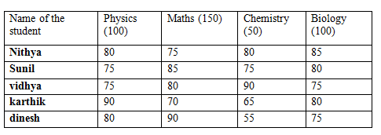
Student marks – 2D array with row representing student and column subject

Slide 14
Customer | Salesperson
Ramesh | Bola
Dinesh | Gola
Mahesh | Bola
Suresh | Bola
Paresh | Gola
Javaresh | Gola
Jaggesh | Rajni
Linked Lists
File containing customer and the handling sales person

Slide 15
One way of organizing is use an array for sales person and pointer in the customer file
Salesperson
Bola
Gola
Rajni
Customer | Salesperson
Ramesh | 0
Dinesh | 1
Mahesh | 0
Suresh | 0
Paresh | 1
Javaresh | 1
Jaggesh | 2
0
1
2
Searching customers of a given salesperson would require searching of entire file

Slide 16
Second way of organizing is use an array for sales person and pointer to customers
Salesperson | Pointer
Bola | 0,2,3
Gola | 1,4,5
Rajni | 6
Customer
Ramesh
Dinesh
Mahesh
Suresh
Paresh
Javaresh
Jaggesh
0
1
2
3
4
5
6
Set of pointers keep changing as customers are added and deleted

Slide 17
Most efficient way of organizing is linked list
Salesperson | Pointer
Bola | 0
Gola | 1
Rajni | 6
Customer | Salesperson
Ramesh | 2
Dinesh | 4
Mahesh | 3
Suresh | NULL
Paresh | 5
Javaresh | NULL
Jaggesh | NULL
0
1
2
3
4
5
6
Bola
Ramesh
Mahesh
Suresh

Slide 19
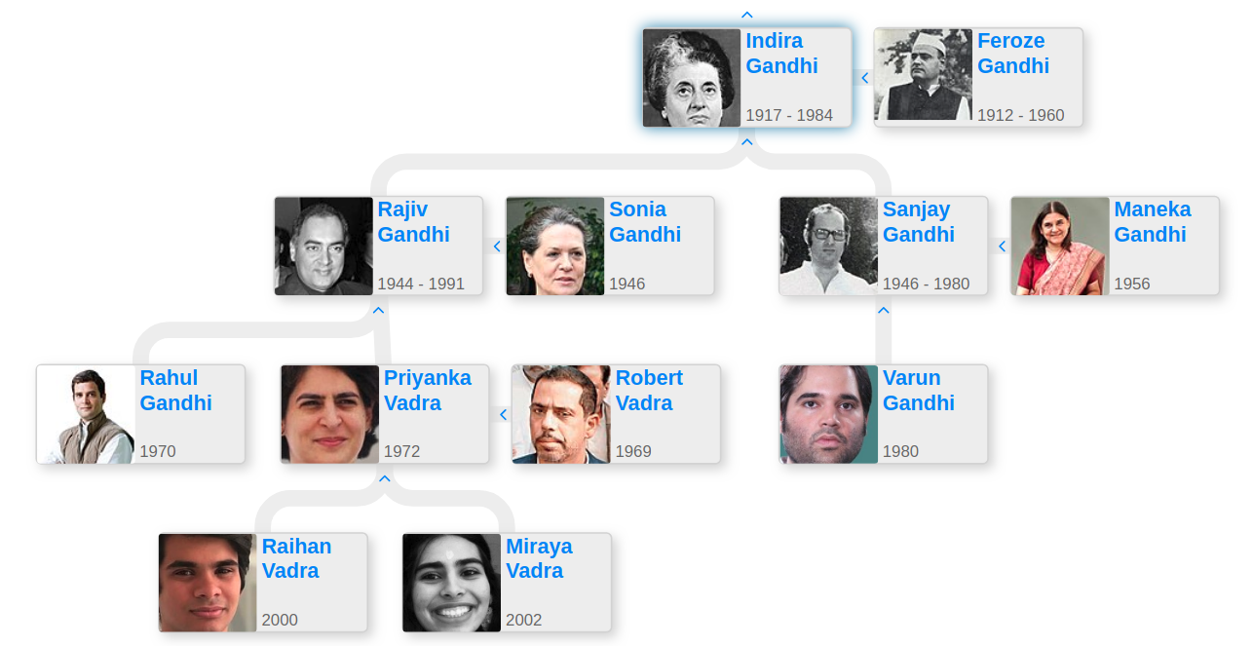

Slide 20
Write a tree for:
Employee (SSN, Name, Address, Age, Salary)
Employee
Address
Age
Salary
SSN
Name
Street
Area
First
Middle
Last
City
State
Zip

Slide 21
Write a tree for:
(2*x+y)*((a-7*b)^3)
*
+
^
-
3
*
y
a
*
2
x
7
b

Slide 22
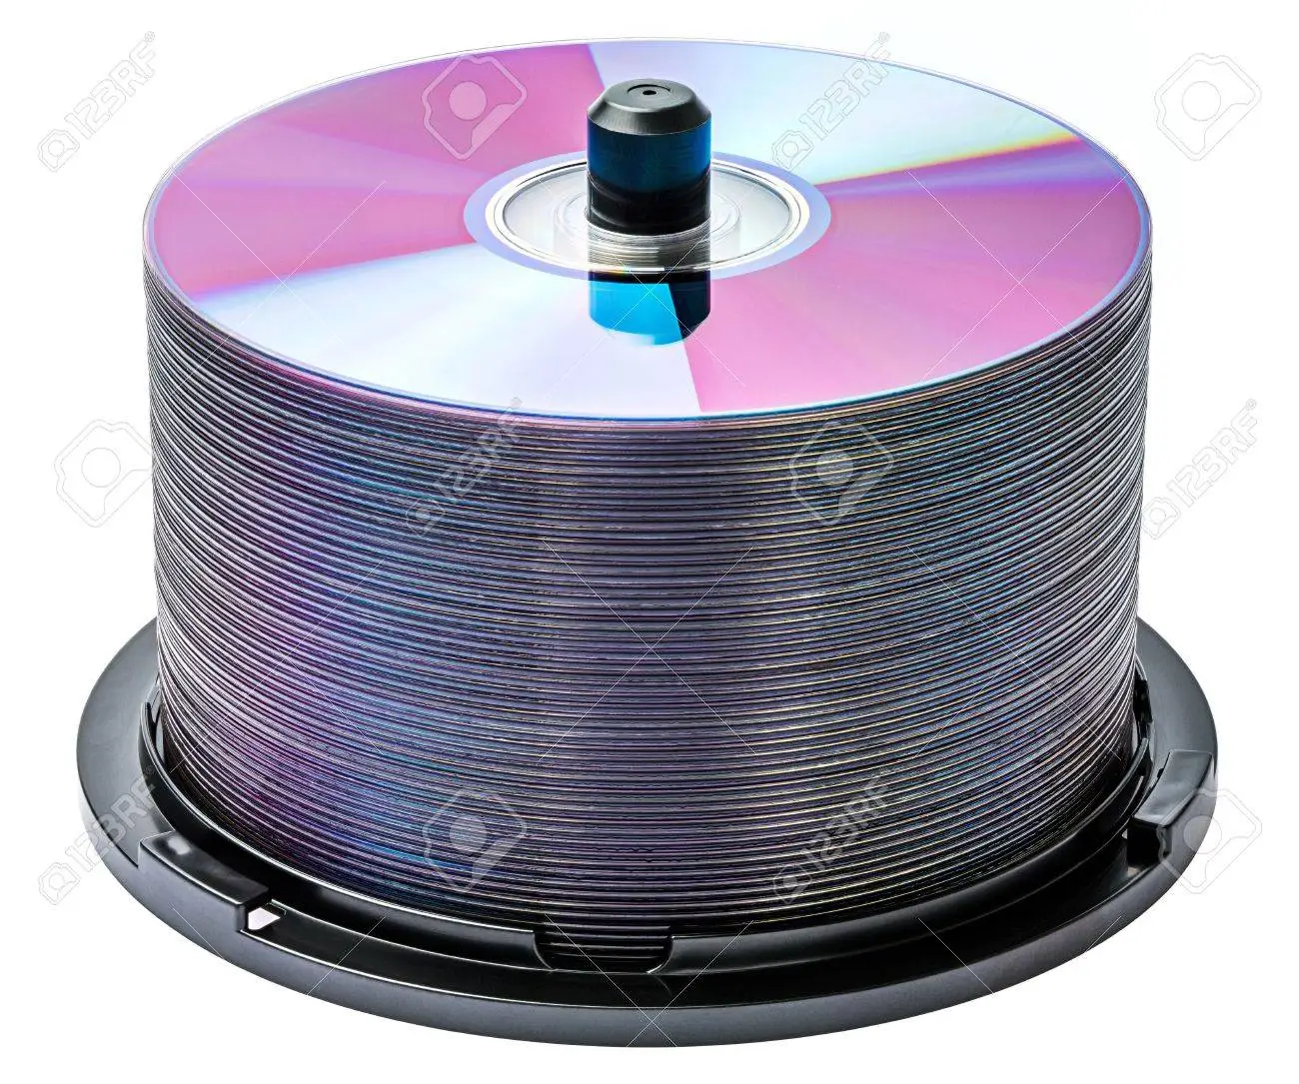
Other Data Structures…..
Stack of Disks
Queue for Ticket

Slide 23
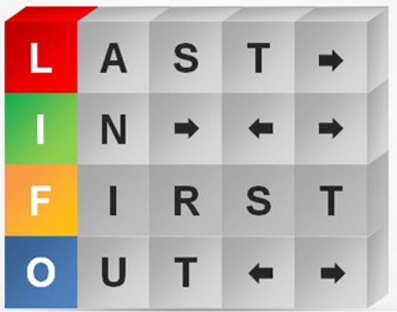
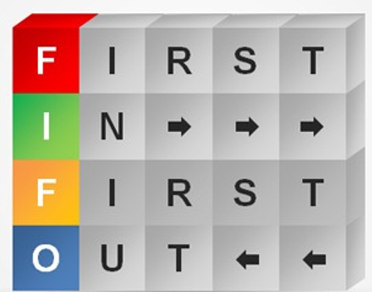
Queue is FIFO
Insert at Rear End and deletion at Front End
Stack is LIFO
Both insertion and deletion only on TOP

Slide 24
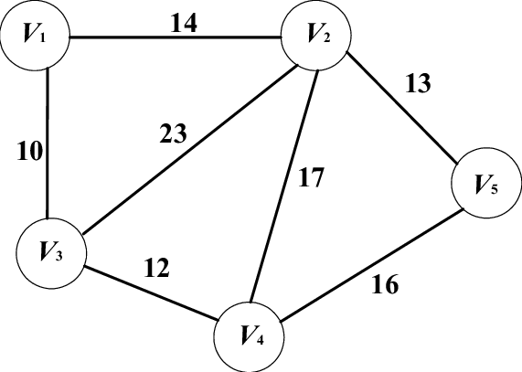
Graph Data Structure

Slide 25
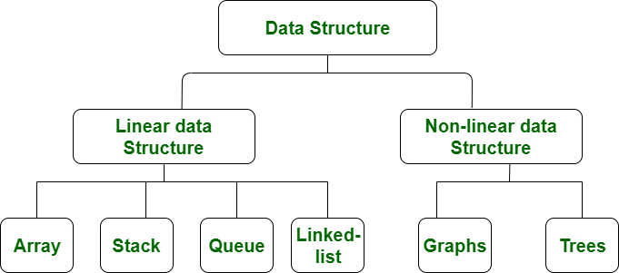

Slide 26
Differences between Linear and Non-linear Data Structure
Parameter | Linear DS | Non-Linear DS
Linear- each element has connection to previous and next
Hierarchical – Each element have connection to parent and child
Arrangement
Levels
Single level
Multiple levels
Traversal
In a single run
Multiple runs required
Implementation
Easier due to indexing or pointers
Complex – involvement of multiple pointers
Memory utilization
Efficient
Inefficient
Examples
Array, Linked List, Stacks, Queues
Trees and Graphs
Applications
Software Development
AI and ML

Slide 28
SMART LOCKS

Slide 29
SMART NOTICE BOARDS

Slide 30
SMART DIGITAL DISPLAYS

Slide 31
SMART ROOM FRESHNERS

Slide 32
SMART PIGEON REPELLERS

Slide 33
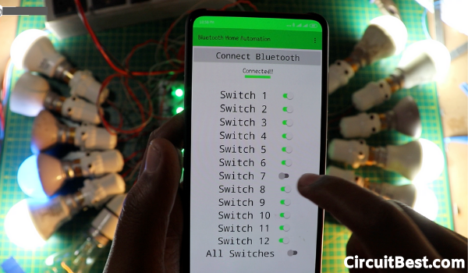

Slide 35
Data Structures
Define
Logical organization of the data OR
Mathematical organization of the data
Consideration-1
Rich enough to represent real world
Consideration-2
Simple enough to process effectively

Slide 36
Searching
Traversing

Slide 37
Inserting
Deleting

Slide 38
Sorting
Merging

Slide 39
Gym center maintains membership file which contains following information (Name, Address, TelephoneNumber, Age, Sex)
Demonstrate all possible operations : Searching, Traversing, Insertion, Deletion, Updation, Sorting and Merging

Slide 40
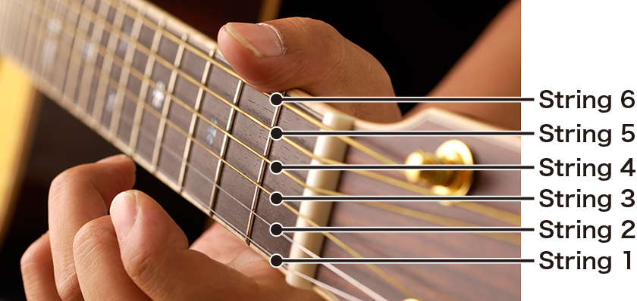
Strings

Slide 41
Strings are made from characters

Slide 42
Alphabets
Numbers
Special Characters

Slide 43
A finite sequence of zero or more characters is called
Strings
Number of characters in a string is called
Length
Character in C is denoted by
‘ ’
Strings are denoted in C is denoted by
“ ”

Slide 44
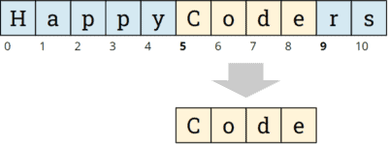
What is String concatenation
What is Substring
Denoted by X//Y//Z
Denoted by S1//S2
If X is empty string, then Y is called initial substring of S
If Z is an empty string, Y is called terminal string of S

Slide 45
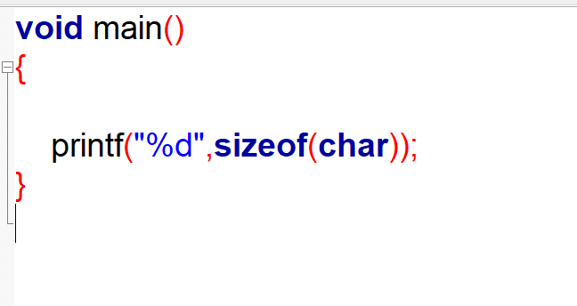
Size of a character in C is 1 byte

Slide 46
Storage

Slide 47
String Storage Techniques
Record Oriented Fixed Length
Variable Length storage with fixed maximum
Linked Storage

Slide 48
Example Program
#include<stdio.h>
void main()
{
printf(“Welcome to AIML”);
}
Record

Slide 49
Record Oriented Fixed Length
#include<stdio.h>
void main()
{
printf(“Welcome to AIML”);
}
Each Record is of fixed length, 80 characters normal

Slide 50
Ease of Access
Ease of Updation (provided new data size do not exceed record length)
Time waste if maximum blank spaces exist in a record
Records may be lengthy
Updation when size exceeds record length requires too much shifting

Slide 51
Case of Record Insertion
0 | #include<stdio.h>
1 | void main()
2 | {
3 | printf(“Welcome to AIML”);
4 | }
Inserting a new record in the middle will require bottom records to be shifted by 1

Slide 52
0 | #include<stdio.h>
1 | void main()
2 | {
3 | printf(“Welcome to AIML”);
4 | }
5 | int x;
POINT
0
1
2
5
3
4

Slide 53
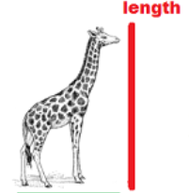
Variable Length storage with Fixed maximum
If actual record length is known, one can only read upto specified length. This helps when record size is far less than fixed length
Approaches
Markers -$$

Slide 54
Variable Length Storage with Markers
POINT
#include<stdio.h>$$
void main()$$
{$$
printf(“Welcome to AIML”);$$
}$$
0
1
2
3
4
Markers are also called as Sentinels

Slide 55
Variable Length Storage with Lengths listed
POINT
#include<stdio.h>
void main()
{
printf(“Welcome to AIML”);
}
18 | 0
12 | 1
02 | 2
33 | 3
02 | 4

Slide 56
Variable Length Storage with Markers and variable size
POINT
#include<stdio.h>$$void main()$${$$
printf(“Welcome to AIML”);$$}$$
0
1
2
3
4
Such methods provides efficient storage
However, if record lengths keep changing, such approaches are not suitable

Slide 57
Linked Storage
Linked List is a linear collection of nodes.
Each node has data and pointer to next node
1 character per node
A
L
L
I
S
W
E
L
L
𝟇
4 characters per node
ALL
IS W
ELL
𝟇

Slide 58
String Operations
SUBSTRING(string, initial, length)
INDEX(string,pattern)
SUBSTRING
INDEXING
CONCATENATION
LENGTH
CONCAT(S1, S2)
LENGTH(string)

Slide 59
PATTERN MATCHING

Slide 60
Pattern Matching Algorithms
Assumption:
2 Strings- One Text, another Pattern
Finding whether Pattern exists in Text
Length of Pattern <= Length of Text
INDEX STARTS AT 1

Slide 61
First Pattern Matching Algorithm
Let Text(T) = “MACHINE LEARNING”
PATTERN(P)= “EARN”
M
A
C
H
I
N
E
L
E
A
R
N
I
N
G
E
A
R
N
EARN ≠ MACH
E
A
R
N
EARN ≠ ACHI
E
A
R
N
EARN ≠ CHIN
E
A
R
N
EARN ≠ HINE

Slide 62
M
A
C
H
I
N
E
L
E
A
R
N
I
N
G
E
A
R
N
EARN ≠ INE
E
A
R
N
EARN ≠ NE L
E
A
R
N
EARN ≠ E LE
E
A
R
N
EARN ≠ LEAR
E
A
R
N
EARN = EARN

Slide 63
Algorithm
Input: T-Text, P-Pattern, S-LENGTH(T), R-LENGTH(P)
Step 1: Initialize : K=1 and MAX=S-R+1
Step 2: REPEAT STEP 3 to 5 WHILE K<=MAX
Step 3: FOR L=1 to R
IF P[L]≠ T[K+L-1] THEN GOTO STEP 5
Step 4: SET INDEX=K and EXIT
Step 5: K=K+1
Step 6: INDEX=0
Step 7: EXIT

Slide 64
Tracing
T- “HASEENA”, P-”ENA”,
FOR L=1 to R means
FOR L=1 to 3
S-LENGTH(T)=7
R-LENGTH(P)=3
L=1
P[L]≠ T[K+L-1]
P[1] ≠T[1+1-1]
P[1] ≠T[1]
E ≠H => EXIT
Initializations:
K=1
MAX=S-R+1=7-3+1=5
K=K+1=>K=2
REPEAT WHILE K<=MAX
1<=5->TRUE
REPEAT WHILE K<=MAX
2<=5->TRUE

Slide 65
FOR L=1 to R means
FOR L=1 to 3
FOR L=1 to R means
FOR L=1 to 3
L=1
P[L]≠ T[K+L-1]
P[1] ≠T[2+1-1]
P[1] ≠T[2]
E ≠A => EXIT
L=1
P[L]≠ T[K+L-1]
P[1] ≠T[3+1-1]
P[1] ≠T[3]
E ≠S => EXIT
K=K+1=>K=3
K=K+1=>K=4
REPEAT WHILE K<=MAX
3<=5->TRUE
REPEAT WHILE K<=MAX
4<=5->TRUE

Slide 66
FOR L=1 to R means
FOR L=1 to 3
FOR L=1 to R means
FOR L=1 to 3
L=1
P[L]≠ T[K+L-1]
P[1] ≠T[4+1-1]
P[1] ≠T[4]
E =E
L=1
P[L]≠ T[K+L-1]
P[1] ≠T[5+1-1]
P[1] ≠T[5]
E =E
L=2
P[L]≠ T[K+L-1]
P[2] ≠T[5+2-1]
P[2] ≠T[6]
N = N
L=3
P[L]≠ T[K+L-1]
P[3] ≠T[5+3-1]
P[3] ≠T[7]
A = A
L=2
P[L]≠ T[K+L-1]
P[2] ≠T[4+2-1]
P[2] ≠T[5]
N ≠ E
INDEX=K =>INDEX=5
K=K+1=>K=5
REPEAT WHILE K<=MAX
5<=5->TRUE

Slide 67
K=K+1=>K=6
REPEAT WHILE K<=MAX
6<=5->FALSE,
THE END AND INDEX=5

Slide 68
Tracing
T- “HASEENA”, P-”SENA”,
FOR L=1 to R means
FOR L=1 to 4
S-LENGTH(T)=7
R-LENGTH(P)=4
L=1
P[L]≠ T[K+L-1]
P[1] ≠T[1+1-1]
P[1] ≠T[1]
E ≠H => EXIT
Initializations:
K=1
MAX=S-R+1=7-4+1=4
K=K+1=>K=2
REPEAT WHILE K<=MAX
1<=4->TRUE

Slide 69
FOR L=1 to R means
FOR L=1 to 4
FOR L=1 to R means
FOR L=1 to 4
L=1
P[L]≠ T[K+L-1]
P[1] ≠T[3+1-1]
P[1] ≠T[3]
S =S
L=1
P[L]≠ T[K+L-1]
P[1] ≠T[2+1-1]
P[1] ≠T[2]
S ≠A => EXIT
L=2
P[L]≠ T[K+L-1]
P[2] ≠T[3+2-1]
P[2] ≠T[4]
E =E
L=3
P[L]≠ T[K+L-1]
P[3] ≠T[3+3-1]
P[3] ≠T[5]
N ≠ E
K=K+1=>K=3
REPEAT WHILE K<=MAX
3<=4->TRUE
K=K+1=>K=4
REPEAT WHILE K<=MAX
4<=4->TRUE

Slide 70
FOR L=1 to R means
FOR L=1 to 4
L=1
P[L]≠ T[K+L-1]
P[1] ≠T[4+1-1]
P[1] ≠T[4]
S ≠ E
K=K+1=>K=5
REPEAT WHILE K<=MAX
5<=4->FALSE
THE END AND INDEX=0

Slide 71
Textbooks:
1. Ellis Horowitz and Sartaj Sahni, Fundamentals of Data Structures in C, 2nd Ed, Universities Press, 2014.
2. Seymour Lipschutz, Data Structures Schaum'sOutlines, Revised 1st Ed, McGraw Hill, 2014.
3. Reema Thareja, Data Structures using C, 3rd Ed, Oxford press, 2012.
Data Structures
TextBooks

Slide 72
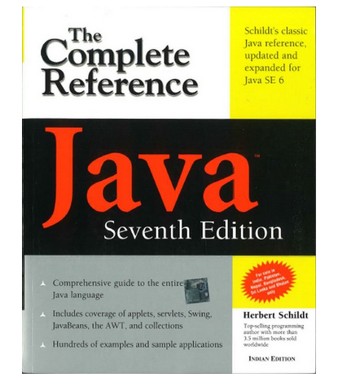

Slide 73
Second Pattern Matching Algorithm
Uses a table derived from particular pattern P but is independent of text T
P=aaba
Pattern Matching Table
a
b
x
$$Q_{0}$$
$$Q_{1}$$
$$Q_{0}$$
$$Q_{0}$$
$$Q_{1}$$
$$Q_{2}$$
$$Q_{0}$$
$$Q_{0}$$
$$Q_{2}$$
$$Q_{2}$$
$$Q_{3}$$
$$Q_{0}$$
$$Q_{3}$$
$$P$$
$$Q_{0}$$
$$Q_{0}$$

Slide 74
Pattern Matching Graph
b,x
$$Q_{0}$$
a
a
b
a
$$Q_{1}$$
$$Q_{2}$$
$$Q_{3}$$
$$P$$
x
a
b,x
b,x
Check for patterns:
T=aabcaba
T=abcaabaca

Slide 75
=aabcaba
$$Q_{0}$$
a
a
b
$$Q_{1}$$
$$Q_{2}$$
$$Q_{3}$$
b
a
c
abcaabaca
c
$$Q_{0}$$
a
a
b
a
$$Q_{1}$$
$$Q_{2}$$
$$Q_{3}$$
$$P$$
b
a

Slide 76
Algorithm
Input: T-Text, P-Pattern, S-LENGTH(T), R-LENGTH(P)
Step 1: Initialize : K=1 and S1= $Q_{0}$
Step 2: REPEAT STEP 3 to 5 WHILE $S_{K}$≠P and K<=N
Step 3: READ $T_{K}$
Step 4: SET $S_{K+1}=F({S_{K},T}_{K})$
Step 5: SET K=K+1
Step 6: IF $S_{K}=P then$
INDEX=K
ELSE
INDEX=0
Step 7: EXIT

Slide 77
Pattern Matching Table
Trace patterns using algorithm:
T=aabcaba
T=abcaabaca
a
b
x
$$Q_{0}$$
$$Q_{1}$$
$$Q_{0}$$
$$Q_{0}$$
$$Q_{1}$$
$$Q_{2}$$
$$Q_{0}$$
$$Q_{0}$$
$$Q_{2}$$
$$Q_{2}$$
$$Q_{3}$$
$$Q_{0}$$
$$Q_{3}$$
$$P$$
$$Q_{0}$$
$$Q_{0}$$

Slide 78
Linear Arrays

Slide 79
Definition of Linear Array
List of finite number of n homogeneous elements such that:
Elements referred by index of n consecutive numbers
Elements stored in contiguous memory allocation
$$Length=UB −LB+1$$

Slide 80
Array Name: Posers
Posers[0]
Posers[1]
Posers[2]
Posers[3]
Subscripted variable
Subscript

Slide 81
Each declaration of an array has 3 pieces of information:
Name of the array
Data type of the array
Index set of the array

Slide 82
Representation of Linear Arrays in Memory
int A[4];
int *A;
A=malloc(sizeof(int)*4);
Stack
1010
1014
1018
1022
Stack
1010-A
Heap
2030
2034
2038
2042
Static Memory Allocation
Dynamic Memory Allocation

Slide 83
Linear Arrays can be accessed in constant time

Slide 84
Programs/Algorithms on Linear Array Operations
Traversing an Array (Display)
Inserting an element at specific position
Deleting an element from specific position
Bubble sort
Linear Search
Binary Search

Slide 85
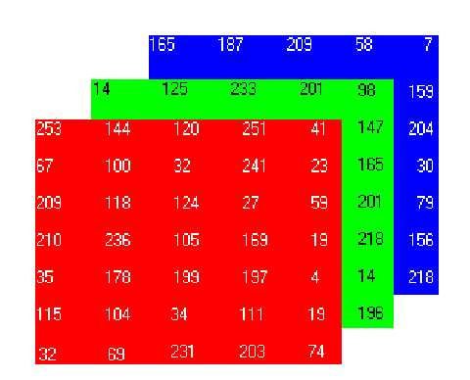
3 X 3 Matrix
3X 7 X 5 Matrix

Slide 86
Identify the size of matrix for following scenarios
Attendance of 5 students for 5 days
DSA, ADE, CO marks of 3 students for 3 tests
Temperature of Shimoga for last 5 days
Seating arrangement for 20 students in 10 benches, with 2 students per bench
3 frames of a video with each frame is a color image (RGBA) and size of the frame is 50 X 50

Slide 87
Representation of 2D Arrays(Matrix Arrays) in Memory
 | 0 | 1 | 2
0 | 14 | -9 | 25
1 | 56 | 22 | 18
2 | 5 | 0 | 58
(0,0)
(1,0)
(2,0)
(0,1)
(1,1)
(2,1)
(0,2)
(1,2)
(2,2)
Column-major Order
(0,0)
(0,1)
(0.2)
(1,1)
(1,2)
(1,3)
(2,0)
(2,1)
(2,2)
Row-major Order

Slide 88
Programs/Algorithms on 2D Matrices
Static Allocation, read input, display, trace of a matrix
Repeat Q1 with dynamic allocation
Dynamic allocation with transpose operation

Slide 89
What is the output of following code:
#include<stdio.h>
void main()
{
int i, marks[10];
for(i=0;i<10;i++)
marks[i]=-1;
for(i=0;i<10;i++)
printf("%d\n",marks[i]);
}
Array Initialization to a single value
If array concept is not there, one would need n varables, and n repetitive code

Slide 90
$$Address of A\left[k\right]=BA\left(A\right)+w(k−LB)$$
k – subscript
BA – Base Address
w – word length- 2bytes for int, 4bytes for float (32 bit compilers)
LB – lower bound
Consider int A[10];
Compute Address of A[7] if BA=1012

Slide 91
Initialization while declaration
Storing values in an Array
Read from keyboard
Assign Individually

Slide 92
Identify the correct one:
1. int a[4] = {0};
2. int a[4]={1,2,3};
3. int a[4]={1,2,3,4};
4. int a[4]={1,2,3,4,5};
5. int a[]={1,2,3,4,5};

Slide 93
Write a C program to initialize an array A of first 8 natural numbers. Later copy the same to another array B.
Write a C program to initialize an array A of first 8 natural numbers. Later copy only even numbers to another array B.

Slide 94
Jagged Teeth
Write a C program to create Jagged arrays (Pointer arrays)

Slide 95
Arrays

Slide 96
Structures

Slide 98
Person to be modelled as structure
struct person
{
char name[20];
int age;
float salary;
};

Slide 99
Group of person
Array of structures

Slide 100
Aliases with typedef
typedef struct
{
char name[20];
int age;
float salary;
date dob;
} humanbeing;
Master Blaster
Cheeku
Maahi
Gabbar Singh
Hitman
Rockstar

Slide 101
Size of the structure= sum of size of all the fields
Correction: While computing size of char array, take multiple of 4 (word boundary)
Write a C program to create an array of 3 persons, read the data and print the same – Use static allocation
Write a C program to create an array of n persons, read the data and print the same – Use dynamc allocation

Slide 102
Nested Structures
typedef struct
{
char name[20];
int age;
float salary;
date dob;
} humanbeing;
typedef struct
{
int day;
int month;
int year;
} date;

Slide 105
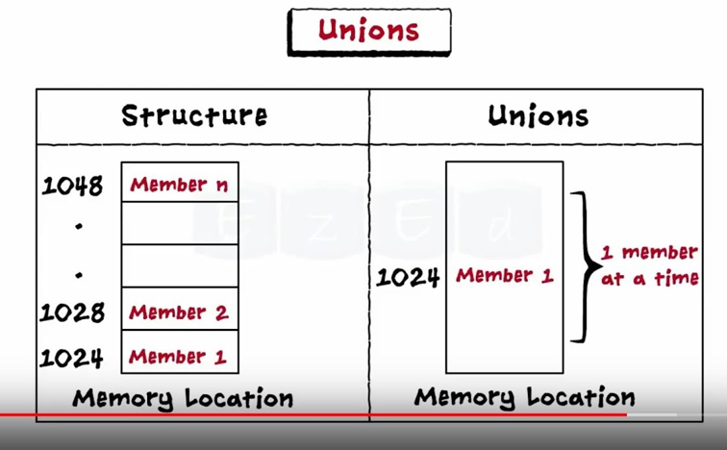

Slide 106
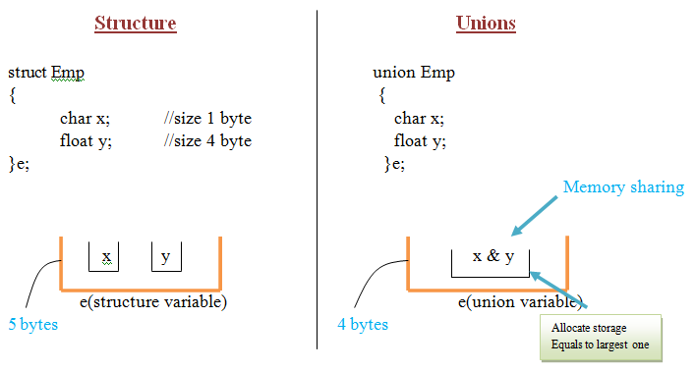

Slide 108
Structure– many at a time
Union – one at a time

Slide 109
Self referential structures
Linked List

Slide 112
Sparse Matrix

