Slide 1
DATA STRUCTURES AND APPLICATIONS
- Integrated Professional Core Course

Slide 2
SYSTEM STACK
A special stack used by programs to process function calls
Each function is allotted an area called “Activation Record” or “Stack frame”
Only one function can execute at any time.
Hence function to be selected is one at the top of stack
PUSH- whenever a function is called, new stack frame is pushed on top of stack
POP – whenever a function execution is completed, stack frame from top is popped

Slide 3
SYSTEM STACK IN ACTION
main()
{
f1(3);
}
void f1(int x)
{
int y=2;
printf(“%d”,x);
}
previous frame pointer
previous frame pointer
Local variables, parameters
f1()
x,y
return address
return address
previous frame pointer
previous frame pointer
main()
return address
return address

Slide 4
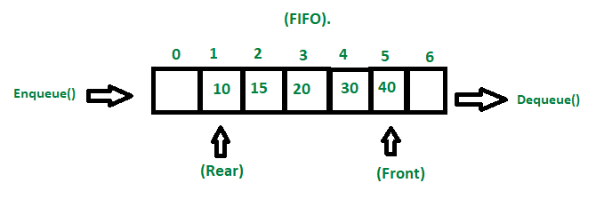

Slide 5
Rear=2
Rear=3
Enqueue(10)
Rear=1
Rear=4
Enqueue(20)
30
40
Enqueue(30)
20
Dequeue()
50
Enqueue(40)
Front=0
Rear=5
Rear=0
Enqueue(50)
10
60
Enqueue(60)
100
70
Enqueue(70)
90
80
Rear=9
Rear=6
Enqueue(80)
Enqueue(90)
Rear=8
Rear=7
Enqueue(100)
Rear=-1
Front=-1
Enqueue(110)
QUEUE
OVERFLOW

Slide 6
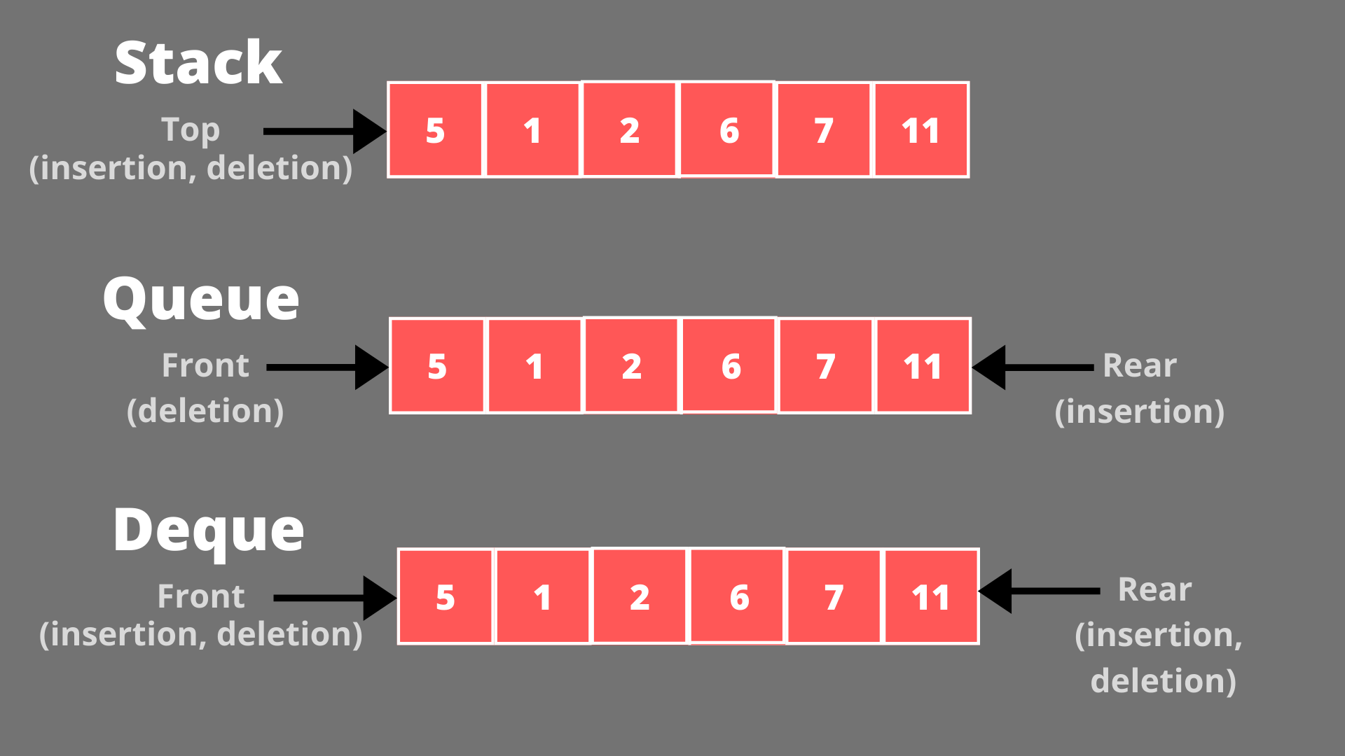

Slide 7
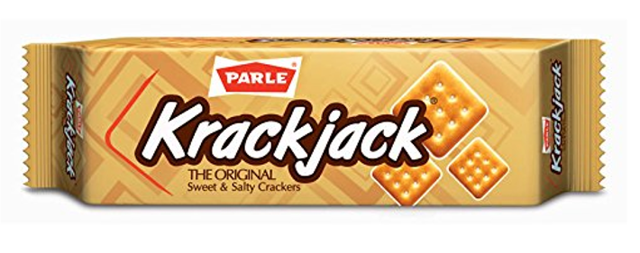
Job Scheduling

Slide 8
Dequeue maintenance using 2 pointers:
Left – left side of the queue
Right –right side of the queue
Initially,
LEFT=-1, RIGHT=5
Add 20 to left side of the Queue:
LEFT=0, RIGHT=5
0
1
2
3
4
5
Add 40 to left side of the Queue:
LEFT=1, RIGHT=5
20
Add 90 to right side of the Queue:
LEFT=1, RIGHT=4
20
40
20
Add 110 to right side of the Queue:
LEFT=1, RIGHT=3
40
90
20
40
110
90

Slide 9
Variations of Dequeues

Slide 12
PRIORITY QUEUES
A Priority Queue is a collection of elements with each element assigned a priority
Deletion of an element is based on following rules:
1. An element of higher priority before lower priority
2. For same priority elements, FIFO
Timesharing systems with high priority programs first and programs with normal priority into standard queue

Slide 13
Priority Queue Representation
One way
list
Array

Slide 14
Oneway List Representation
Collection of Nodes
Each Node has 3 fields: INFO, PRN, LINK
Rule: Lower numbers indicate higher priority
Higher priority nodes behind lower priority
Same priority nodes in the order added

Slide 15
Eg: (AAA,1), (BBB,1), (CCC,4), (DDD,3), (EEE,2)
AAA
1
/
AAA
1
BBB
1
/
AAA
1
BBB
1
CCC
4
/
AAA
1
BBB
1
DDD
3
CCC
4
/

Slide 16
AAA
1
BBB
1
EEE
2
DDD
3
CCC
4
/
For insertion search for a node whose priority is greater than this node
Deletion is always done by removing first node

Slide 17
Array Representation
Maintain separate queue for each level of priority
Each priority has its own queue and pair of pointers front and rear.
FRONT
REAR
1
2
3
4
5
6
1
2
1
2
1
 | AAA
BBB | CCC | XXX
FFF |  |  |  | DDD | EEE
 |  |  | GGG
2
1
2
3
2
3
0
3
0
3
4
5
4
1
4
5
4
5
4
5

Slide 18
Deletion:
Find smallest K such that FRONT[K]!=NULL
Delete and process front element in row K of Queue
Exit
Insertion of an ITEM with priority M:
Insert ITEM to rear element in row M of Queue
Exit

Slide 19
Expressions

Slide 20
Precedence: Who is first
Associativity: Order of evaluation among same precedence operators (LtoR or RtoL)
Eg: Evaluate the expression: x=a/b-c+d*e-a*c
where a=4, b=c=2, d=e=3

Slide 22
Type of Expressions
Polish
Reverse Polish/Suffix
Postfix and Prefix expressions are used by compilers due to efficiency concerns during evaluation

Slide 23
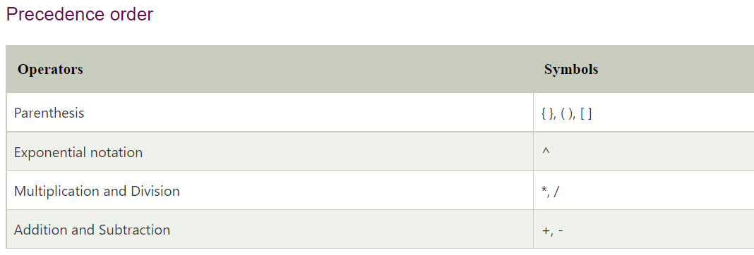

Slide 24
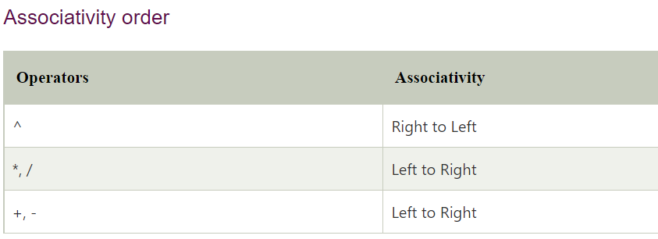

Slide 25
CONVERSION FROM INFIX TO POSTFIX
ALGORTITHM:
STEP 1: SCAN EXPRESSION FROM LEFT TO RIGHT
STEP 2: IF CURRENT TOKEN IS NUMBER/CHAR, PRINT IT. GOTO STEP 1
STEP 3: IF CURRENT TOKEN IS OPERATOR O:
3.1: IF PRECEDENCE(O) <= PRECEDENCE (TOS)
POP TOS SYMBOL and PRINT
REPEAT 3.1
3.2: ELSE PUSH O to STACK
GOTO STEP 1

Slide 26
STEP 4: IF CURRENT TOKEN IS ‘(‘, PUSH TO STACK. GO TO STEP 1
STEP 5: IF CURRENT TOKEN IS ‘)’, POP AND PRINT ALL SYMBOLS UNTIL YOU GET ‘(‘. GOTO STEP 1
STEP 6: POP ANY RESIDUAL SYMBOLS AND PRINT
STEP 7: IF CURRENT TOKEN IS EOS, EXIT

Slide 27
Examples:
$$a∗b∗c$$
$$−a+b−c+d$$
$$a∗−b+c$$
$\left(a+b\right)∗d+e/(f+a∗d)$ +c

Slide 28
CONVERSION FROM INFIX TO PREFIX
ALGORTITHM:
STEP 1: REVERSE GIVEN EXPRESSION
STEP 2: SCAN EXPRESSION FROM LEFT TO RIGHT
STEP 3: IF CURRENT TOKEN IS NUMBER/CHAR, PRINT IT. GOTO STEP 1
STEP 4: IF CURRENT TOKEN IS OPERATOR O:
4.1: IF PRECEDENCE(O) < PRECEDENCE (TOS)
POP TOS SYMBOL and PRINT
REPEAT 4.1
4.2: ELSE PUSH O to STACK
GOTO STEP 1

Slide 29
STEP 5: IF CURRENT TOKEN IS ‘)‘, PUSH TO STACK. GO TO STEP 1
STEP 6: IF CURRENT TOKEN IS ‘(’, POP AND PRINT ALL SYMBOLS UNTIL YOU GET ‘)‘. GOTO STEP 1
STEP 7: POP ANY RESIDUAL SYMBOLS AND PRINT
STEP 8: IF CURRENT TOKEN IS EOS, REVERSE THE OUTPUT, PRINT and EXIT

Slide 30
Examples:
$$a∗b∗c$$
$$−a+b−c+d$$
$$a∗−b+c$$
$\left(a+b\right)∗d+e/(f+a∗d)$ +c

Slide 31
EVALUATION OF POSTFIX EXPRESSIONS
ALGORTITHM:
STEP 1: SCAN EXPRESSION FROM LEFT TO RIGHT
STEP 2: IF CURRENT TOKEN IS NUMBER/CHAR, PUSH NUMBER/CHAR. GOTO STEP 1
STEP 3: IF CURRENT TOKEN IS OPERATOR O:
3.1: POP TOS SYMBOL –NUM2
POP TOS SYMBOL – NUM1
PUSH (NUM1 OP NUM2)
GOTO STEP 1
STEP 4: IF CURRENT TOKEN IS EOS, PRINT TOS and EXIT

Slide 32
Examples:
$$6+7∗3$$
$$\left(6+7\right)∗3+4/2$$

Slide 33
EVALUATION OF PREFIX EXPRESSIONS
ALGORTITHM:
STEP 1: REVERSE THE GIVEN EXPRESSION
STEP 2: SCAN EXPRESSION FROM LEFT TO RIGHT
STEP 3: IF CURRENT TOKEN IS NUMBER/CHAR, PUSH NUMBER/CHAR. GOTO STEP 1
STEP 4: IF CURRENT TOKEN IS OPERATOR O:
4.1: POP TOS SYMBOL –NUM1
POP TOS SYMBOL – NUM2
PUSH (NUM1 OP NUM2)
GOTO STEP 1
STEP 5: IF CURRENT TOKEN IS EOS, PRINT TOS and EXIT

Slide 34
Examples:
$$6+7∗3$$
$$\left(6+7\right)∗3+4/2$$

Slide 35
For the following expression, perform:
Conversion to postfix
Evaluation of postfix
Conversion to prefix
Evaluation of prefix
Show all steps, make it creative, colourful and put ur USN, Name while submitting
$$5∗5+7/2$$
$$− (4+6)$$

Slide 36
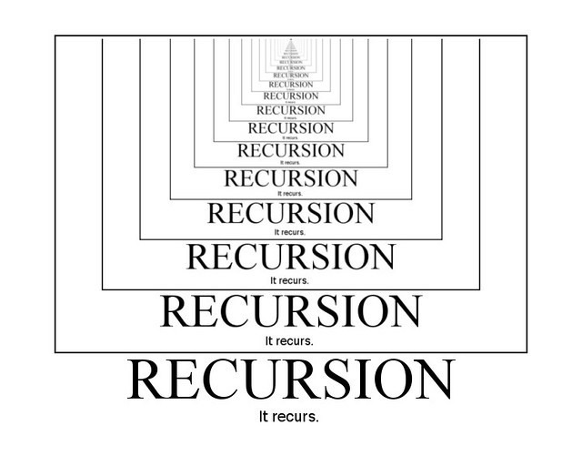

Slide 37
RECURRENCE RELATION FOR FACTORIAL
$$fact(n)=\left\{\begin{aligned}n=1 \\ n>1\end{aligned}\right.$$
$$1$$
$$n∗fact(n−1)$$
RECURRENCE RELATION FOR FIBONACCI
$$fib(n)=\left\{\begin{aligned}n=0 or n=1 \\ n>1\end{aligned}\right.$$
$$n$$
$$fib\left(n−1\right)+fib(n−2)$$

Slide 38
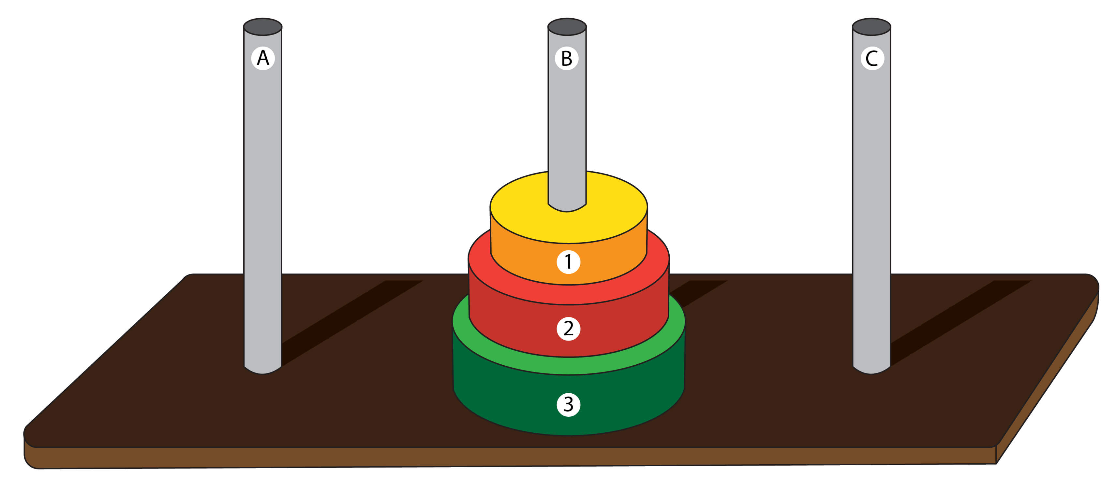
TOWER OF HANOI
Rules:
Always small disk should be on the top of big disk
Only one disk movement at a time

Slide 39
SOLUTION
MOVE TOP N-1 DISKS FROM PEG A to PEG B
MOVE THE TOP DISK FROM PEG A TO PEG C
MOVE TOP N-1 DISKS FROM PEG B TO PEG C

