Slide 1
DATA STRUCTURES AND APPLICATIONS
- Integrated Professional Core Course

Slide 2
LINKED LIST

Slide 3
List is a collection of items
Addition, deletion, updation, traversal, searching, sorting, merging frequently needed

Slide 4
Drawbacks of Arrays
Insertion and deletion at specific position is expensive
Extension is difficult

Slide 5
Linked List consists of nodes where each node has data and link to other node
Schematic
START
/
NEXT
INFORMATION
NULL PTR

Slide 6
Linked list to store patients of hospital beds in alphabetical order

Slide 7
Representation of Linked List in Memory
INFO
LINK
0
0
1
Eg: SCAM
1
START
2
2
3
A
3
8
4
4
5
S
5
7
6
6
7
C
7
3
8
M
8
NULL

Slide 8
Problem-1:
Consider IA scores in subjects:
DS- 18,20,17,11,15
ADE- 20,19,14,12,18
Represent this as 2 linked lists in memory

Slide 9
Problem-2:
Consider 4 brokerage firms:
B1, B2, B3, B4
Where customers for each firm are:
B1- MONA, SONA, RONA
B2- SOMA, RAAMA, HAAMA
B3- NULL LIST
B4- AMAYA, LAKSHYA
Represent this as linked lists

Slide 10
Problem-3:
Discuss how an employee file containing 3 records with fields (EMPID, Name, Designation, Rank) can be stored using linked lists and without linked lists. Compare and contrast both approaches

Slide 11
LETS CODE LINKED LISTS

Slide 12
Insertion into Linked List
START
A
B
C
D
/
AVAIL
/
Insert a node value P between B and C
START
A
B
C
D
/
/
AVAIL

Slide 13
Special Cases
Insertion at the beginning
Insertion at the end

Slide 14
INSERTION ALGORITHMS
AT THE BEGINING
AFTER A GIVEN NODE
SORTED LIST

Slide 15
DELETION ALGORITHMS
FOLLOWING A GIVEN NODE
MATCHING ITEM

Slide 16
LINKED LISTS

Slide 17
Algorithm
STEP 1: REFER LIST BY A POINTER T
STEP 2: LET S=T->NEXT
STEP 3: IF S->DATA < T->DATA, SWAP S->DATA AND T->DATA
STEP 4 MOVE S to S->NEXT
STEP 5: IF S->NEXT==NULL,
MOVE T to T->NEXT AND GOTO STEP 2
STEP 6: ELSE GOTO STEP 3
STEP 7: EXIT

Slide 18
Merging 2 linked lists
SIMPLE MERGE
SORTED MERGE

Slide 19
Algorithm-SIMPLE MERGE
STEP 1: REFER LIST1 BY A POINTER TEMP1
STEP 2: REFER LIST2 BY A POINTER TEMP2
STEP 3: IF TEMP1!=NULL
3.1 ADD TEMP1 to END OF MERGEDLIST
3.2 MOVE TEMP1=TEMP1->NEXT
3.3 GOTO STEP3
STEP 4: IF TEMP2!=NULL
4.1 ADD TEMP2 to END OF MERGEDLIST
4.2 MOVE TEMP2=TEMP2->NEXT
4.3 GOTO STEP4
STEP 5 EXIT

Slide 20
Algorithm-SORTED MERGE
STEP 1: REFER LIST1 BY A POINTER TEMP1
STEP 2: REFER LIST2 BY A POINTER TEMP2
STEP 3: IF TEMP1!=NULL AND TEMP2!=NULL
3.1: IF TEMP1->DATA<TEMP2->DATA
3.1.1: ADD TEMP1 to MERGEDLIST,
TEMP1=TEMP1->NEXT, GOTO STEP 3
3.1.2: ELSE ADD TEMP2 to MERGEDLIST.
TEMP2=TEMP2->NEXT, GOTO STEP 3
STEP 4: IF TEMP1!=NULL, COPY RESIDUAL NODES TO MERGEDLIST and EXIT
STEP 5 IF TEMP2!=NULL, COPY RESIDUAL NODES TO MERGEDLIST and EXIT

Slide 21
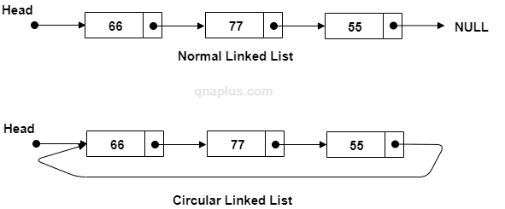

Slide 22
Operations of Circular linked lists
INSERT FRONT (START)
INSERT REAR (END)
DELETE FRONT (START)
DELETE REAR (END)
INSERT ANY
DELETE ANY

Slide 23
Required code:
START=newnode;
newnode->next=START
Nothing
START=NULL
INSERT FRONT (START)
Required code:
TEMP to last node
TEMP->next=newnode;
newnode->next=START
START=newnode
START
20
Something
newnode
START
TEMP
START
20
30
40
12
newnode

Slide 24
Required code:
START=newnode;
newnode->next=START
START=NULL
Nothing
INSERT REAR (END)
START
Required code:
TEMP to last node
TEMP->next=newnode;
newnode->next=START
20
newnode
Something
START
TEMP
20
30
40
12
newnode
2/4/2023
24

Slide 25
INSERT SPECIFIC POSITION
Position=2
START
TEMP
20
30
40
Required code:
TEMP to specific node
newnode->next= TEMP->next
TEMP->next=newnode;
12
newnode

Slide 26
CUR
DELETE FRONT (START)
START
START
TEMP
20
30
40
Required code:
TEMP to last node
cur=START
START=START->next
TEMP->next=START;
free(cur)

Slide 27
DELETE REAR (END)
START
PREV
TEMP
20
30
40
Required code:
TEMP to last node
PREV=previous of TEMP
PREV->next=START
free(TEMP)

Slide 28
Location=2
PREV
DELETE SPECIFIC LOCATION
START
TEMP
20
30
40
Required code:
TEMP to specific node
PREV=previous of TEMP
PREV->next=TEMP->next
free(TEMP)

Slide 29
Operations of Doubly linked lists
INSERT FRONT (START)
INSERT REAR (END)
DELETE FRONT (START)
DELETE REAR (END)
INSERT ANY
DELETE ANY

Slide 30
Required code:
START=newnode;
START=NULL
Nothing
INSERT FRONT (START)
Required code:
newnode->next=START
START->prev=newnode
START=newnode
START
20
newnode
Something
START
START
20
30
40
12
newnode

Slide 31
Required code:
START=newnode;
START=NULL
Nothing
INSERT REAR (END)
Required code:
TEMP->next=newnode
newnode->prev=TEMP
START
20
newnode
Something
START
TEMP
20
30
40
12
newnode

Slide 32
Required code:
TEMP to specific node
NTEMP=TEMP->next
newnode->next=NTEMP
TEMP->next=newnode;
newnode->prev=TEMP
NTEMP->prev=newnode
INSERT SPECIFIC POSITION
START
TEMP
NTEMP
20
30
40
12
newnode
2/4/2023
32

Slide 33
Required code:
TEMP=START
START=START->next
START->prev=NULL
free(TEMP)
DELETE FRONT (START)
TEMP
START
START
20
30
40

Slide 34
Required code:
Put TEMP to last node
NTEMP=TEMP->prev
NTEMP->next=NULL
free(TEMP)
DELETE REAR (END)
NTEMP
TEMP
START
20
30
40

Slide 35
Required code:
Move TEMP to specific node
NTEMP=TEMP->prev
NTEMP->next=TEMP->next
FTEMP=TEMP->next
FTEMP->prev=NTEMP
free(TEMP)
Location=2
DELETE SPECIFIC
NTEMP
TEMP
START
FTEMP
20
30
40

Slide 36
Write C function to find the reverse of elements of a DLL

Slide 37
Header Linked Lists
Linked lists in which starting node is a special node called Header node. Header node does not have any data. It is used to connect to the other nodes.

Slide 38
Types of Header linked lists
Grounded
Circular

Slide 39
Operations of Header linked lists
INSERT FRONT (START)
INSERT REAR (END)
DELETE FRONT (START)
DELETE REAR (END)
INSERT ANY
DELETE ANY

Slide 41
int gcd(int m, int n)
{
int p=4;
return gcd(n,m%n);
}
while(i>0);
{
i++;
}
void display()
{
prinf(“hi”);
}
display();
int display()
{
return 2;
}
diplay();
Int display()
{
return 2;
}

Slide 42
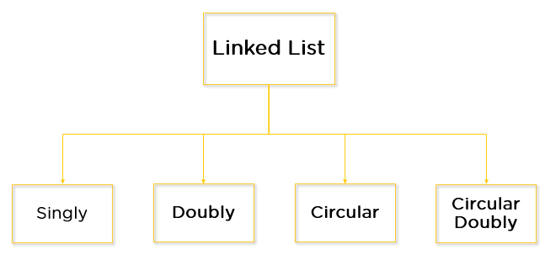

Slide 43
SINGLY LINKED LIST (SLL)

Slide 44
DOUBLY LINKED LIST (DLL)

Slide 45
CIRCULAR LINKED LIST (CLL)

Slide 46
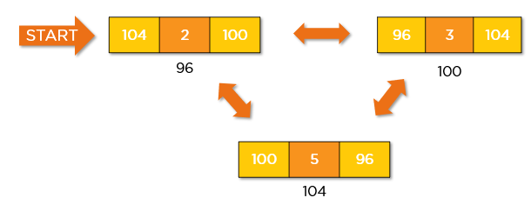
CIRCULAR DOUBLY LINKED LIST (CDLL)

Slide 48
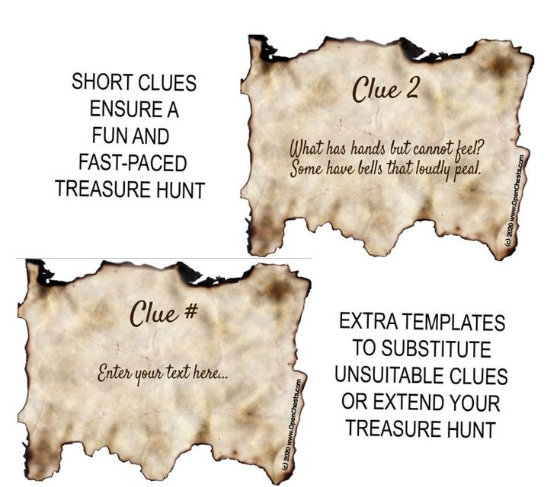
TREASURE HUNT

Slide 50
TRAIN IN AMUSEMENT PARK

Slide 51
WILD WATER AMUSEMENT PARK

