Slide 1
DATA STRUCTURES AND APPLICATIONS
- Integrated Professional Core Course

Slide 2
TREES

Slide 3
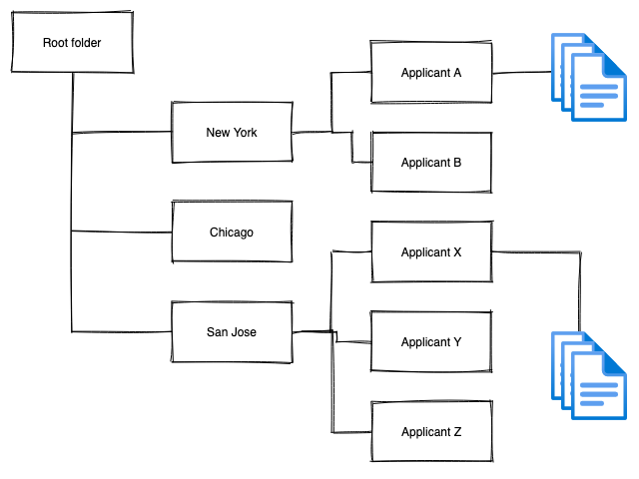
Files and Folders Storage

Slide 4
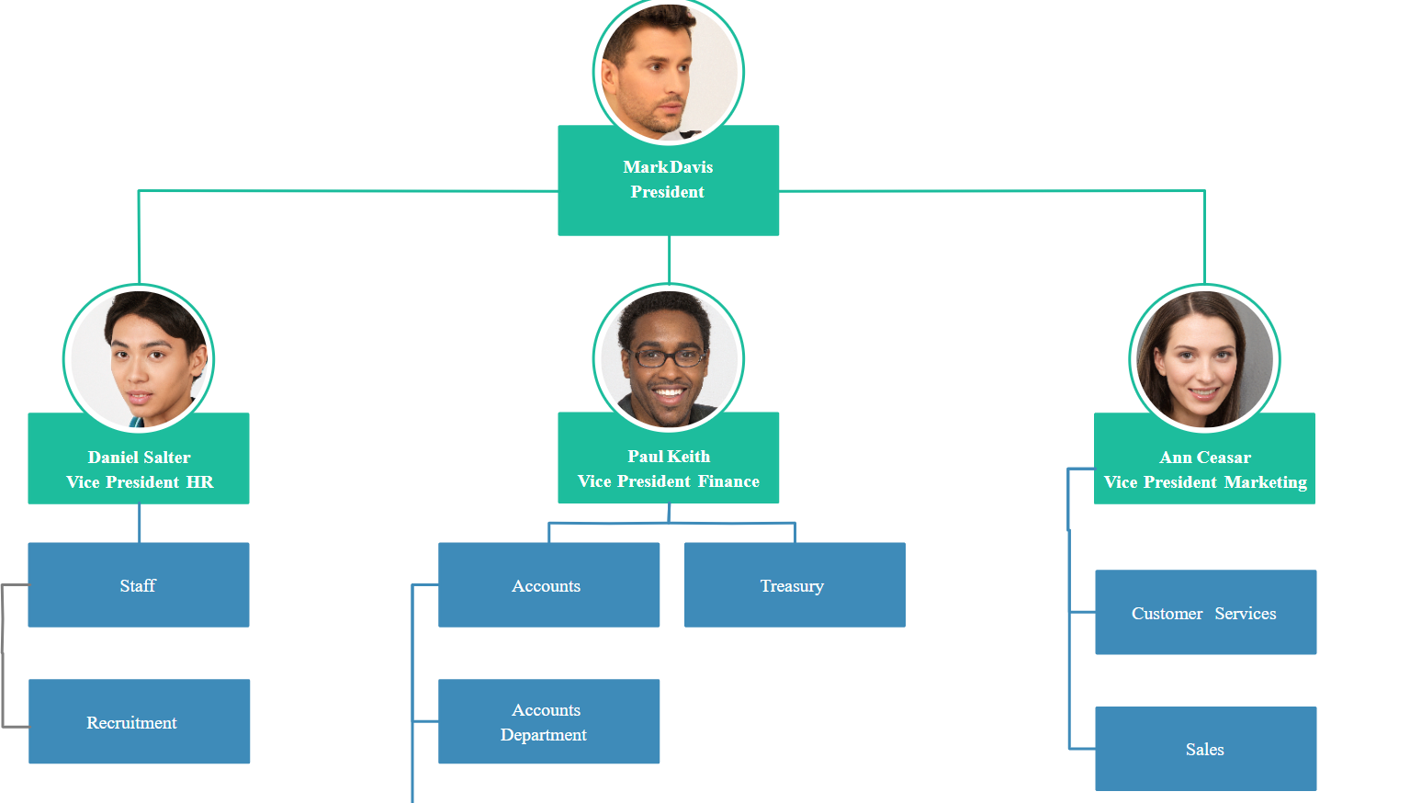
Organization chart

Slide 5
Computer network

Slide 6
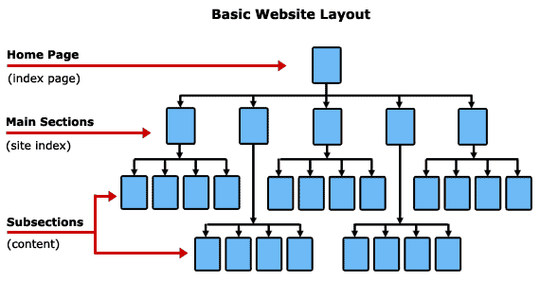
Website graph

Slide 7
Social Network

Slide 8
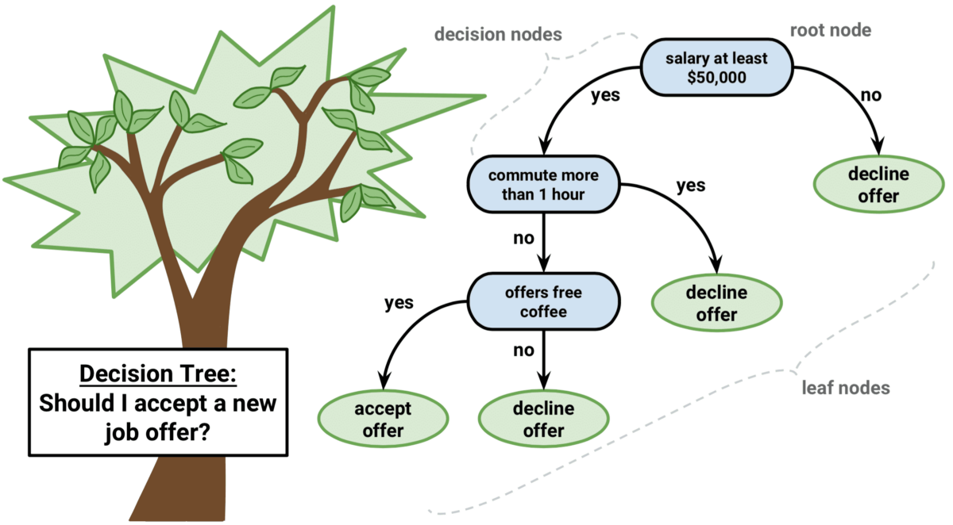

Slide 9
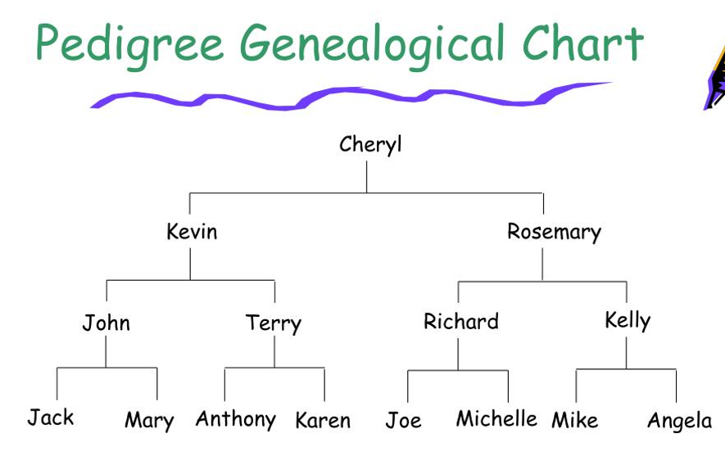
Chart of ancestors

Slide 10
Chart of descendants

Slide 11
Definition of a tree
A tree is a finite set of one or more nodes such that:
Specially designated node called root
Remaining nodes are partitioned into n disjoint sets, each of which are subtrees

Slide 12
Tree terminology
A
B
C
D
E
F
G
H
I
J
K
L
M

Slide 13
Node stands for any item in the tree + branching
A
Number of subtrees of any given node is called degree
B
C
D
E
F
G
H
I
J
K
Zero degree – Leaf node
Nonzero degree - Nonterminal
L
M

Slide 14
A
Children of same parent - siblings
B
C
D
Degree of a tree – maximum degree of any node
E
F
G
H
I
J
K
Ancestors of any node is then nodes in the path from root to that node
L
M
Level of root starts from 1
Then depth(height) of tree is max level of any node

Slide 15
Representation of trees
List Representation
DATA
CHILD1
CHILD2
CHILDk
A
0
B
F
0
C
G
0
D
I
J
0
E
K
L
0
H
M
0

Slide 16
Left child Right sibling
data
Left child
Right sibling

Slide 17
A
B
C
D
E
H
I
F
G
J
K
L
M

Slide 18
Representation as degree two (Binary Tree)
A
B
C
E
G
D
F
K
H
I
L
M
J

Slide 19
For the given tree,
Write the Left child right sibling representation
Write the binary tree representation
A
B
C
D
E
F
G
H
I
J
K
L
M

Slide 20
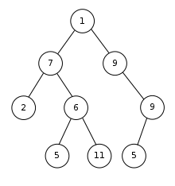
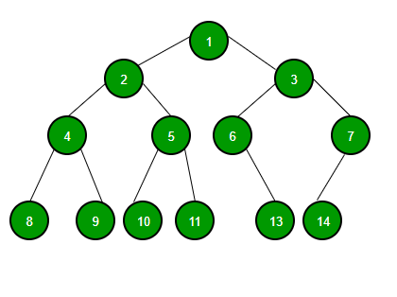

Slide 21
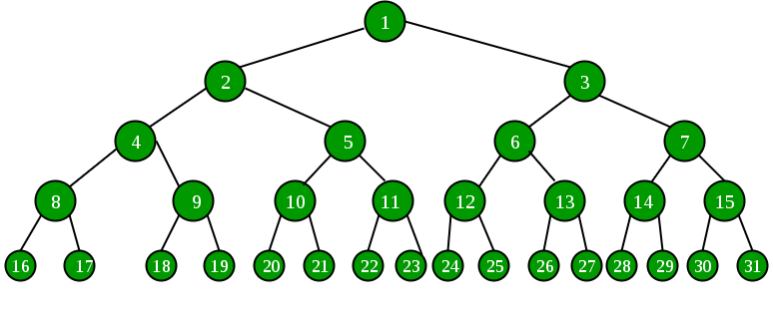
A binary tree is a finite set of nodes that is either empty or consists of root node and two disjoint binary trees called left subtree and right subtree

Slide 22
Abstract Data Type of a Binary Tree
ADT Binary_Tree:
objects: finite set of nodes either empty or consisting of root node, left subtree and right subtee
functions:
BinTree Create()
::=Creates an empty binary tree
::=if(bt==empty binary tree) return TRUE
else return FALSE
Boolean IsEmpty(bt)
::=return binary tree with root node item and left subtree bt1 and right subtree bt2
BinTree MakeBT(bt1, item, bt2)

Slide 23
::=if (IsEmpty(bt)) return error else
return left subtree of bt
BinTree Lchild(bt)
element Data(bt)
::=if (IsEmpty(bt)) return error else
return data in the root node of bt
BinTree Rchild(bt)
::=if (IsEmpty(bt)) return error else
return right subtree of bt

Slide 24
Differentiate Trees vs Binary Trees
Difference
Trees
Binary Trees
No. of children
Any number
Atmost 2
Order of children
Does not matter
Left and right different
Empty
Exists
Does not exist
Example

Slide 25
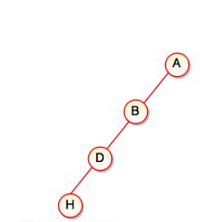
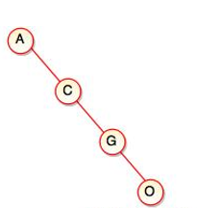
Skewed Binary Trees

Slide 26
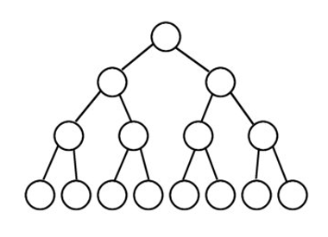
Full binary trees

Slide 27
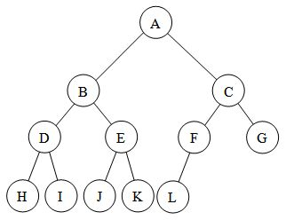
Complete binary trees

Slide 28
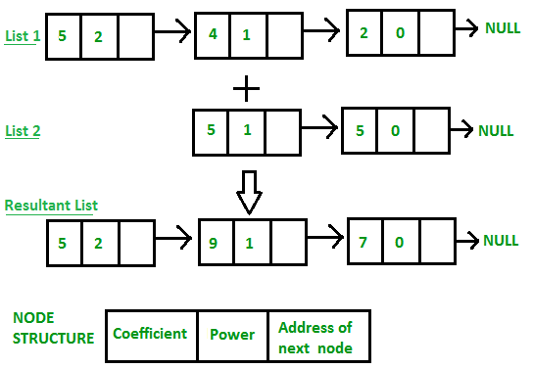

Slide 29
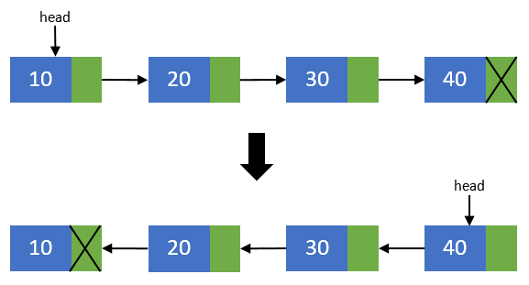

Slide 30
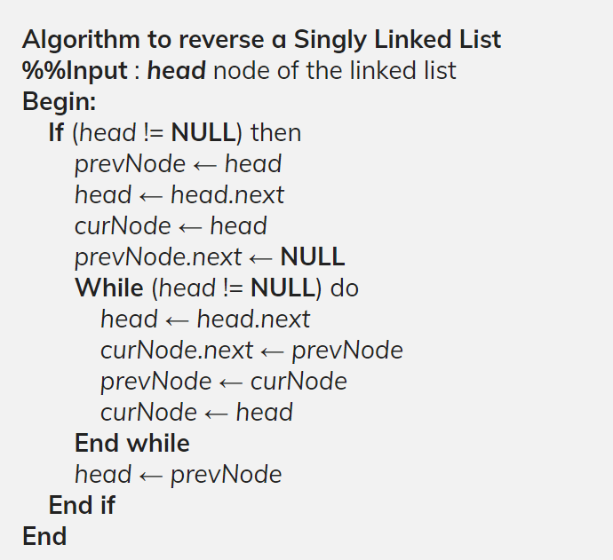

Slide 31
Binary Tree Representations
Array Representation
Linked List Representation

Slide 32
0
-
A
1
A
B
Array Representation
2
3
C
B
C
4
D
5
E
6
F
E
7
G
D
F
G
8
H
9
I
10
H
I
11
12
13
14
15
16

Slide 33
0
-
A
1
A
2
B
B
3
4
C
5
C
6
D
7
8
D
9
E
10
11
12
13
14
15
16
E

Slide 34
Array Representation Analysis
$$parent\left(i\right)=\left\lfloor i/2\right\rfloor if i≠1, If i=1, no parent$$
$$leftChild\left(i\right)=2i if 2i≤n, Else no Left Child$$
$$rightChild\left(i\right)=2i+1, if 2i+1 ≤n, Else no Right Child$$

Slide 35
PROS
CONS
Directly Accessible
Best suited for full binary trees/complete binary trees
For skewed trees, 50% waste of memory
Insertion and deletion in middle very slow

Slide 36
Linked List Representation
typedef struct
{
int data;
struct node *leftChild;
struct node *rightChild;
}node;
Node
Left Child Pointer
Data
Right Child Pointer

Slide 37
Example
A
B
C
D
E
G
F
H
I

Slide 38
A
B
C
D
0
E
0
0
F
0
0
G
0
0
H
0
0
I
0

Slide 39
A
A
0
B
B
0
C
C
0
D
E
D
0
0
E
0

Slide 40
Exercise
A
B
Write both Sequential (Array) and Linked Representation
C
D
E

Slide 41
Without stack
Binary Tree Traversals
Level order
Iterative Inorder
Inorder
Preorder
Postorder

Slide 42
Example
Inorder:
+
A/B*C*D+E
Preorder:
*
E
*
+**/ABCDE
D
/
C
Postorder:
AB/C*D*E+
A
B
+*E*D/CAB
Levelorder:

Slide 43
void inorder(treePointer ptr)
{
if(ptr)
{
inorder(ptr->leftChild);
printf(“%d”,ptr->data);
inorder(ptr->rightChild);
}
}
Inorder:
A/B*C*D+E

Slide 44
void preorder(treePointer ptr)
{
if(ptr)
{
printf(“%d”,ptr->data);
preorder(ptr->leftChild);
preorder(ptr->rightChild);
}
}
Preorder:
+**/ABCDE

Slide 45
void postorder(treePointer ptr)
{
if(ptr)
{
postorder(ptr->leftChild);
postorder(ptr->rightChild);
printf(“%d”,ptr->data);
}
}
Postorder:
AB/C*D*E+

Slide 46
void levelorder(treePointer ptr)
{
treePointer queue[MAX_SIZE];
if(!ptr) return;
addq(ptr);
for(;;)
{
ptr=deleteq();
if(ptr)
{
printf(“%d”,ptr->data);
if(ptr->leftChild)
addq(ptr->leftChild);
if(ptr->rightChild)
addq(ptr->rightChild);
}
else
break;
}
}
Levelorder:
+*E*D/CAB

Slide 47
Write all Tree traversals
A
B
C
D
E
G
F
H
I

