Slide 1
PRINCIPLES OF PROGRAMMING USING C
By,
Ashwini J P
Department of AIML
JNN College of Engineering

Slide 2
SYLLABUS - MODULE I
INTRODUCTION TO C
1. Introduction to COmputers
2. Input Output Devices.
3. Desinging Efficient Programs
4. Introduction to C
5. Structure of C Programs
6. Files used in a C Program
7. Compilers

Slide 3
SYLLABUS - MODULE I
INTRODUCTION TO C
8. Compiling and Executing C Programs
9. Variables
10. Constants
11. Input/Output Statements in C

Slide 4
INTRODUCTION TO COMPUTERS

Slide 5
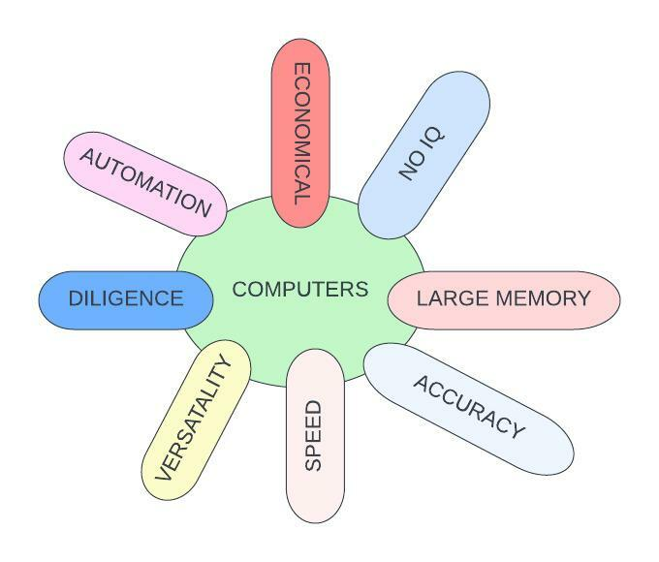
INTRODUCTION TO COMPUTERS
Defn 1: Electronic Device That is designed to accept data, perform the required Mathematical and Logical operations at High Speed and Output the Result.
Characteristics of Computers.

Slide 6
INTRODUCTION TO COMPUTERS
Defn 1: Electronic Device That is designed to accept data, perform the required Mathematical and Logical operations at High Speed and Output the Result.
Characteristics of Computers.
Computer- Electronic Device which performs a function based on given set of instructions known as program

Slide 7
INTRODUCTION TO COMPUTERS
Defn 1: Electronic Device That is designed to accept data, perform the required Mathematical and Logical operations at High Speed and Output the Result.
1. DoB - 12-12-92 (Raw Data)
2. Processing This data : 2022-1992=30-> Age Infn....Produced
Characteristics of Computers.
Computer
1. Accepts Data
2. Process Data
3.Produces Information

Slide 8
INTRODUCTION TO COMPUTERS
Defn 1: Electronic Device That is designed to accept data, perform the required Mathematical and Logical operations at High Speed and Output the Result.
Characteristics of Computers.
Speed of computer in terms of Nano Seconds (10⁻⁹) and Pico Seconds (10⁻¹²)

Slide 9
INTRODUCTION TO COMPUTERS
Defn 1: Electronic Device That is designed to accept data, perform the required Mathematical and Logical operations at High Speed and Output the Result.
Characteristics of Computers.
“Computer is Never wrong”. Either DATA is Wrong or Set of INSTRUCTIONS is wrong.
“GARBAGE IN-GARBAGE OUT” - Means Wrong Input So Wrong Output.

Slide 10
INTRODUCTION TO COMPUTERS
Defn 1: Electronic Device That is designed to accept data, perform the required Mathematical and Logical operations at High Speed and Output the Result.
Characteristics of Computers.
No USER INTERVENTION required.

Slide 11
INTRODUCTION TO COMPUTERS
Defn 1: Electronic Device That is designed to accept data, perform the required Mathematical and Logical operations at High Speed and Output the Result.
Characteristics of Computers.
Computers Don’t Get Tired.
Every Instruction no matter how long, how many times executed, will execute with same ACCURACY

Slide 12
INTRODUCTION TO COMPUTERS
Defn 1: Electronic Device That is designed to accept data, perform the required Mathematical and Logical operations at High Speed and Output the Result.
Characteristics of Computers.
Being Flexible
Variety of tasks from Simple E-mail to Weather Prediction, Banking, Medicine etc.
Verstaile as they can perform Many Tasks at Same Time.

Slide 13
INTRODUCTION TO COMPUTERS
Defn 1: Electronic Device That is designed to accept data, perform the required Mathematical and Logical operations at High Speed and Output the Result.
Characteristics of Computers.
Primary Memory - Fast, very Costly, RAM.
Secondary MEmory - Slow, Cheap, Hard Disk, DVD etc.

Slide 14
INTRODUCTION TO COMPUTERS
Defn 1: Electronic Device That is designed to accept data, perform the required Mathematical and Logical operations at High Speed and Output the Result.
Characteristics of Computers.
No decision making abilities on their own.

Slide 15
INTRODUCTION TO COMPUTERS
Defn 1: Electronic Device That is designed to accept data, perform the required Mathematical and Logical operations at High Speed and Output the Result.
Characteristics of Computers.
Computers are considered as “SHORT TERM INVESTMENTS” to gain “LONG TERM PROFIT”
Reduces Manpower.
Save Time, Energy and Money.

Slide 16
INTRODUCTION TO COMPUTERS
Stored Program Concepts
1. Introduces by Sir Jhon Von Neumann in 1940s.
2. Further W. Mauchly and J Presper Eckert Added features to make it flexible.
3. First Stored Program Concept computer was built in England named Manchester Mark I

Slide 17
INTRODUCTION TO COMPUTERS
Stored Program Concepts
1. Before any Data is Processed, instructions are read in memory.
2. Instructions are stored in computers memory for execution.
3.Instructions are stored in Binary Format.

Slide 18
INTRODUCTION TO COMPUTERS
Stored Program Concepts
4. Processing starts from first instruction which will be transfered to Control Unit.
5. Instructions written by the user are performed sequentially, until there is a break.
6. I/O and Processing operations can be overlapped.

Slide 19
DESIGNING EFFICIENT PROGRAMS

Slide 20
DESIGNING EFFICIENT PROGRAMS
Pragramming Paradigms
Style of Programming that defines structure and basic elements of program
MONOLITHIC
Emphasize on SOLUTION
PROCEDURAL
Emphasize on ALGORITHMS
STRUCTURED
Emphasize on MODULES
OBJECT ORIENTED
Emphasize on CLASS and OBJECTS
LOGIC ORIENTED
Expressed in PREDICATE CALCULUS
RULE ORIENTED
Expressed in RULES
CONSTRAINT ORIENTED
Utilizes relationship to solve a problem

Slide 21
INTRODUCTION TO C

Slide 22
INTRODUCTION TO C
Introduction
Developed in 1970s, by DENNIS RITCHIE at BELL LABORATORIES on UNIX OS.
Why the name ‘C’?
Well its features are derived from a language called ‘B’
Why learn “C”?
Many languages like C++, JAVA etc are derived from C

Slide 23
INTRODUCTION TO C
Introduction
Background
In 1960s
Widely Used in USA and Europe
ALGOL
ALGOL
In 1967 by Martin Richards
Basic Combined Programming Language
BCPL
BCPL
In 1970 by Ken Thompson
B
In 1972 by Dennis Richie
Derived from ALGOL, BCPL and B and also supports Data Types.
Traditional C
A book on C Programming Language by W. Kernighan and Dennis Ritchie is is so popular that K&RC (A version) was released
K & RC
ANSIC
American National Standard Institute (ANSI) standardized C in 1983.
ANSI.ISOC
ISO adopted ANSI C in 1989. Also called C89
C95
Modifications in 1995
C99
New features added from JAVA and C++ in 1999

Slide 24
INTRODUCTION TO C
Introduction
Characteristics of C
High Level Programming Language - Emphasize on Problem than hardware.
Small Size: 32 keywords.
Extensive use of function calls
Structured Programming: Problem in terms of functions/modules.
Unlike PASCAL it supports loose typing. (Char to int etc.)
Stable Language ; ANSI C standarized in 1983 and to date same.
QUICK Language: Execution time is quicker compared to many other language.
Facilitates Low Level (Bit wise) programming.

Slide 25
INTRODUCTION TO C
Introduction
Characteristics of C
Core Language: C++, JAVA etc are based on C. If you learn C learning other language is simple.
Portable Language: Written on one computer can be run on other.
Extensible Language: You can add a new sfunctionality to existing library.
It is always considered as SECOND BEST. First best keep on varying....

Slide 26
INTRODUCTION TO C
Introduction
Uses of C
Primarily used for System Programming.
Compilers, libraries etc. are written in C.
Intermediate Language: Because of Portability and Convenience.
Widely used for End User Applications.

Slide 27
STRUCTURE OF C PROGRAMS

Slide 28
INTRODUCTION TO C
Introduction
Structure of a C Program
Preprocessor Directive
Global Declarations
main() { Local Declarations; Statements }
Function1() { Local Declarations; Statements } ...............................................
Functionn() { Local Declarations; Statements }
Special Instructions to Prepare Program for Compilation.
Ex: include
C program is set of functions.
A function is set of C Statements executed together.
Statements are written in logical sequence

Slide 29
INTRODUCTION TO C
Introduction
Structure of a C Program
Preprocessor Directive
Global Declarations
main() { Local Declarations; Statements }
Function1() { Local Declarations; Statements } ...............................................
Functionn() { Local Declarations; Statements }
A very important function present in every C Program.
Execution starts from here.

Slide 30
INTRODUCTION TO C
Introduction
Structure of a C Program
Preprocessor Directive
Global Declarations
main() { Local Declarations; Statements }
Function1() { Local Declarations; Statements } ...............................................
Functionn() { Local Declarations; Statements }
In every function we have DECLARATION PART and STATEMENTS PART.
Declaration: Data used by this function is declared
Statements: Executed in a logical sequence.
Local Declared Data : VISIBLE only inside the function. LIFETIME ends when function ends.

Slide 31
INTRODUCTION TO C
Introduction
Structure of a C Program
Preprocessor Directive
Global Declarations
main() { Local Declarations; Statements }
Function1() { Local Declarations; Statements } ...............................................
Functionn() { Local Declarations; Statements }
VISIBLE throughout the program.
LIFETIME till prgram ends.

Slide 32
INTRODUCTION TO C
Introduction
Writing the First C Program
#include<stdio.h>
int main()
{
printf(“\n WELCOME TO THE WORLD OF C”);
return 0;
}

Slide 33
INTRODUCTION TO C
Introduction
Writing the First C Program
#include<stdio.h>
int main()
{
printf(“\n WELCOME TO THE WORLD OF C”);
return 0;
}
MEMORY
OUTPUT SCREEN

Slide 34
INTRODUCTION TO C
Introduction
Writing the First C Program
#include<stdio.h>
int main()
{
printf(“\n WELCOME TO THE WORLD OF C”);
return 0;
}
MEMORY
OUTPUT SCREEN

Slide 35
INTRODUCTION TO C
Introduction
Writing the First C Program
#include<stdio.h>
int main()
{
printf(“\n WELCOME TO THE WORLD OF C”);
return 0;
}
MEMORY
OUTPUT SCREEN
WELCOME TO THE WORLD OF C

Slide 36
INTRODUCTION TO C
Introduction
Writing the First C Program
ESCAPE SEQUENCE
(Means THERE IS SOME OTHER MEANING FOR THIS ‘n’)
#include<stdio.h>
int main()
{
printf(“\n WELCOME TO THE WORLD OF C”);
return 0;
}
MEMORY
OUTPUT SCREEN
WELCOME TO THE WORLD OF C

Slide 37
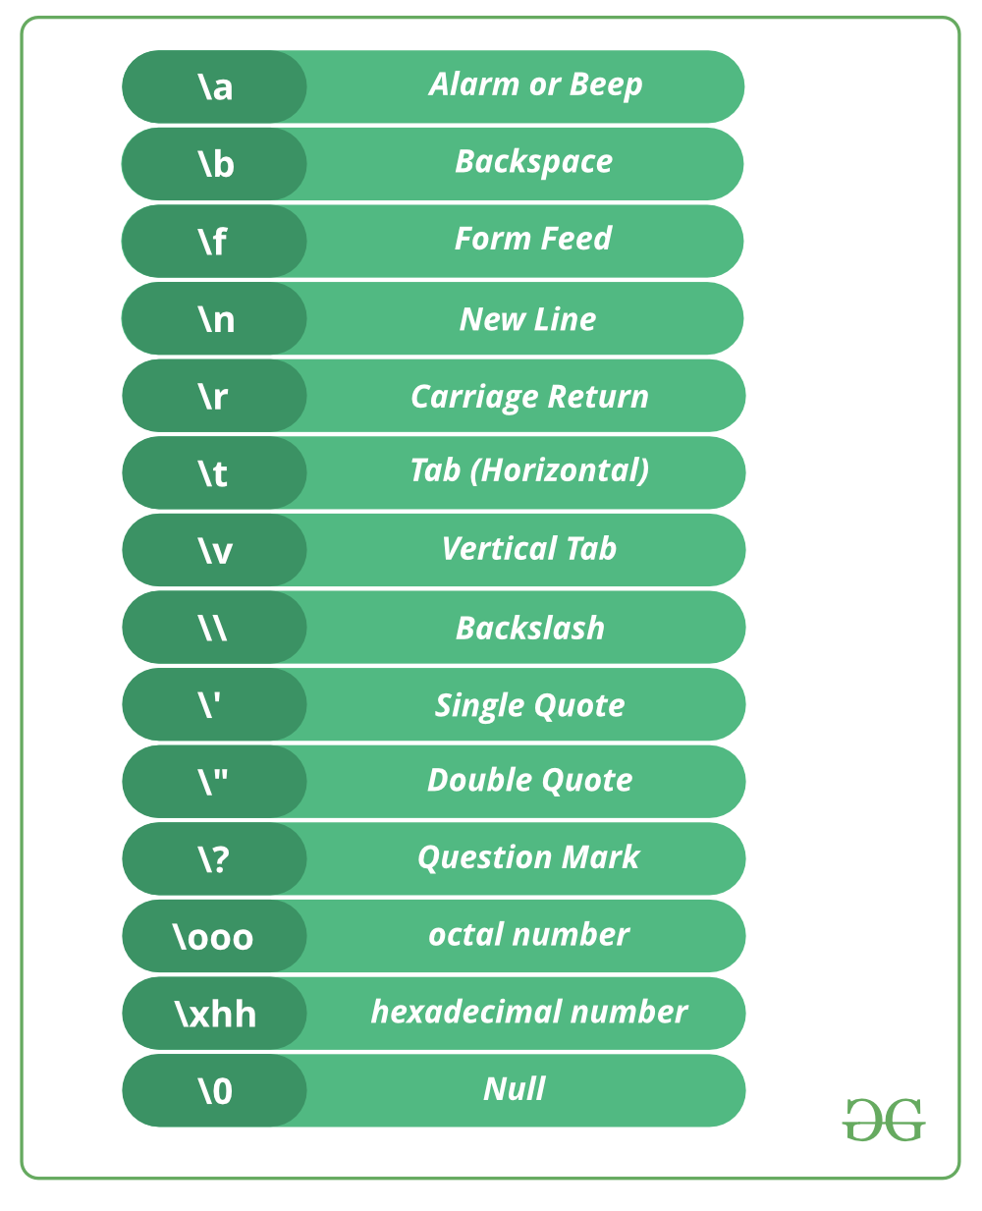
INTRODUCTION TO C
Introduction
Writing the First C Program
#include<stdio.h>
int main()
{
printf(“\n WELCOME TO THE WORLD OF C”);
return 0;
}
MEMORY
OUTPUT SCREEN
WELCOME TO THE WORLD OF C

Slide 38
INTRODUCTION TO C
Introduction
Writing the First C Program
#include<stdio.h>
int main()
{
printf(“\n WELCOME TO THE WORLD OF C”);
return 0;
}
MEMORY
OUTPUT SCREEN
WELCOME TO THE WORLD OF C

Slide 39
INTRODUCTION TO C
Introduction
Writing the First C Program
#include<stdio.h>
int main()
{
printf(“\n WELCOME TO THE WORLD OF C”);
return 0;
}
Some Rules:
1. Every Function statements are enclosed between {}
2. Every Statement ends with a SEMICOLON.

Slide 40
INTRODUCTION TO C
Introduction
Writing the First C Program
Where do we write a C program and how to run it?
Case 1: CODEBLOCKS
Download and Install it from
www.codeblocks.org › downloads

Slide 41
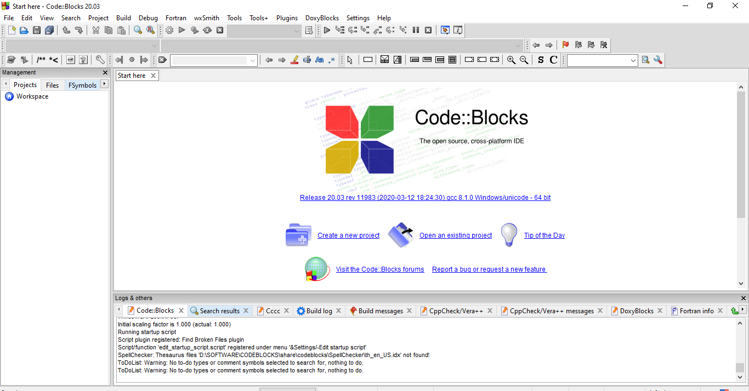
INTRODUCTION TO C
Introduction
Writing the First C Program
Where do we write a C program and how to run it?
Case 1: CODEBLOCKS
INITIAL SCREEN

Slide 42
INTRODUCTION TO C
Introduction
Writing the First C Program
Where do we write a C program and how to run it?
Case 1: CODEBLOCKS
Open New File

Slide 43
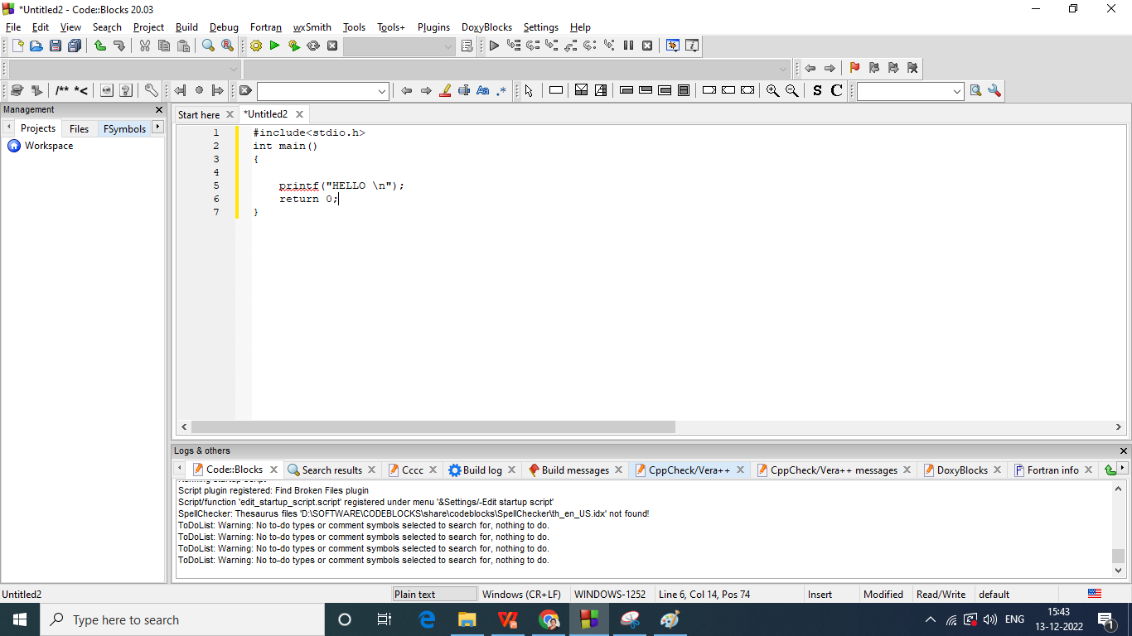
INTRODUCTION TO C
Introduction
Writing the First C Program
Where do we write a C program and how to run it?
Case 1: CODEBLOCKS
Type Your Program

Slide 44
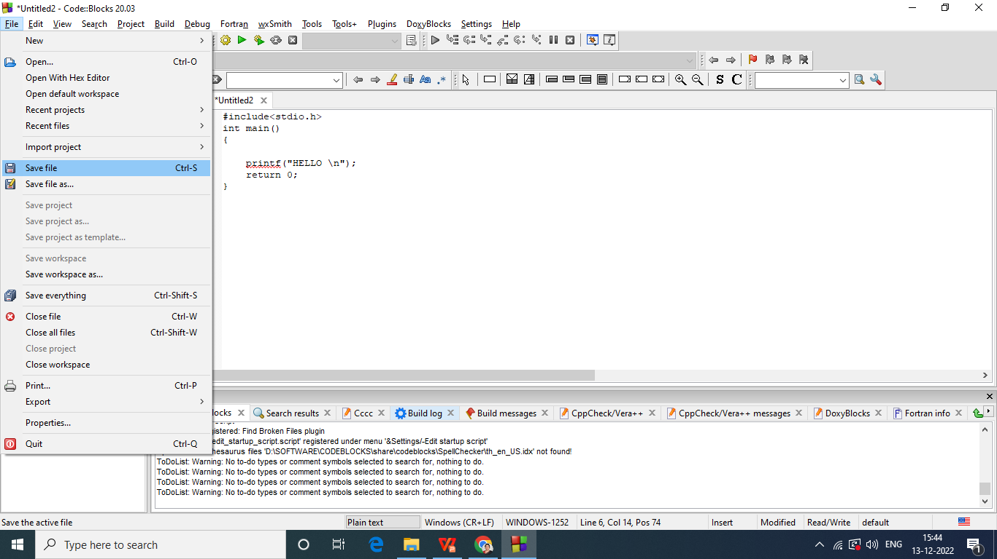
INTRODUCTION TO C
Introduction
Writing the First C Program
Where do we write a C program and how to run it?
Case 1: CODEBLOCKS
Save

Slide 45
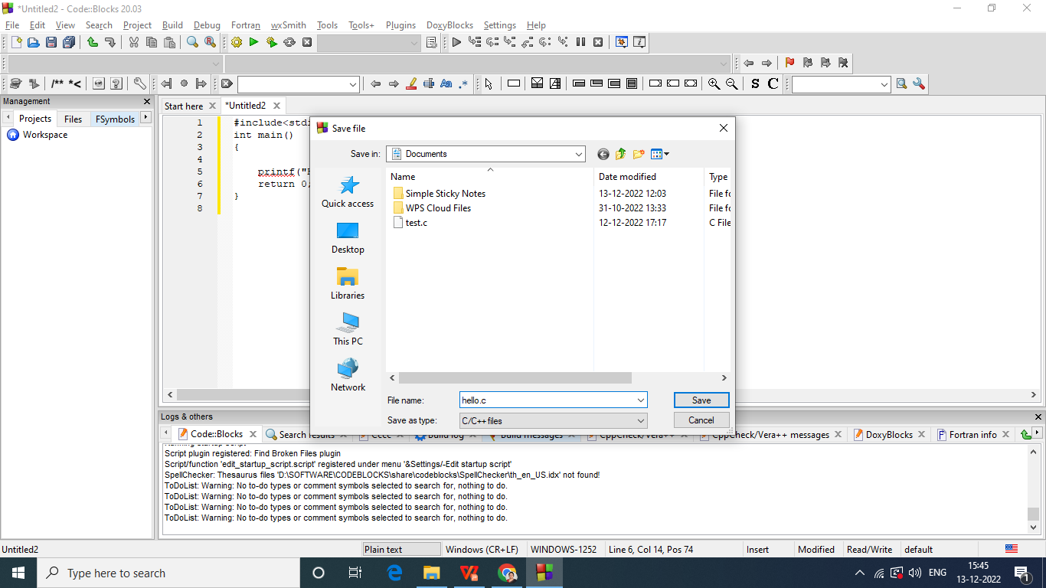
INTRODUCTION TO C
Introduction
Writing the First C Program
Where do we write a C program and how to run it?
Case 1: CODEBLOCKS
Save

Slide 46
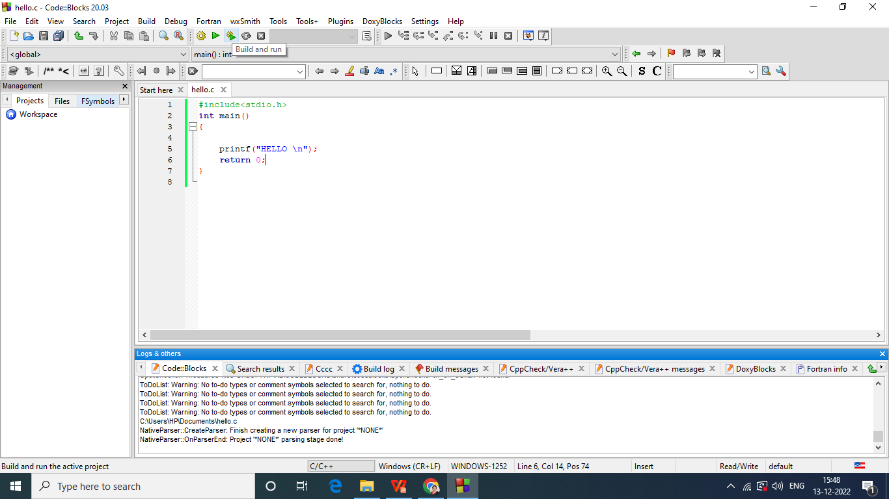
INTRODUCTION TO C
Introduction
Writing the First C Program
Where do we write a C program and how to run it?
Case 1: CODEBLOCKS
Build and Run

Slide 47
INTRODUCTION TO C
Introduction
Writing the First C Program
Where do we write a C program and how to run it?
Case 2: Install any compiler cc, gcc or tc separately on your OS
Open Notepad, Type your Program.
Save it with extension “.c”
Go to command prompt.
For cc compiler give command as “cc filename.c”
Then run program as “./a.out”

Slide 48
INTRODUCTION TO C
Introduction
Writing the First C Program
Where do we write a C program and how to run it?
Case 2: Install any compiler cc, gcc or tc separately on your OS
Open Notepad, Typw your Program.
Save it with extension “.c”
Go to command prompt.
For cc compiler give command as “cc filename.c”
Then run program as “./a.out”

Slide 49
FILES USED IN C PROGRAMS

Slide 50
FILES USED IN C PROGRAMS
Files in a C Program
SOURCE FILE
HEADER FILE
OBJECT FILE
EXECUTABLE FILE
File Extention is “.c” [Example: test.c, add.c, avg.c]
It must contain one main() function.

Slide 51
FILES USED IN C PROGRAMS
Files in a C Program
SOURCE FILE
HEADER FILE
OBJECT FILE
EXECUTABLE FILE
“.h” extension.
Used to store subroutines which can be used in multiple programs.
Advantages.
Same Subroutine in More programs: Compile the source code of subroutine once and link the object file in any other program.
Change / add subroutines which should be reflected in all the programs: Change/add new feaures, recompile and continue.

Slide 52
FILES USED IN C PROGRAMS
Files in a C Program
SOURCE FILE
HEADER FILE
OBJECT FILE
EXECUTABLE FILE
Standard Header Files
string.h
stdlib.h
stdio.h
math.h
alloc.h
conio.h

Slide 53
FILES USED IN C PROGRAMS
Files in a C Program
SOURCE FILE
HEADER FILE
OBJECT FILE
EXECUTABLE FILE
Generated by Compilers.
Contain compact binary code.
“.o” extension.

Slide 54
FILES USED IN C PROGRAMS
Files in a C Program
SOURCE FILE
HEADER FILE
OBJECT FILE
EXECUTABLE FILE
Linker uses Object file to generate executable file.
“.exe” extension.

Slide 55
COMPILING AND EXECUTING THE PROGRAMS

Slide 56
COMPILERS
C program must run through a compiler to create executable file.
C program: Human Readable.
Executable code: Machine Readable.
The source file contains
ASCII characters and can be created using EDITORS
COMPILER TRANSLATES SOURCE CODE to OBJECT CODE.

Slide 57
COMPILERS
COMPILER TRANSLATES SOURCE CODE to OBJECT CODE.
Object code contains
Machine Instructions for the CPU
Operating system API (Application Program Interface)
OBJECT FILE IS NOT EXECUTABLE FILE

Slide 58
COMPILERS
LINKERS TRANSLATES OBJECT FILE to EX

Slide 59
COMPILING AND EXECUTING C PROGRAMS

Slide 60
COMPILING AND EXECUTING C PROGRAMS
Source File
Pre-process
Compiler
Object Files
Linker
Library Files
Library Files
Executable Files
Source File
Pre-process
Compiler
Object Files
Library Files

Slide 61
USING COMMENTS
Comments make your program readable.
Single line comment: //
Multi line comments:
/*.....................
......................*/

Slide 62
VARIABLES

Slide 63
VARIABLES
How do you learn a language?
1. Alphabets
2. Words
3. Grammer to join words to statements.

Slide 64
VARIABLES
ALPHABETS OF C (Valid Characters)
1.A to Z
2. a to z
3. 0 to 9
4 Special Characters: ` ~ @ ! $ # ^ * % & ( ) [ ] { } < > + = _ – | / \ ; : ' “ , . ?
in ‘C’ characters are represented in ASCII format.
8 bits for 1 character.

Slide 65
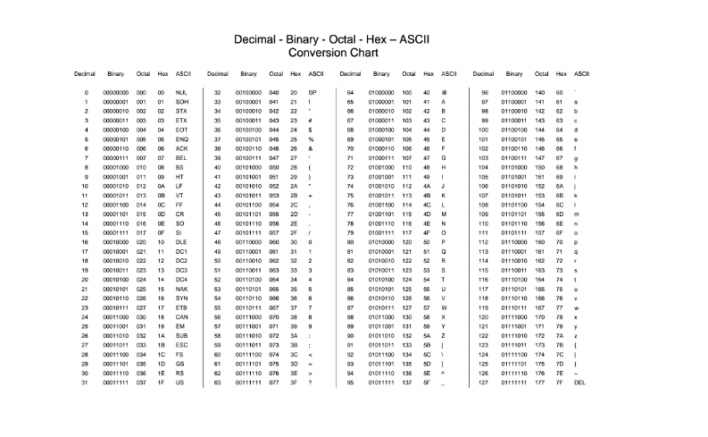
VARIABLES

Slide 66
CONSTANTS

Slide 67
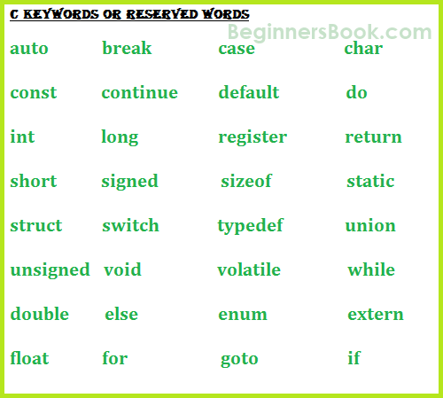
VARIABLES
WORDS OF C (Meaningful Words)
C has only 32 Meaningful words.
They are also called as “KEYWORDS”

Slide 68
VARIABLES
Finally what is a VARIABLE?
A variable is defined as a meaningful name given to the data storage location in computer memory.
Identifiers are names given to program elements such as variables and functions.
You can’t give any name.....There are some RULES to follow.......
NO Special Character EXCEPT ‘_’
NO two continuous ‘_’
NO KEYWORD
Variables are CASE SENSITIVE (FIRST≠first)
Begin with Alphabet or _

Slide 69
VARIABLES
Finally what is a VARIABLE?
A variable is defined as a meaningful name given to the data storage location in computer memory.
When using a variable, we actually refer to address of the memory where the data is stored.
There are two categories.
VARIABLES
NUMERIC
CHARACTER
1. 0 to 9, a to z, A to Z
2. Enclosed with single quote (Ex ‘a’)
int
float

Slide 70
VARIABLES
Finally what is a VARIABLE?
A variable is defined as a meaningful name given to the data storage location in computer memory.
When using a variable, we actually refer to address of the memory where the data is stored.
There are two categories.
Modifiers can be used
short
long
unsigned
signed
VARIABLES
NUMERIC
CHARACTER
1. 0 to 9, a to z, A to Z
2. Enclosed with single quote (Ex ‘a’)
int
float

Slide 71
VARIABLES
How to declare VARIABLE?
MODIFIER DATATYPE variable-name;
MODIFIER not compulsory
DATATYPE
char
int
float
double
EXAMPLE
char ch;
int num,a_val;
float a, b;
long int avg;

Slide 72
DATA TYPE | SIZE IN BYTES | RANGE
char | 1 | -128 to 127
unsigned char | 1 | 0 to 255
signed char | 1 | -128 to 127
int | 2 | -32768 to 32767
unsigned int | 2 | 0 to 65535
signed short int | 2 | -32768 to 32767
signed int | 2 | -32768 to 32767
short int | 2 | -32768 to 32767
unsigned short int | 2 | 0 to 65535
long int | 4 | -2147483648 to 2147483647
unsigned long int | 4 | 0 to 4294967295
signed long int | 4 | -2147483648 to 2147483647
float | 4 | 3.4E-38 to 3.4E+38
double | 8 | 1.7E-308 to 1.7E+308
long double | 10 | 3.4E-4932 to 1.1E+4932
VARIABLES
Finally what is a VARIABLE?
A variable is defined as a meaningful name given to the data storage location in computer memory.
When using a variable, we actually refer to address of the memory where the data is stored.
There are two categories.
VARIABLES
NUMERIC
CHARACTER
1. 0 to 9, a to z, A to Z
2. Enclosed with single quote (Ex ‘a’)
int
float

Slide 73
STREAMS
Streams are associated with a physical device such as the monitor or with a file stored on the secondary memory.
Streams in a C program
Text Stream
Binary Stream
Keyboard
Data
Terminated by ‘\n’ (new line)
Monitor
Data

Slide 74
CONSTANTS
Constants are identifiers whose value does not change.
To declare a constant, precede the normal variable declaration with const keyword.
const float pi = 3.14;
#define PI 3.14159 --> Preprocessor Directive
RULES
Usually CAPITAL LETTERS are used. Just to make them lookk different compared to others.
No space between # and define (#define)
#define is a pre-processor compiler directive and not a statement. Therefore, it does not end with a semi-colon.

Slide 75
INPUT-OUTPUT STATEMENTS IN C

Slide 76
INPUT-OUTPUT STATEMENTS IN C
printf() function
Display String and Variable Values
Defined in stdio.h
Format: prontf(“CONTROL STRING”, VARIABLE LIST);
It includes
Strings to be displayed
Format Specifiers
Escape Sequence

Slide 77
INPUT-OUTPUT STATEMENTS IN C
printf() function
Display String and Variable Values
Defined in stdio.h
Format: prontf(“CONTROL STRING”, VARIABLE LIST);
It includes
Strings to be displayed
Format Specifiers
Escape Sequence
EXAMPLE
printf(“HI MY NAME IS ASHWINI”);
Double Quotes Very Important
No Variable List is optional

Slide 78
INPUT-OUTPUT STATEMENTS IN C
printf() function
Display String and Variable Values
Defined in stdio.h
Format: prontf(“CONTROL STRING”, VARIABLE LIST);
FORMAT: %[flags][width][.precision][length]specifier
EXAMPLE: printf(“Result=%d”,c);
It includes
Strings to be displayed
Format Specifiers
Escape Sequence
Some integer has to be printed here
That integer is stored in variable c.

Slide 79
INPUT-OUTPUT STATEMENTS IN C
printf() function
Length | Description
h | When the argument is a short int or unsigned short int.
l | When the argument is a long int or unsigned long int for integer specifiers.
L | When the argument is a long double (used for floating point specifiers)
Display String and Variable Values
Defined in stdio.h
Format: prontf(“CONTROL STRING”, VARIABLE LIST);
Flag | Description
- | Left-justify within the data given field width
+ | Displays the data with its numeric sign (either + or -)
# | Used to provide additional specifiers like o, x, X, 0, 0x or 0X for octal and hexa decimal values respectively for values different than zero.
0 | The number is left-padded with zeroes (0) instead of spaces
FORMAT: %[flags][width][.precision][length]specifier
It includes
Strings to be displayed
Format Specifiers
Escape Sequence

Slide 80
INPUT-OUTPUT STATEMENTS IN C
Specifier | Qualifying Input
c | For single character
d | For decimal values
F, f | For floating point numbers
E, e | Floating point numbers in exponential format
G, G | Floating point numbers in the shorter of e format
o | For Octal number.
s | For a sequence of (string of) characters
u | For Unsigned decimal value
x,X | For Hexadecimal value.
printf() function
Display String and Variable Values
Defined in stdio.h
Format: prontf(“CONTROL STRING”, VARIABLE LIST);
FORMAT: %[flags][width][.precision][length]specifier
It includes
Strings to be displayed
Format Specifiers
Escape Sequence

Slide 81
INPUT-OUTPUT STATEMENTS IN C
printf() function
Display String and Variable Values
Defined in stdio.h
Format: prontf(“CONTROL STRING”, VARIABLE LIST);
An escape sequence is a sequence of characters that does not represent itself when used inside a character or string literal, but is translated into another character or a sequence of characters that may be difficult or impossible to represent directly.
It includes
Strings to be displayed
Format Specifiers
Escape Sequence

Slide 82
INPUT-OUTPUT STATEMENTS IN C
printf() function
Display String and Variable Values
Defined in stdio.h
Format: prontf(“CONTROL STRING”, VARIABLE LIST);
It means that they are treated differently....
Or they represent something which directly you can’t represrent
It includes
Strings to be displayed
Format Specifiers
Escape Sequence

Slide 83
INPUT-OUTPUT STATEMENTS IN C
printf() function
Display String and Variable Values
Defined in stdio.h
Format: prontf(“CONTROL STRING”, VARIABLE LIST);
It means that they are treated differently....
Or they represent something which directly you can’t represrent
It includes
Strings to be displayed
Format Specifiers
Escape Sequence

Slide 84
INPUT-OUTPUT STATEMENTS IN C
printf() function
#include<stdio.h>
main()
{
int a,b;
float c,d;
a = 15;
b = a / 2;
printf("%d\n",b);
printf("%3d\n",b);
printf("%03d\n",b);
c = 16.3;
d = c / 3;
printf("%3.2f\n",d);
printf(“%4.3f\n”,d)
}
OUTPUT SCREEN
7
7
007
5.43
5.433
MEMORY
a | 15
b | 7
c | 15.3
d | 5.1

Slide 85
INPUT-OUTPUT STATEMENTS IN C
printf() function
#include<stdio.h>
main()
{
float c,d;
c = 16.3;
d = c / 3;
printf("%8.2f\n",d);
printf("%8.3f\n",d);
printf("%8.4f\n",d);
printf("%8.5f\n",d);
printf("%8.6f\n",d);
}
OUTPUT SCREEN
5.43
5.433
5.4333
5.43333
5.433333
MEMORY
c | 16.3
d | 5.43333333333

Slide 86
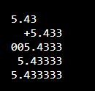
INPUT-OUTPUT STATEMENTS IN C
printf() function
#include<stdio.h>
main()
{
float c,d;
c = 16.3;
d = c / 3;
printf("%-8.2f\n",d);
printf("%+8.3f\n",d);
printf("%08.4f\n",d);
printf("%8.5f\n",d);
printf("%8.6f\n",d);
}
OUTPUT SCREEN
MEMORY
c | 16.3
d | 5.43333333333

Slide 87
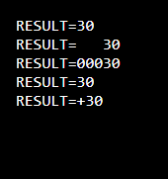
INPUT-OUTPUT STATEMENTS IN C
printf() function
#include<stdio.h>
main()
{
int a=10,b=20,c;
c = a+b;
printf("RESULT=%d\n", c);
printf("RESULT=%5d\n", c);
printf("RESULT=%05d\n", c);
printf("RESULT=%-5d\n", c);
printf("RESULT=%+d\n", c);
}
OUTPUT SCREEN
MEMORY
a | 10
b | 20
c | 30

Slide 88
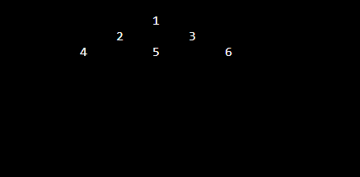
INPUT-OUTPUT STATEMENTS IN C
printf() function
#include<stdio.h>
main()
{
printf(“%40d”,1);
printf("%35d", 2);
printf("%10d\n", 3);
printf("%30d", 4);
printf("%10d", 5);
printf("%10d\n", 6);
}
OUTPUT SCREEN
MEMORY

Slide 89
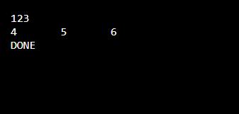
INPUT-OUTPUT STATEMENTS IN C
printf() function
#include<stdio.h>
main()
{
printf("%d", 1);
printf("%d", 2);
printf("%d\n", 3);
printf("%d\t", 4);
printf("%d\t", 5);
printf("%d\n", 6);
printf("DONE");
}
OUTPUT SCREEN
MEMORY

Slide 90
INPUT-OUTPUT STATEMENTS IN C
OUTPUT SCREEN
scanf() function
To read formatted data.
Format: scanf (“control string”, arg1, arg2, ………….argn);
#include<stdio.h>
main()
{
int num;
printf(“\n ENTER A NUMBER :\n “);
scanf("%d", &num);
printf("\n FOR YOUR KIND INFORMATION, YOU ENTERED %d\n", num);
printf(“THANK YOU”);
}
MEMORY

Slide 91
INPUT-OUTPUT STATEMENTS IN C
OUTPUT SCREEN
scanf() function
To read formatted data.
Format: scanf (“control string”, arg1, arg2, ………….argn);
#include<stdio.h>
main()
{
int num;
printf(“\n ENTER A NUMBER : \n“);
scanf("%d", &num);
printf("\n FOR YOUR KIND INFORMATION, YOU ENTERED %d\n", num);
printf(“THANK YOU”);
}
MEMORY
num

Slide 92
INPUT-OUTPUT STATEMENTS IN C
OUTPUT SCREEN
scanf() function
ENTER A NUMBER
To read formatted data.
Format: scanf (“control string”, arg1, arg2, ………….argn);
#include<stdio.h>
main()
{
int num;
printf(“\n ENTER A NUMBER :\n “);
scanf("%d", &num);
printf("\n FOR YOUR KIND INFORMATION, YOU ENTERED %d\n", num);
printf(“THANK YOU”);
}
MEMORY
num

Slide 93
INPUT-OUTPUT STATEMENTS IN C
OUTPUT SCREEN
scanf() function
ENTER A NUMBER
10
To read formatted data.
Format: scanf (“control string”, arg1, arg2, ………….argn);
#include<stdio.h>
main()
{
int num;
printf(“\n ENTER A NUMBER :\n “);
scanf("%d", &num);
printf("\n FOR YOUR KIND INFORMATION, YOU ENTERED %d\n", num);
printf(“THANK YOU”);
}
MEMORY
num | 10

Slide 94
INPUT-OUTPUT STATEMENTS IN C
OUTPUT SCREEN
scanf() function
ENTER A NUMBER
10
FOR YOUR KIND INFORMATION, YOU ENTERED 10
To read formatted data.
Format: scanf (“control string”, arg1, arg2, ………….argn);
#include<stdio.h>
main()
{
int num;
printf(“\n ENTER A NUMBER :\n “);
scanf("%d", &num);
printf("\n FOR YOUR KIND INFORMATION, YOU ENTERED %d\n", num);
printf(“THANK YOU”);
}
MEMORY
num | 10

Slide 95
INPUT-OUTPUT STATEMENTS IN C
OUTPUT SCREEN
scanf() function
ENTER A NUMBER
10
FOR YOUR KIND INFORMATION, YOU ENTERED 10
THANK YOU
To read formatted data.
Format: scanf (“control string”, arg1, arg2, ………….argn);
#include<stdio.h>
main()
{
int num;
printf(“\n ENTER A NUMBER :\n “);
scanf("%d", &num);
printf("\n FOR YOUR KIND INFORMATION, YOU ENTERED %d\n", num);
printf(“THANK YOU”);
}
MEMORY
num | 10

Slide 96
INPUT-OUTPUT STATEMENTS IN C
scanf() function
#include<stdio.h>
main()
{
int num;
float fnum;
char ch, str[10];
double dnum;
short snum;
long int lnum;
printf(“\n Enter the values : “);
scanf("%d %f %c %s %e %hd %ld", &num, &fnum, &ch, str, &dnum, &snum, &lnum);
printf("\n num = %d \n fnum = %.2f \n ch = %c \n str = %s \n dnum = %e \n snum = %hd \n lnum = %ld", num, fnum, ch, str, dnum, snum, lnum);
}

Slide 97
OPERATORS IN C
ARITHMETIC OPERATORS
OPERATION | OPERATOR | SYNTAX
Multiply | * | a * b
Divide | / | a / b
Addition | + | a + b
Subtraction | - | a - b
Modulus | % | a % b
RELATIONAL OPERATORS
OPERATOR | MEANING | EXAMPLE
< | LESS THAN | 3 < 5 GIVES 1
> | GREATER THAN | 7 > 9 GIVES 0
>= | LESS THAN OR EQUAL TO | 100 >= 100 GIVES 1
<= | GREATER THAN EQUAL TO | 50 >=100 GIVES 0

Slide 98
OPERATORS IN C
EQUALITY OPERATORS
OPERATOR | MEANING
= = | RETURNS 1 IF BOTH OPERANDS ARE EQUAL, 0 OTHERWISE
!= | RETURNS 1 IF OPERANDS DO NOT HAVE THE SAME VALUE, 0 OTHERWISE
LOGICAL OPERATORS
A | B | A &&B
0 | 0 | 0
0 | 1 | 0
1 | 0 | 0
1 | 1 | 1
A | B | A || B
0 | 0 | 0
0 | 1 | 1
1 | 0 | 1
1 | 1 | 1
A | ! A
0 | 1
1 | 0

Slide 99
OPERATORS IN C
CONDITIONAL OPERATORS
OPERATOR | MEANING
exp1 ? exp2:exp3 | IF “exp1”=TRUE THEN “exp2” will be executed ELSE “exp3” will be executed
int a=10, b=20, large;
large=a>b?a:b;
printf(“LARGE IS %d\n”,large);

Slide 100
OPERATORS IN C
BITWISEOPERATORS
OPERATOR | MEANING
& (BITWISE AND) | 0 & 0 = 0 0 & 1 = 0 1 & 0 = 0 1 & 1 = 1
| (BITWISE OR) | 0 & 0 = 0 0 & 1 = 1 1 & 0 = 1 1 & 1 = 1
^ (BITWISE XOR) | 0 ^ 0 = 0 0 ^ 1 = 1 1 ^ 0 = 1 1 ^ 1 = 0
~ (BITWISE NOT) | ~0=1 ~1=0
int a=10, b=20, and, or,xor, not;
and=a&b;
or=a|b;
xor=a^b;
not=~a;
printf(“RESULT OF BIT-AND IS %d\n”,and);
printf(“RESULT OF BIT-OR IS %d\n”,or);
printf(“RESULT OF BIT-XOR IS %d\n”,xor);
printf(“RESULT OF BIT-NOT IS %d\n”,not);

Slide 101
OPERATORS IN C
ASSIGNMENT OPERATORS
COMMA OPERATORS
OPERATOR | MEANING
= | a=10; a=b=c=10;
+= | a+=10; (Same as a=a+10)
-= | a- =10;
*= | a*=
/= | a/=10;
OPERATOR | USAGE | MEANING
, | int a=2, b=3, x=0; x=(++a, b+=a) | Left to Right. a=3, b=3+3=6 x=6
SIZEOF OPERATORS
OPERATOR | USAGE
sizeof(variable) | int a,res; res=sizeof(int); printf(“SIZE OF INTEGER=%d”,res);

Slide 102
TYPE CONVERSION AND TYPE CASTING
Required when an expression has variables of different data types.
Data Types are PROMOTED (LOWER TO HIGHR DATA TYPES)
Hierarchy (LOWER TO HIGHER)
char || short || int || long || float || double
char ch;
int i;
float f;
double d, res;
res=(ch+i)×(f/i)+(d-f)
float x;
int y=3;
x=y;
double
x=3.0
int
float
double
float

Slide 103
TYPE CONVERSION AND TYPE CASTING
Required when an expression has variables of different data types.
Data Types are PROMOTED (LOWER TO HIGHR DATA TYPES)
Hierarchy (LOWER TO HIGHER)
char || short || int || long || float || double
float f=3.5;
int i;
i=f;
char ch;
int i;
i=1234;
ch=i
Forcefully Demoting FLOAT to INT
i=3 (Data is lost)
i=0000010011010010 (Binary equ. of 1234)
ch=11010010 (Last 8 bits)

Slide 104
TYPE CONVERSION AND TYPE CASTING
Type Casting
1. Forced Conversion.
Explicitly telling the compiler to represent the value of expression in some format.
float sal=10000.00
int s;
s=(int) salary;
int a=500, b=70;
float res;
res=(float) a/b;
res=(int) 9.5;
9.5 is converted to 9
res=(int) 12.3/(int) 4.2;
same as 12/4
res=(double)total/n;
total data type converted to double
res=(int) (a+b);
Result of addition is converted to int
res=(int)a+b;
a is converted to int and added to b

