Slide 1
OBJECT ORIENTED PROGRAMMING WITH JAVA

Slide 3
SOURCE CODE
(.java)
COMPILE
(javac)
.class file
WINDOWS JVM
LINUX JVM
MACOS JVM

Slide 4
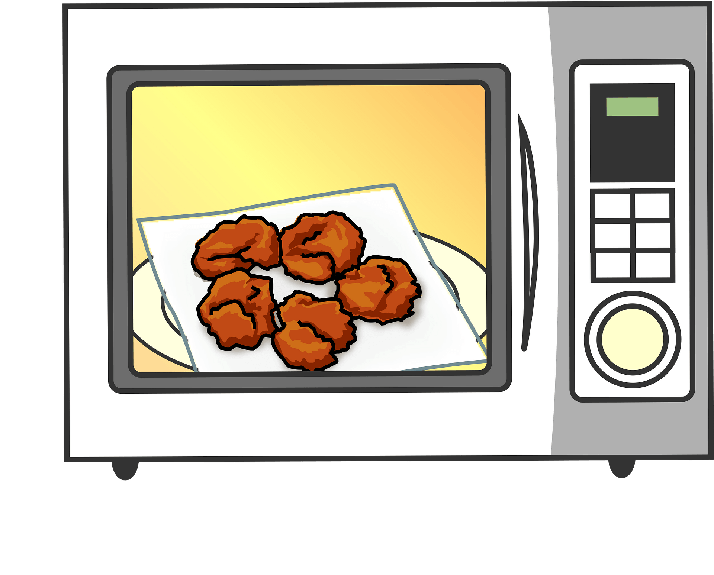
Java was designed to run on consumer electronic devices
JAMES GOSLING->Green Team to design new language
Original name Green Talk
Renamed as Oak-symbol of strength
Legal snags let to a new name – came Coffee Java

Slide 5
The two paradigms of programming

Slide 6
Differences between 2 paradigms
Code divided into procedures/functions
Top down approach
Communication via function calls
Less reusable (function)
Less flexible (function)
No data security
Code divided into classes
Bottom up approach
Objects communicate with message passing
More resuable (class)
More flexible (class)
Provides data security
STRUCTURED/
PROCEDURAL
OBJECT ORIENTED

Slide 8
Abstraction

Slide 9
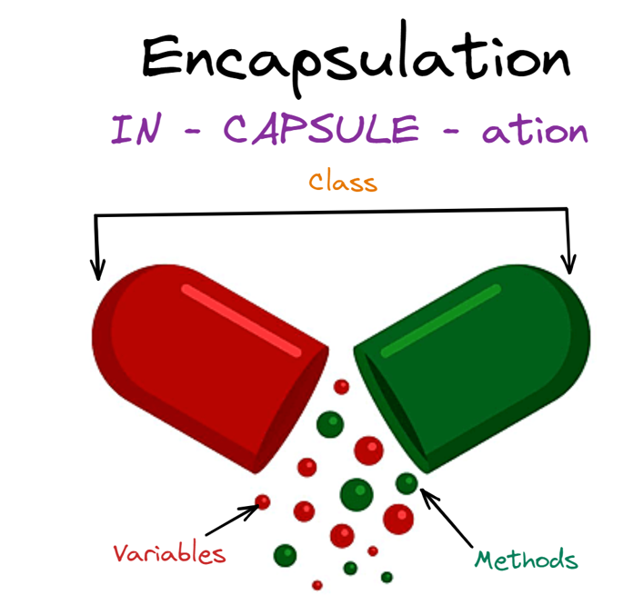

Slide 10
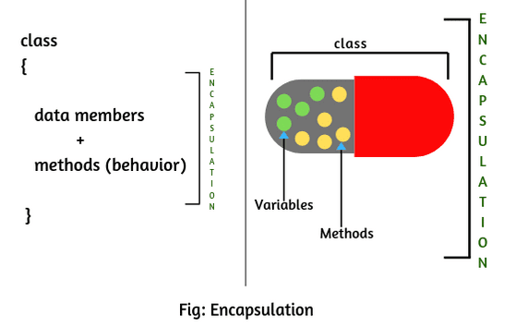

Slide 11
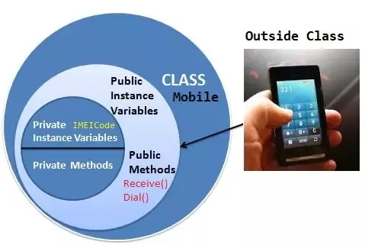

Slide 13
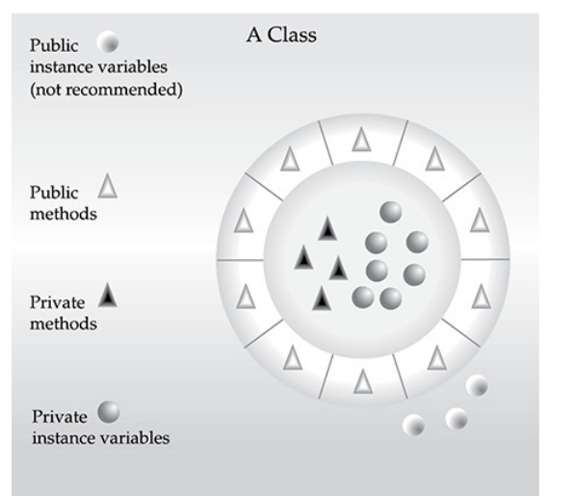

Slide 14
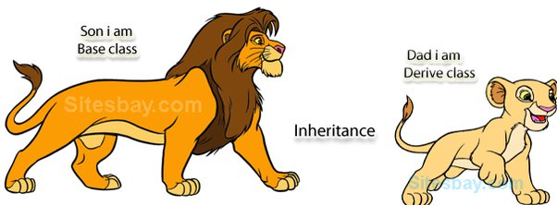

Slide 15
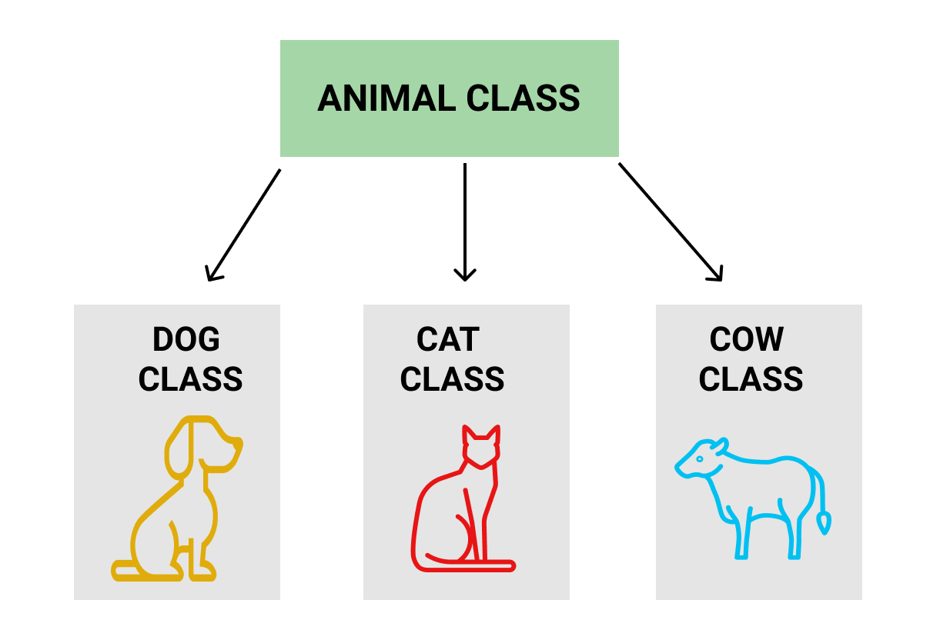

Slide 18
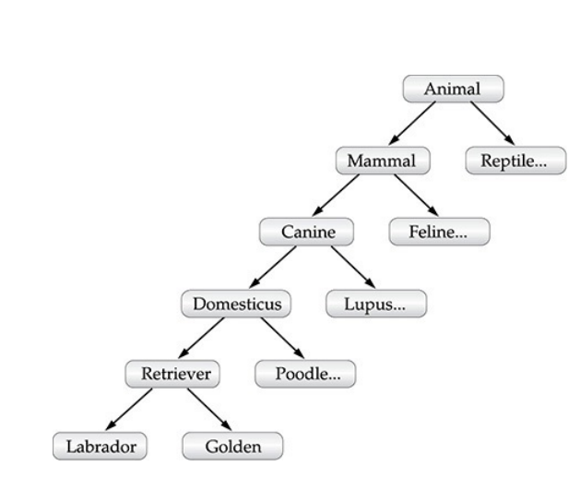
SUPER CLASS AND SUBCLASS
PARENT AND CHILD
BASE AND DERIVED

Slide 19
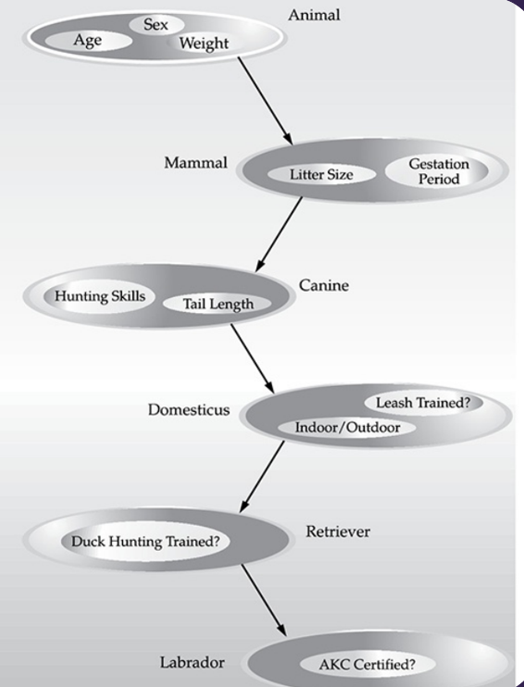

Slide 21
POLY
MORPHISM

Slide 22
Example polymorphic situations:
Area of geometrical shapes
Speaking of various animals
Currency of countries
Use of chalkpiece

Slide 23
E
A
OOP
I
P

Slide 24
Lets start exercising

Slide 25
First program: Greeting
Second program: Greeting someone
Third program: Greeting anyone
Fourth program: Who is taller

Slide 26
Fifth program: Who is tallest

Slide 28
long
64bits
int
32bits
short
16bits
byte
8bits

Slide 29
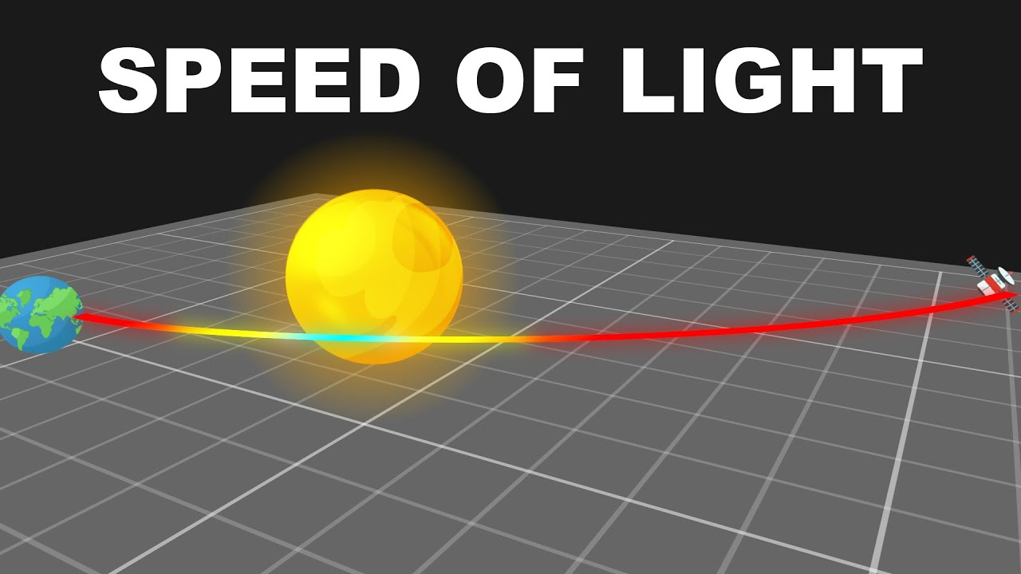
Compute the distance travelled for n days
Given: speed of light=186000

Slide 30
double
64bits
Double precision
float
32bits
Single precision
WAJP: Area of circle

Slide 31
Characters
16 bits
Unicode
No negative characters
WAJP: Print all English alphabets

Slide 32
WAJP: Report Boolean answer PASS or FAIL based on marks of a student

Slide 33
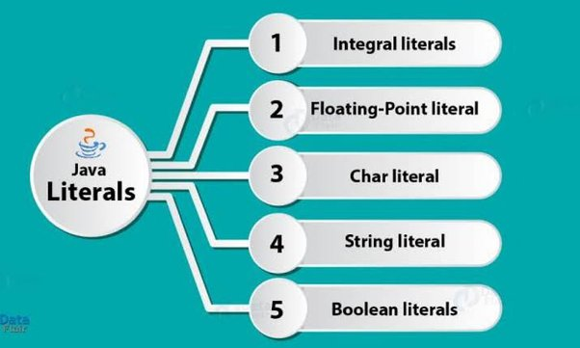

Slide 34
Dynamic Initialization of variables

Slide 35
Scope and Lifetime of variables
Scope of variable – Area of the code where variable is visible
Lifetime of variable – Duration when variable exists in the memory
Block
WAJP: Demonstrating the scope and lifetime of variable
METHOD
CLASS
Types of Scope

Slide 36
Type conversion and casting
Automatic
Automatic
Explicit
Explicit
Compatible/large
Widening
Incompatible
Narrowing
WAJP: Demonstrate type casting

Slide 37
WAJP: Demonstrate Automatic Type promotions in expression

Slide 38
Declaring arrays – 2 ways
Memory allocation only using new
Initialization possible

Slide 39
WAJP: Find average of a double array of 5 elements
WAJP: Demonstration of a 3D array

Slide 40
Jagged Teeth

Slide 41
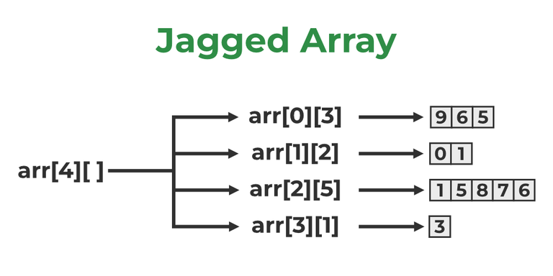
WAJP: Create Jagged Array as shown above

Slide 42
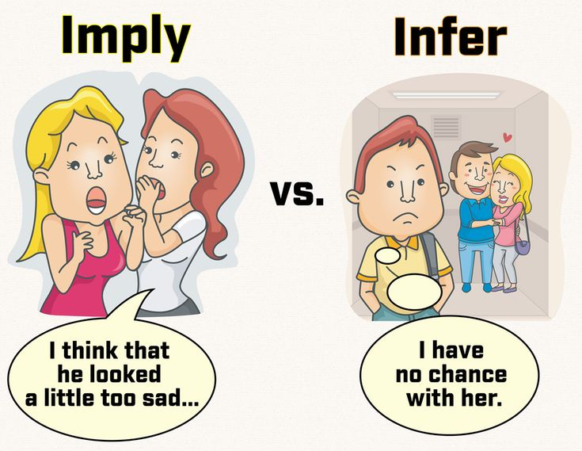

Slide 43
Type Inference with Local Variables.
WAJP: To demonstrate var keyword for inference and as a variable

Slide 45
WAJP: To demonstrate modulus operator for both integer and double
WAJP: To demonstrate pre and post increment operators
WAJP: To demonstrate bitwise operators &,|,~

Slide 46
WAJP: To demonstrate bitwise operators <<(left shift)
WAJP: To demonstrate bitwise operators >>(right shift)
>>> (unsigned right shift)

Slide 47
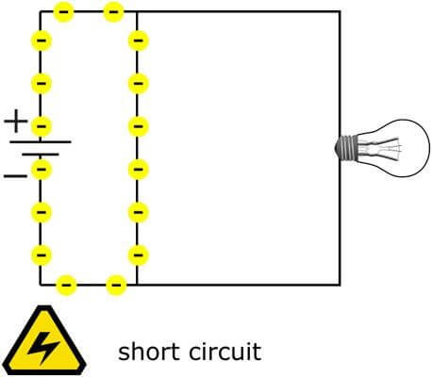
Short Circuit operators -&&, ||

Slide 48
WAJP: To demonstrate guarded division
WAJP: To find absolute value of number

Slide 49
WAJP: To find mid point of 2 numbers using while loop with null statement

Slide 50
Variations of for loop
for loop dedicated for an array without indexing
Demonstration of break and continue
Demonstration of labelled break and continue

Slide 51
Local variable type inference in for loop
Pattern Generation program

