Slide 1


MICRO-CONTROLLER AND EMBEDDED SYSTEMS (MES)

Slide 2

ARM INSTRUCTIONS
Different ARM revisions have various instruction sets
Express capabilities of ARM processor
PRE and POST conditions
PRE <preconditions>
INSTRUCTION(s)
POST<postconditions>
No direct memory access
In case of registers, usually destination first

Slide 3
DATA PROCESSING INSTRUCTIONS
MULTIPLY
MOVE
Arithmetic
Logical
Comparison
Operate on Registers
If suffix S is added, flags in cpsr is updated.
MOV and Logical instructions update C, N and Z flags

Slide 4

MOVE INSTRUCTIONS
Simplest ARM instruction
Used to set initial values and transfer data between registers
Syntax:
instruction{cond}{S} Rd, N
N-register or immediate value
MOV
MVN

Slide 5
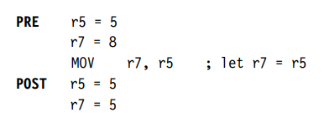
MOV example

Slide 6
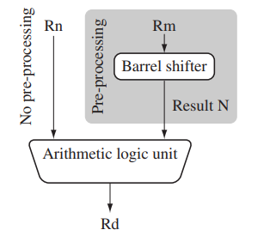
BARREL SHIFTER
Unique and powerful feature of ARM to shift data left or right by specified positions before used in instructions
However, instructions MUL, CLZ, and QADD does not use barrel shifter!!

Slide 7



Barrel shifter example

Slide 8
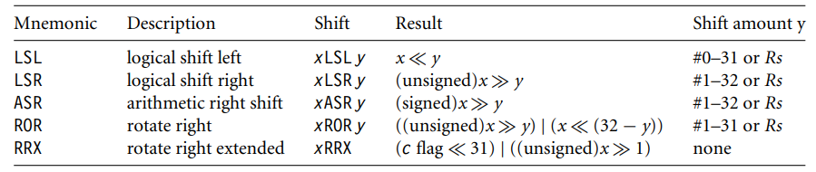
BARREL SHIFTER OPERATIONS

Slide 9
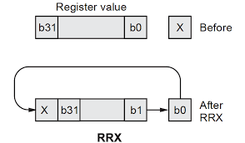

Slide 10


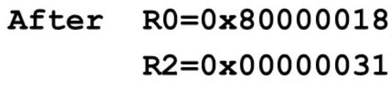

Slide 11
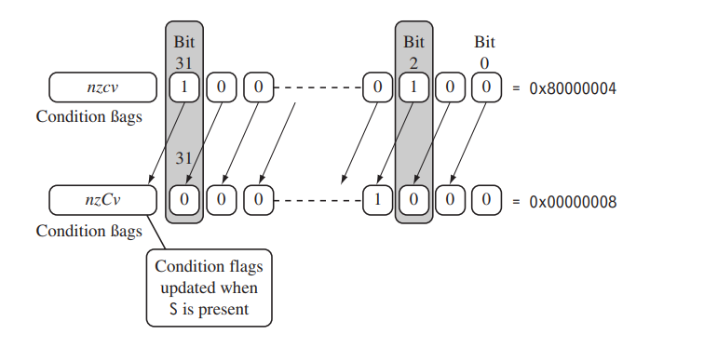
IMPACT OF BARREL SHIFTER ON CONDITION FLAGS

Slide 12
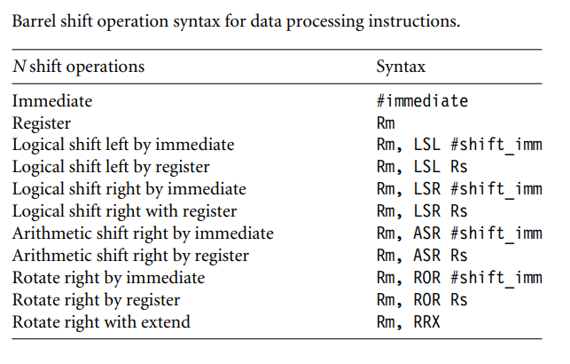

Slide 13


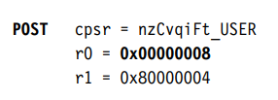
Barrel shifter with cpsr update example

Slide 14
ARITHMETIC INSTRUCTIONS
Syntax: instruction{<cond>}{S} Rd, Rn, N
ADC
Add with Carry
Rd=Rn+N+carry
ADD
Add without carry
Rd=Rn+N
RSB
Reverse Subtract
Rd=N-Rn
RSC
Reverse Subtract with Carry
Rd=N-Rn-carry
Subtract with Carry
Rd=Rn-N-carry
SBC
SUB
Subtract without carry
Rd=Rn-N

Slide 15



Arithmetic Instruction examples

Slide 16



Arithmetic Instruction examples

Slide 17



Arithmetic Instruction examples

Slide 18



Arithmetic Instruction with Barrel Shifter

Slide 19
LOGICAL INSTRUCTIONS
Syntax: instruction{<cond>}{S} Rd, Rn, N
AND
Logical bitwise AND
Rd=Rn & N
ORR
Logical bitwise OR
Rd=Rn | N
EOR
Exclusive OR
Rd=Rn ^ N
BIC
Logical bit clear
Rd=Rn & ~N

Slide 20



Logical Instruction Example

Slide 21



Logical Instruction Example

Slide 22
COMPARISON INSTRUCTIONS
Affects only cpsr
Syntax: instruction{<cond>}{S} Rn, N
CMN
Compare negated
Rn + N
CMP
Compare
Rn - N
TEQ
Test for equality
Rn ^ N
TST
Test bits
Rn & N

Slide 23



Comparison Instructions

Slide 24
Multiplication INSTRUCTIONS
Syntax: MLA{<cond>}{S} Rd, Rm,Rs, Rn
MUL {<cond>}{S} Rd, Rm, Rs
MLA
Multiply and accumulate
Rd=(Rm*Rs)+Rn
MUL
Multiply
Rd=Rm*Rs

Slide 25
SIGNED MULTIPLICATION
Syntax: instruction{<cond>}{S} RdLo, ,RdHi, Rm, Rs
SMLAL
Signed multiply accumulate long
[RdHi, RdLo]=
[RdHi, RdLo] +(Rm*Rs)
SMULL
Signed multiply long
[RdHi, RdLo]=Rm*Rs
UMLAL
Unsigned multiply accumulate long
[RdHi, RdLo]=
[RdHi, RdLo] +(Rm*Rs)
UMULL
Unsigned multiply long
RdHi, RdLo]=Rm*Rs

Slide 26
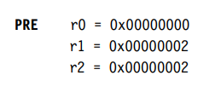

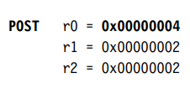
Multiplication example

Slide 27
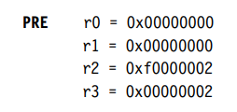


Multiplication example

Slide 28

BRANCHES OF A TREE

Slide 29
BRANCH INSTRUCTIONS
Syntax: instruction{<cond>} label | Rm
B
Branch
pc=label
BL
Branch with link
pc=label
lr-return address
BX
Branch exchange
pc=Rm & 0xfffffffe
BLX
pc=Rm & 0xfffffffe
lr=return address
Branch exchange with link

Slide 30
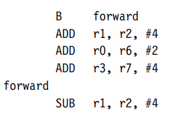
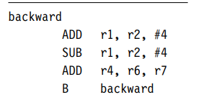
Forward and backward branches

Slide 31
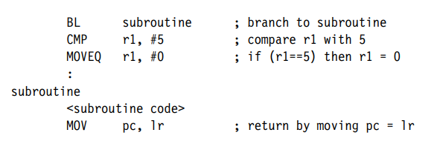
BRANCH TO SUBROUTINES

Slide 32



Slide 33
LOAD AND STORE INSTRUCTIONS
SINGLE REGISTER
MULTIPLE REGISTER
SWAP

Slide 34
Register
Memory
LOAD
Register
Memory
STORE

Slide 35

SINGLE REGISTER TRANSFER
B
A
S
E
R
E
G
I
S
T
E
R
LDR – Load Word
LDRH – Load Half word
LDRB – Load byte
LDRSB – Load signed byte

Slide 36

STR – Store Word
STRH – Store Half word
STRB – Store byte
STRSB – Store signed byte

Slide 37
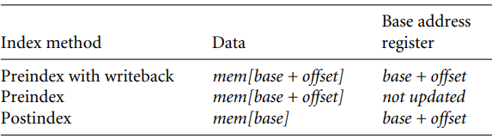
SINGLE REGISTER LOAD STORE ADDRESSING MODES

Slide 38
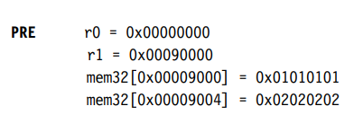


Preindex with writeback

Slide 39


Preindex

Slide 40


Postindex

Slide 41
OFFSET CLASSES OF SINGLE REGISTER LOAD STORE ADDRESSING MODES
SIGNED:
+/-
Register (Rm)
Immediate (12bit)
Scaled: Barrel shifter use with offset

Slide 42
With writeback
Examples
LDR r0, [r1,#4]!
Immediate class
r0=mem32[r1+0x4]
r1=r1+0x4
LDR r0, [r1,r2]!
Register class
r0=mem32[r1+r2]
r1=r1+r2

Slide 43
With writeback
Examples
LDR r0, [r1,r2,LSR#0x4]!
Scaled class
r0=mem32[r1+(r2<<0x4)]
r1=r1+(r2<<0x4)
Only preindex example
LDR r0, [r1,#4]
Immediate class
r0=mem32[r1+4]
r1=not updated

Slide 44
Only Preindex
Examples
LDR r0, [r1,r2]
Register class
r0=mem32[r1+r2]
r1=not updated
LDR r0, [r1,-r2,LSR #0x4]
Scaled class
r0=mem32[r1+-(r2<<0x4)]
r1=not updated

Slide 45
Post index
Examples
LDR r0, [r1],#4
Immediate class
r0=mem32[r1]
r1=r1+4
LDR r0, [r1],r2
Register class
r0=mem32[r1]
r1=r1+r2

Slide 46
Post index
Examples
LDR r0, [r1],r2 LSR #0x4
Scaled class
r0=mem32[r1]
r1=r1+(r2<<0x4)

Slide 47
Variations of STRH
STRH r0, [r1,#0x4]!
Preindex with writeback
Immediate class
mem16[r1+0x4]=r0
r1=r1+0x4
STRH r0, [r1,r2]!
Preindex with writeback
Register class
mem16[r1+r2]=r0
r1=r1+r2

Slide 48
STRH r0, [r1,#0x4]
Variations of STRH
Preindex
Immediate class
mem16[r1+0x4]=r0
r1=not updated
STRH r0, [r1,r2]
Preindex
Register class
mem16[r1+r2]=r0
r1=r1+r2

Slide 49
STRH r0, [r1], #0x4
Variations of STRH
Postindex
Immediate class
mem16[r1]=r0
r1=r1+0x4
STRH r0, [r1], r2
Postindex
Register class
mem16[r1]=r0
r1=r1+r2

Slide 50
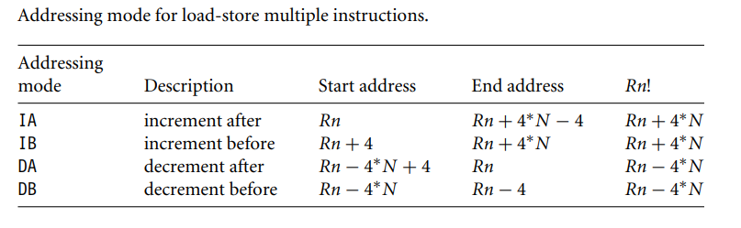
LOAD-STORE MULTIPLE REGISTER TrANSFER

Slide 51

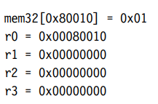


Slide 52
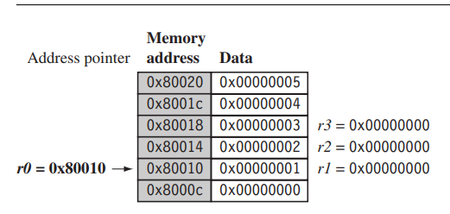
BEFORE LDMIA execution

Slide 53
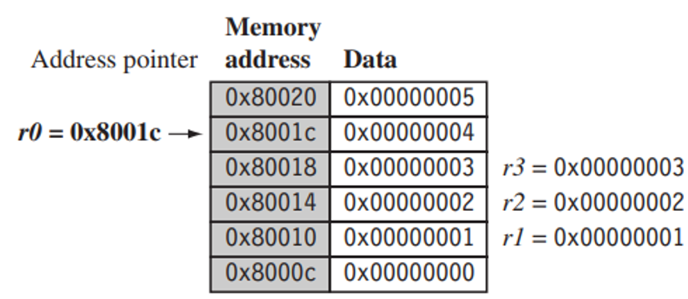
AFTER LDMIA execution

Slide 54
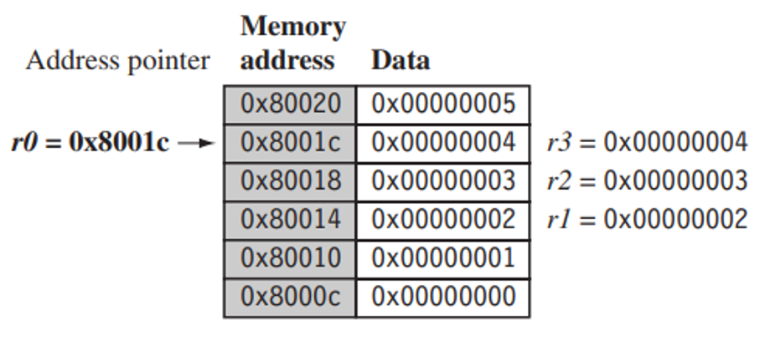
AFTER LDMIB execution

Slide 55
Block memory copy -ALP
loop:
LDMIA r9!, {r0-r7}
STMIA r10, {r0-r7}
CMP r9, r11
BNE loop

Slide 56
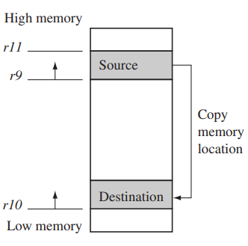
Block memory copy example- Memory map

Slide 57
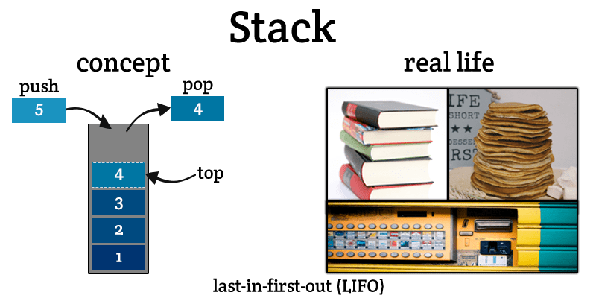

Slide 58
ARM implementation of Stack
PUSH – push data to stack – STRM instruction
POP – pop data from stack – LDRM instruction

Slide 59
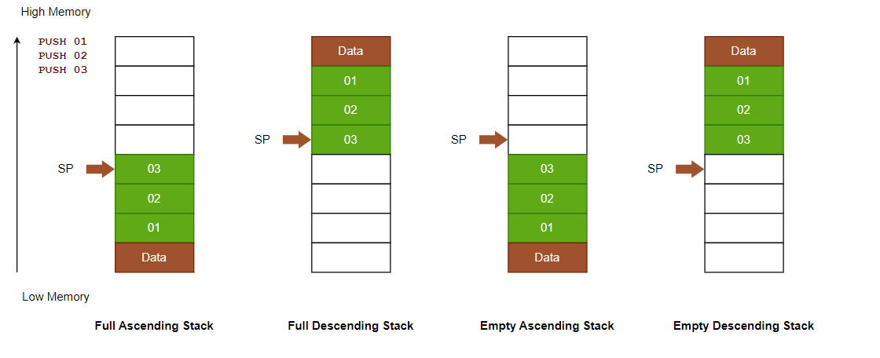

Slide 60
ADDRESSING METHODS FOR STACK OPERATIONS
FA
Full Ascending
POP-LDMFA
PUSH-STMFA
FD
Full descending
POP-LDMFD
PUSH - STMFD
EA
Empty Ascending
POP-LDMEA
PUSH-STMEA
ED
POP- LDMED
PUSH - STMED
Empty Descending

Slide 61
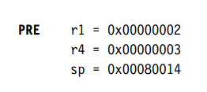

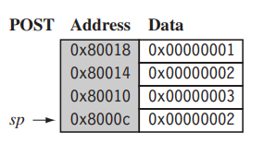
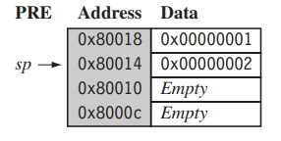
Descending Full Stack Example

Slide 62


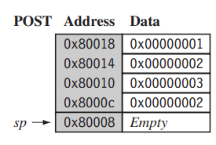
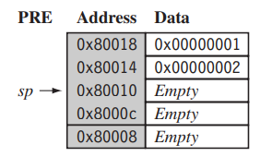
Descending Empty Stack Example

Slide 63
Stack Base – starting address of the stack
Stack pointer – points to the top of the stack
Stack limit – maximum length of the stack beyond which overflow occurs

Slide 64

SWP instruction to swap the contents of memory and register

Slide 65
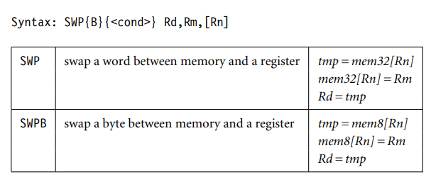

Slide 66
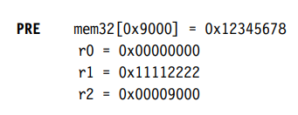

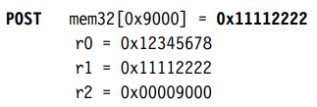
SWP Example

Slide 67

Software Interrupts – call to OS
Format:
SWI{<cond>} SWI number

Slide 68
cpsr:nzcvqift_user
pc=0x00008000
lr=0x003fffff
r0=0x12
SWI Example
PRE
SWI 0x123456
POST
cpsr:nzcvqIft_svc
spsr: nzcvqift_user
pc=0x00000008
lr= 0x00008004
r0=0x12
SWI_Number= <SWI Instruction> AND NOT (0xff000000)

Slide 69
PROGRAM STATUS REGISTER INSTRUCTIONS
MSR
Registers
CPSR
SPSR
MRS

Slide 70
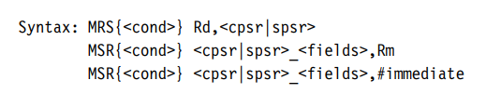




Slide 71

WRITING EFFICIENT C PROGRAMS

Slide 72
OVERVIEW OF C COMPILERS AND OPTIMIZATION
Optimizing code takes time and reduces readability.
Optimize the functions that are frequently executed
Optimize the functions that are important
Document non-obivious optimizations.

Slide 73
void memclr(char *data, int N)
{
for(;N>0;N--)
{
*data=0;
data++;
}
}
Compiler does not know:
N=0
Data array pointer is 4 byte aligned
N is a multiple of 4
C compilers need to be efficient and conservative of ARM processor architecture

Slide 74

ARM Developer Suite
Optimized C compilers
ARM target for GNU C

Slide 75
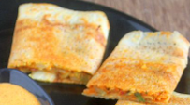
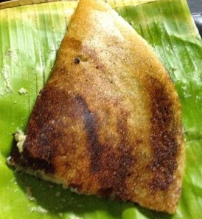
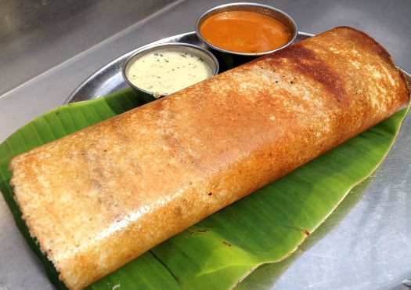

Half word
Word
Byte
Double Word

Slide 76
LOAD and STORE instructions by arm architecture
Pre-ARMv4: LDRB, STRB, LDR, STR
ARMv4: LDRSB, LDRH, LDRSH, STRH, STRSH
ARMv5: LDRD, STRD

Slide 77
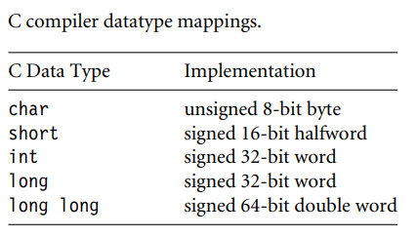



Slide 78
Check sum computation – version1
int checksum_v1(int *data)
{
char i;
int sum=0;
for(i=0;i<64;i++)
{
sum+=data[i];
}
return sum;
}

Slide 79
checksum_v1
  MOV r2,r0; r2->data
  MOV r0,#0; r0->sum
  MOV r1, #0; r1->i
checksum_v1_loop
;r3=data[i]
LDR r3,[r2, r1, LSL #2]
ADD r1,r1,#1 ; i++
AND r1, r1,#0xff
; i=(char) casting
CMP r1, #0x40; i<64
ADD r0,r3,r0; sum+=data[i]
BCC checksum_v1_loop
MOV pc, r14 ;return sum

Slide 80
Check sum computation – version2
int checksum_v2(int *data)
{
unsigned int i;
int sum=0;
for(i=0;i<64;i++)
{
sum+=data[i];
}
return sum;
}

Slide 81
checksum_v2
  MOV r2,r0; r2->data
  MOV r0,#0; r0->sum
  MOV r1, #0; r1->i
checksum_v2_loop
;r3=data[i]
LDR r3,[r2, r1, LSL #2]
ADD r1,r1,#1 ; i++
CMP r1, #0x40; i<64
ADD r0,r3,r0; sum+=data[i]
BCC checksum_v1_loop
MOV pc, r14 ;return sum

Slide 82
Short Check sum computation – version3
short checksum_v3(short *data)
{
unsigned int i;
short sum=0;
for(i=0;i<64;i++)
{
sum=(short)(sum+data[i]);
}
return sum;
}

Slide 83
checksum_v3
  MOV r2,r0; r2->data
  MOV r0,#0; r0->sum
  MOV r1, #0; r1->i
checksum_v3_loop
ADD r3,r2, r1, LSL #1;r3=&data[i]
LDRH r3, [r3,#0];r3=data[i]
ADD r1,r1,#1 ; i++
CMP r1, #0x40; i<64
ADD r0,r3,r0; sum+=data[i]
MOV r0,r0, LSL #16
MOV r0, r0, ASR #16
BCC checksum_v1_loop
MOV pc, r14 ;return sum

Slide 84
Check sum computation – version4
short checksum_v4(short *data)
{
unsigned int i;
int sum=0;
for(i=0;i<64;i++)
{
sum+=*(data++);
}
return (short)sum;
}

Slide 85
checksum_v4
  MOV r2,#0; r2->sum
  MOV r1, #0; r1->i
checksum_v4_loop
LDRSH r3, [r0],#2;r3=*(data++)
ADD r1,r1,#1 ; i++
CMP r1, #0x40; i<64
ADD r2,r3,r2; sum+=r3
BCC checksum_v4_loop
MOV r0,r2, LSL #16
MOV r0, r0, ASR #16
MOV pc, r14 ;return sum

Slide 86
Functions
Function arguments
Callee
short add_v1(short a, short b)
{
return a+(b>>1);
}
ans=add_v1(5,9)
Caller

Slide 87
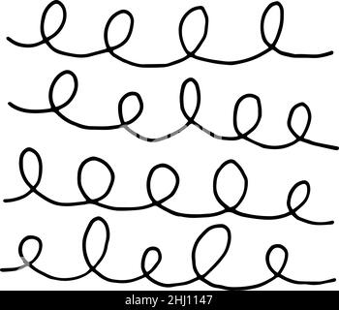
LOOPS
Efficient way of coding loops in C such that it is suitable for ARM architecture

Slide 88
LOOPS WITH FIXED NUMBER OF ITERATIONS
int checksum_v5(int *data)
{
unsigned int i;
int sum=0;
for(i=0;i<64;i++)
{
sum+=*(data++);
}
return sum;
}

Slide 89
checksum_v5
  MOV r2,r0; r2->data
  MOV r0,#0; r0->sum
  MOV r1, #0; r1->i
checksum_v5_loop
LDR r3,[r2],#4
ADD r1,r1,#1 ; i++
CMP r1, #0x40; i<64
ADD r0,r3,r0; sum+=data[i]
BCC checksum_v5_loop
MOV pc, r14 ;return sum
3 instructions for loop – ADD, CMP, BCC

Slide 90
EFFICIENT LOOPING
int checksum_v6(int *data)
{
unsigned int i;
int sum=0;
for(i=64;i!=0;i--)
{
sum+=*(data++);
}
return sum;
}
Down counter

Slide 91
2 instructions for loop – SUBS, BNE
checksum_v6
  MOV r2,r0; r2->data
  MOV r0,#0; r0->sum
  MOV r1, #0x40;r1->i
checksum_v6_loop
LDR r3,[r2],#4
SUBS r1,r1,#1 ; i--
ADD r0,r3,r0; sum+=data[i]
BNE checksum_v6_loop
MOV pc, r14 ;return sum

Slide 92
LOOPS WITH VARIABLE NUMBER OF ITERATIONS
int checksum_v7(int *data, unsigned int N)
{
int sum=0;
for(;N!=0;N--)
{
sum+=*(data++);
}
return sum;
}

Slide 93
checksum_v7
  MOV r2,#0; r2->data
  CMP r1,#0; r0->sum
  BEQ checksum_v7_end
checksum_v7_loop
LDR r3,[r0],#4
SUBS r1,r1,#1 ; i--
ADD r2,r3,r2; sum+=data[i]
BNE checksum_v7_loop
Checksum_v7_end
MOV r0,r2
MOV pc,r14
Extra unnecessary check

Slide 94
LOOPS WITH VARIABLE NUMBER OF ITERATIONS
int checksum_v8(int *data, unsigned int N)
{
int sum=0;
do
{
sum+=*(data++);
}while(--N!=0);
return sum;
}

Slide 95
checksum_v8
  MOV r2,#0; r2->data
checksum_v8_loop
LDR r3,[r0],#4
SUBS r1,r1,#1 ; i--
ADD r2,r3,r2; sum+=data[i]
BNE checksum_v8_loop
MOV r0,r2
MOV pc,r14

Slide 96

LOOP UNROLLING

Slide 97
Loop Overhead:
Each iteration costs: SUBS and BNE
Overhead of SUBS – 1 cycle
Overhead of BNE – 3 cycles
Total overhead – 4cycles
Hence for N iterations -> 4N cycles
Reduce the overhead by repeating loop body several times=> Loop unrolling

Slide 98
LOOP UNROLLING
int checksum_v9(int *data, unsigned int N)
{
int sum=0;
do
{
sum+=*(data++);
  sum+=*(data++);
  sum+=*(data++);
  sum+=*(data++);
        N-=4;
}while(N!=0);
return sum;
}
Loop Overhead:
Each iteration costs 4cycles
Hence for N/4 iterations -> N cycles

Slide 99
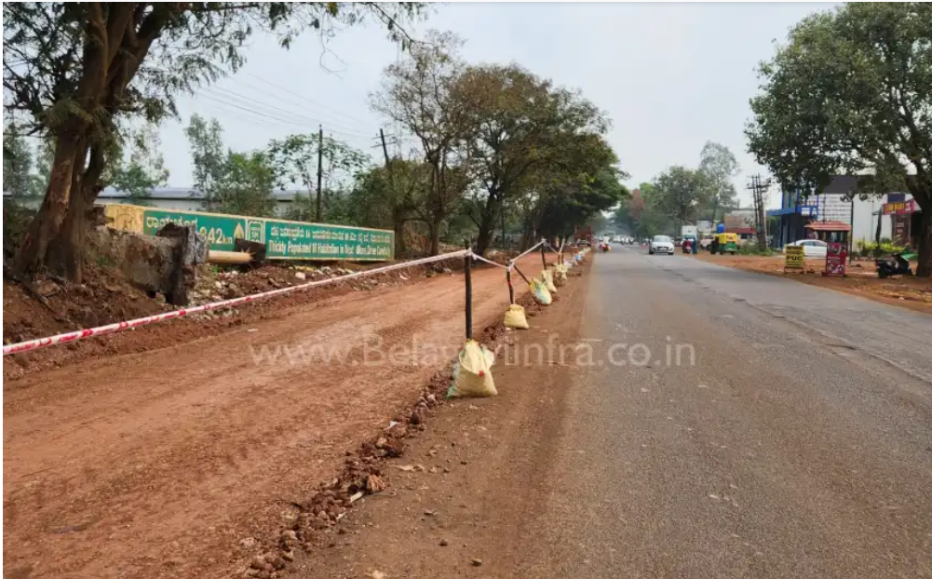
Road widening
Function arguments are said to be passed wide if they are not reduced to range of type.
Else they are narrow

Slide 100
If compiler passes wide, callee should reduce
Callee
Compiler
Caller
If compiler passes narrow, caller should reduce

Slide 101
If compiler returns wide, caller should reduce
Caller
Compiler
Callee
If compiler returns narrow, callee should reduce

Slide 102
short add_v1(short a, short b)
{
return a+(b>>1);
}
add_v1
  ADD r0,r0,r1,ASR #1
  MOV r0,r0, LSL #16
MOV r0, r0, ASR #16
MOV pc, r14 ;return sum

Slide 103
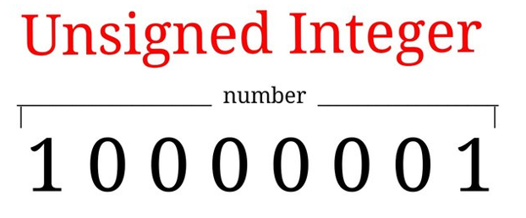
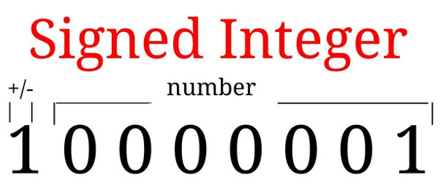

Slide 104
For addition, subtraction and multiplication no difference in signed or unsigned
For division unsigned is better
int average_v1(int a, int b)
{
return (a+b)/2;
}

Slide 105

average_v1
  ADD r0,r0,r1
  ADD r0,r0,r0, LSR #31
MOV r0, r0, ASR #1
MOV pc, r14

Slide 106

REGISTER ALLOCATION
If more variables exist than available registers, some variables are stored in process stack and are called Spilled variables

Slide 107
For efficient implementation:
- minimize the number of spilled variables
- most important and frequently accessed variables are stored in registers
Limit loop variables to 12 (even though in theory 14 registers are possible)
Compiler decides spilling of variables on the basis of frequency of use.
C has register keyword.

Slide 108
FUNCTION CALLS
APCS – ARM Procedure Call Standard – A standard for arguments and return values
In case of Thumb registers, APCS is redefined as ATPCS – ARM Thumb Procedure Call Standard

Slide 109
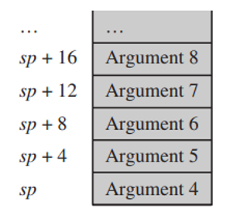
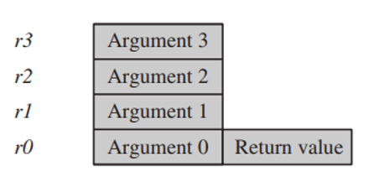
Hence 4 arguments map to 4 registers
Hence for C functions having more than 4 arguments Stack will be accessed by caller and callee
To optimize, use structures in C

Slide 110
char *queue_bytes_v1(char *Qstart, char *Qend, char *Qptr, char *data, unsigned int N)
{
do{
*(Qptr++)=*(data++);
if(Qptr==Qend)
Qptr=Qstart;
}while(--N);
return Qptr;
}

Slide 111
char *queue_bytes_v2(Queue q, char *data, unsigned int N)
{
char *Qptr=q->qptr;
char *Qend=q->qend;
char *Qstart=q->qstart;
do{
*(Qptr++)=*(data++);
if(Qptr==Qend)
Qptr=Qstart;
}while(--N);
return Qptr;
}

Slide 112
typedef struct
{
char *qptr;
char *qstart;
char *qend;
}Queue;
Write before functions before calling them. This allows compiler to make them inline
Critical functions can be coded as __inline keyword

Slide 113

2 pointers are said to be alias, if they point to same address
Changing one affects another.

Slide 114
void timers_v1(int *timer1, int *timer2, int *step)
{
*timer1+=*step;
*timer2+=*step;
}

Slide 115

Compiler

Slide 116

Compiler performs 2 separate loads
timer1
step
Alias??
void timers_v1(int *timer1, int *timer2)
{
int step=4;
*timer1+=step;
*timer2+=step;
}

Slide 117
int checksum_next_packet()
{
int *data;
unsigned int i;
int N, sum=0;
data=get_next_packet(&N);
for(i=0;i<N;i++)
{
sum+=*(data++);
}
return sum;
}

Slide 118
data
N
Never send address of local variables
Instead make a copy and send
Alias??

